Slide 1
Fiorina Chapter 5
A Closer Look at Abortion

Slide 2
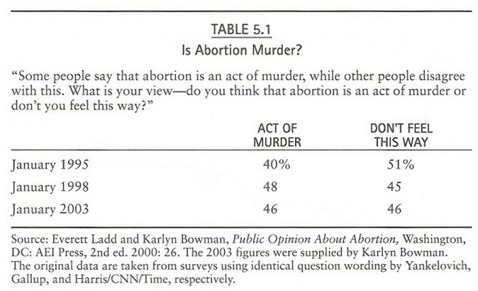

Slide 3
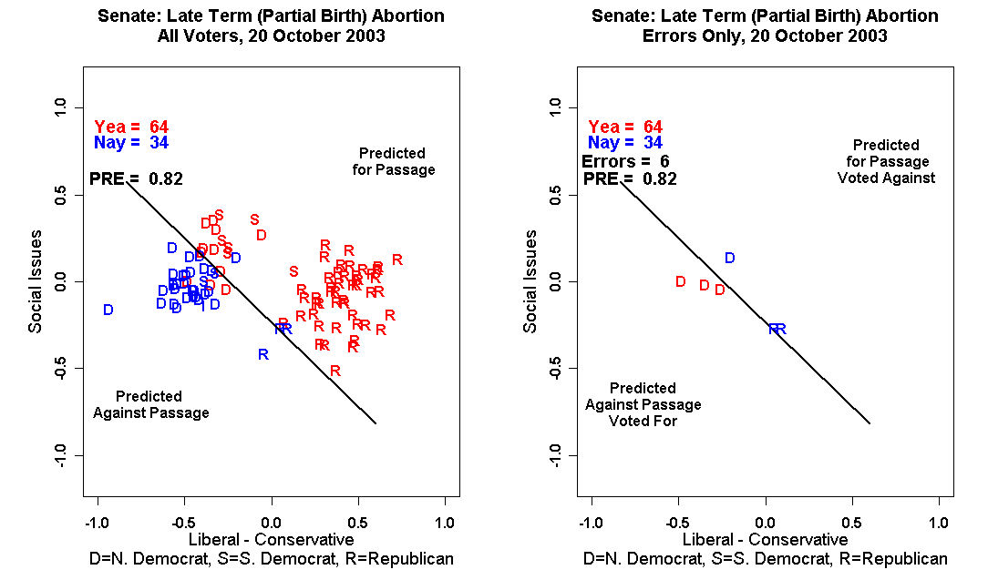

Slide 4
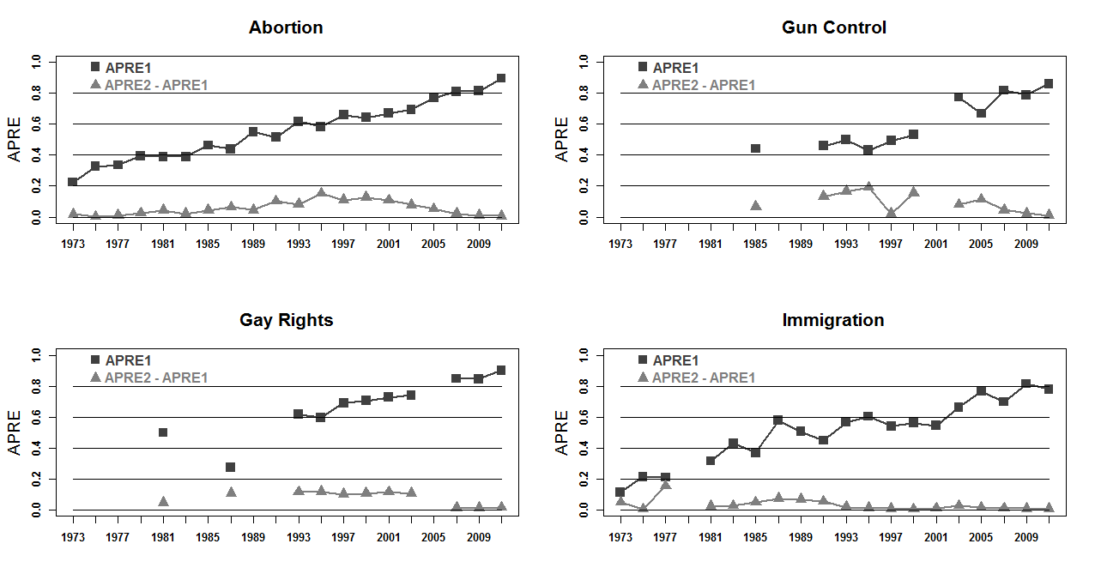
Calculations by Christopher Hare, 2014.

Slide 5
From Christopher Hare, Constrained Citizens? Ideology and the American Voter. Doctoral Dissertation, University of Georgia, September, 2014

Slide 6
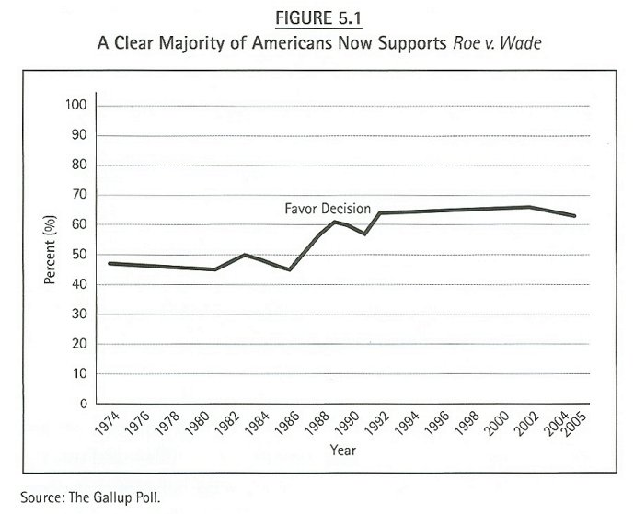

Slide 7
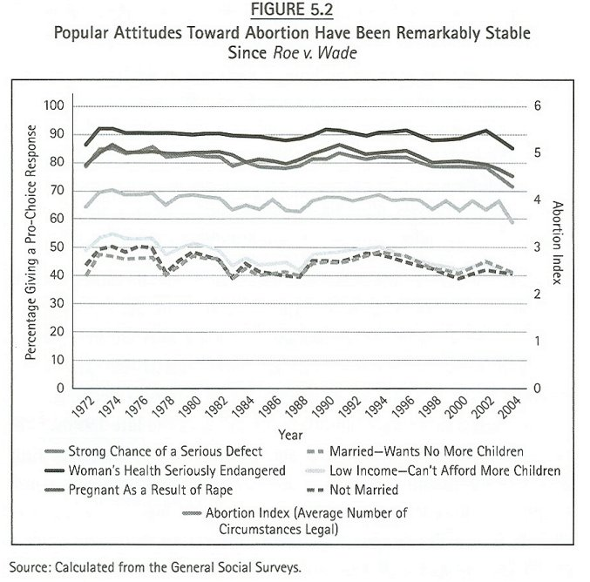

Slide 8
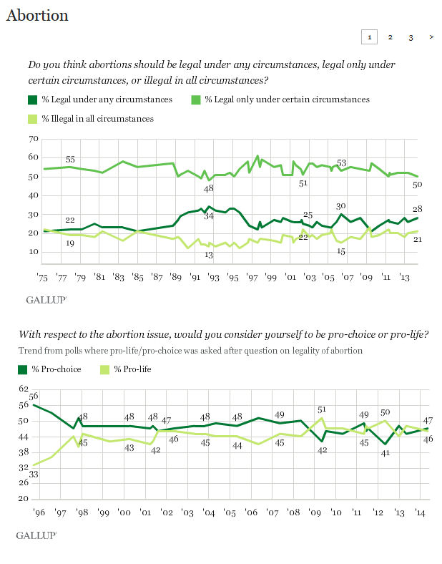

Slide 9
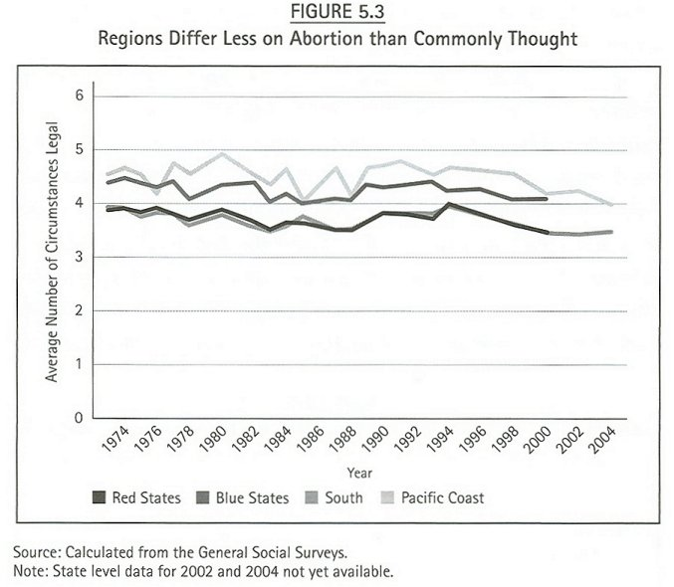

Slide 10
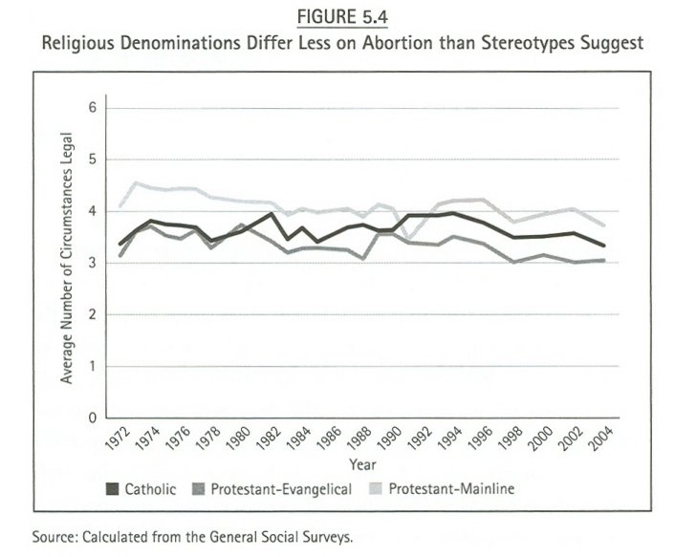

Slide 11
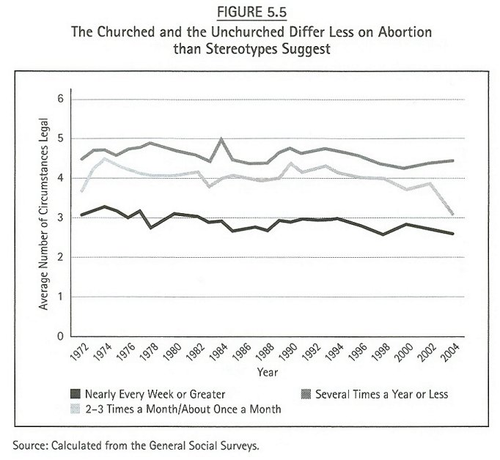

Slide 12
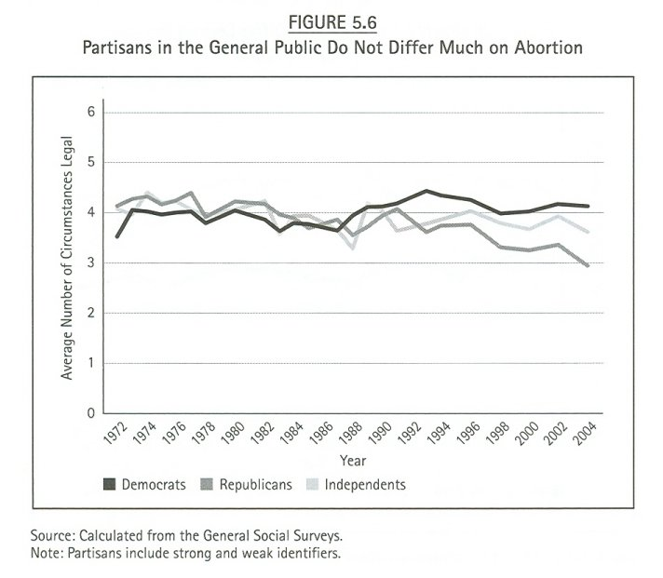

Slide 13
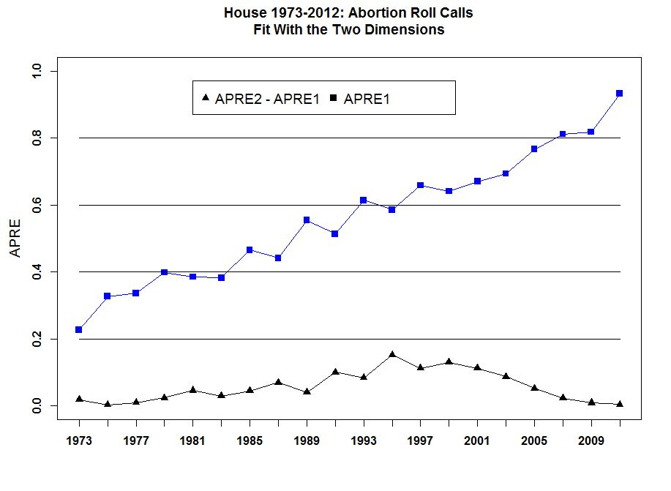

Slide 14
CBS News/New York Times Poll. Sept. 8-12, 2012. N=1,301 adults nationwide. Margin of error ± 3.
"Which of these comes closest to your view? Abortion should be generally available to those who want it. OR, Abortion should be available, but under stricter limits than it is now. OR, Abortion should not be permitted."
 |  | Generally available | Available under stricter limits | Not permitted | Unsure
 |  | % | % | % | %
 | 9/8-12/12 | 42 | 35 | 20 | 3
 | 1/12-17/12 | 37 | 37 | 23 | 4
 | 9/10-15/11 | 31 | 42 | 23 | 4
 | 12/17-20/10 | 36 | 40 | 20 | 4
 | 8/20-24/10 | 36 | 39 | 23 | 2
 | 4/5-12/10 | 36 | 38 | 23 | 3
 | 11/13-16/09 | 34 | 40 | 23 | 3
 | 10/5-8/09 | 41 | 35 | 20 | 4
 | 6/12-16/09 | 36 | 41 | 21 | 3
 | 9/12-16/08 | 37 | 42 | 19 | 2
 | 8/15-20/08 | 34 | 39 | 24 | 3
 | 12/5-9/07 | 36 | 43 | 18 | 3
 | 9/4-9/07 | 34 | 39 | 25 | 2
 | 7/9-17/07 | 41 | 34 | 22 | 3
 | 5/18-23/07 | 39 | 37 | 21 | 3
 | 3/7-11/07 | 34 | 41 | 23 | 2
 | 1/20-25/06 | 38 | 39 | 21 | 2
 | 12/2-6/05 | 38 | 39 | 20 | 3
 | 4/13-16/05 | 36 | 38 | 24 | 2
 | 3/21-22/05 | 35 | 37 | 25 | 3
 | 2/24-28/05 | 35 | 40 | 23 | 2
 | 1/14-18/05 | 36 | 35 | 26 | 3
 | 11/04 | 34 | 44 | 21 | 1
 | 7/04 | 34 | 42 | 22 | 2
 | 1/03 | 39 | 38 | 22 | 1

Slide 15
Washington Post/Kaiser Family Foundation Poll. July 25-Aug. 5, 2012. N=3,130 adults nationwide. Margin of error ± 2.
"Do you think abortion should be legal in all cases, legal in most cases, illegal in most cases, or illegal in all cases?"
 |  | Legal in all cases | Legal in most cases | Illegal in most cases | Illegal in all cases | Unsure
 |  | % | % | % | % | %
 | 7/25 - 8/5/12 | 19 | 36 | 25 | 17 | 3
 | 3/7-10/12 | 21 | 33 | 25 | 17 | 3
 | 7/14-17/11 | 19 | 35 | 30 | 15 | 2
 | 3/23-26/10 | 17 | 35 | 27 | 18 | 2
 | 11/19-23/09 | 19 | 35 | 28 | 16 | 2
 | 6/18-21/09 | 20 | 35 | 26 | 17 | 2

Slide 16
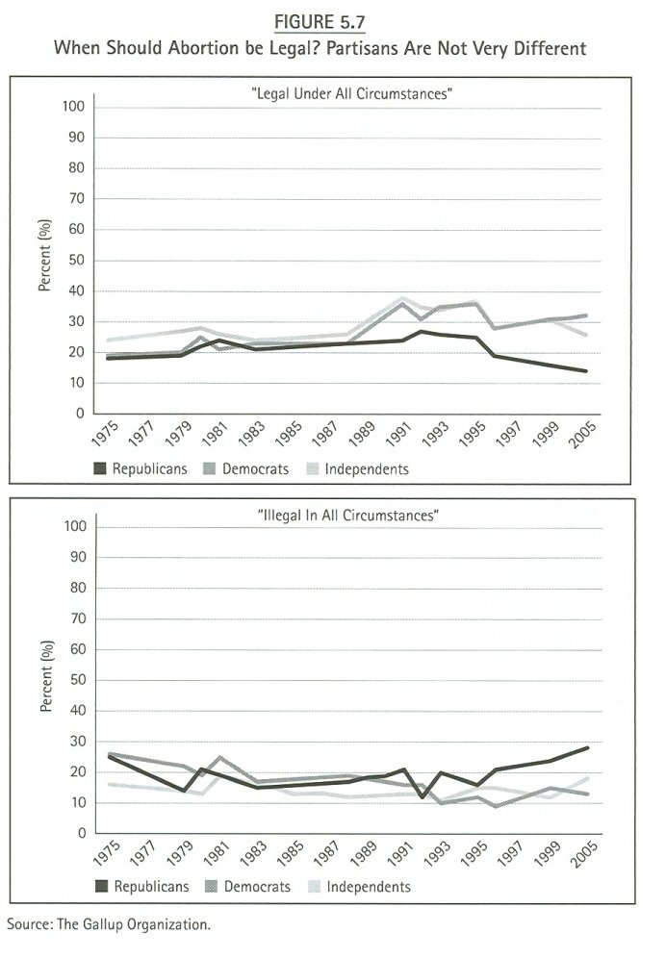

Slide 17
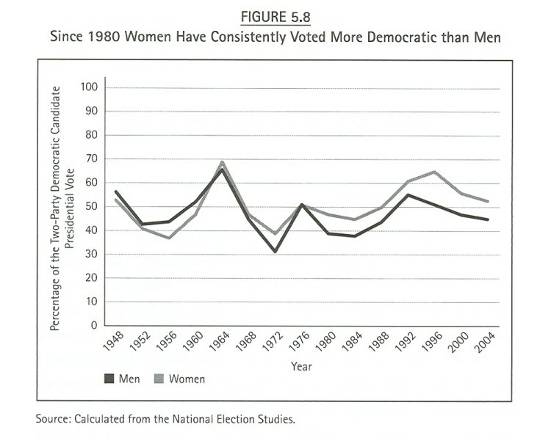

Slide 18
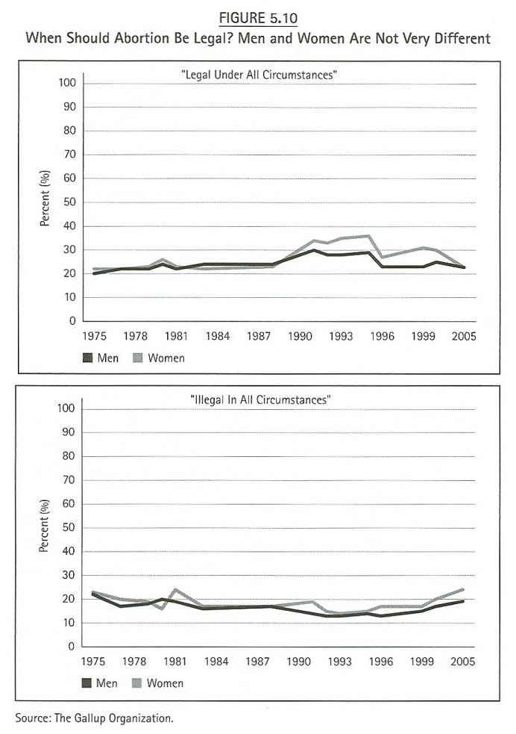

Slide 19
