Slide 1
Money and The Ruling Elite
Money, Organized Interests, and American Politics

Slide 2
1) Inequality and the Money Elite
The Rich get Richer and Richer and Richer and Richer and the Politicians More and More Craven

Slide 3
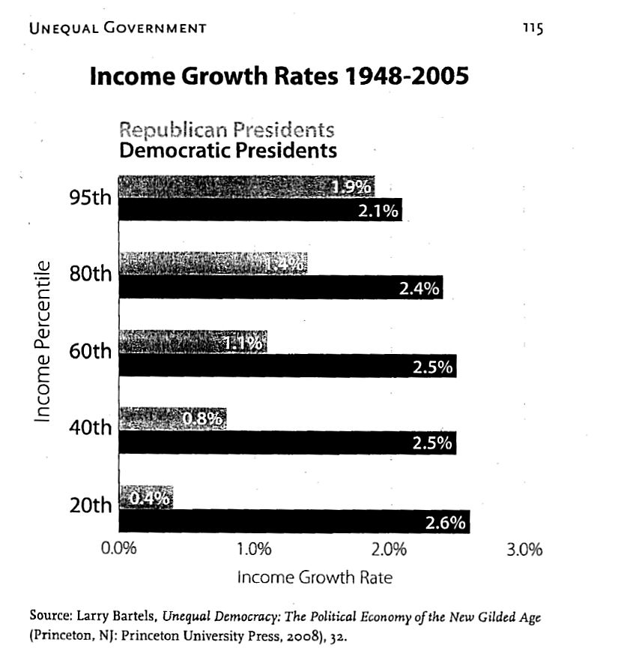

Slide 4
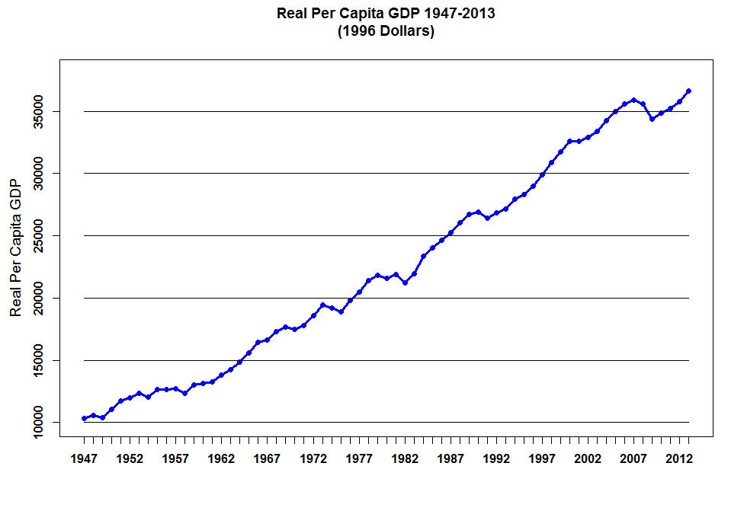

Slide 5
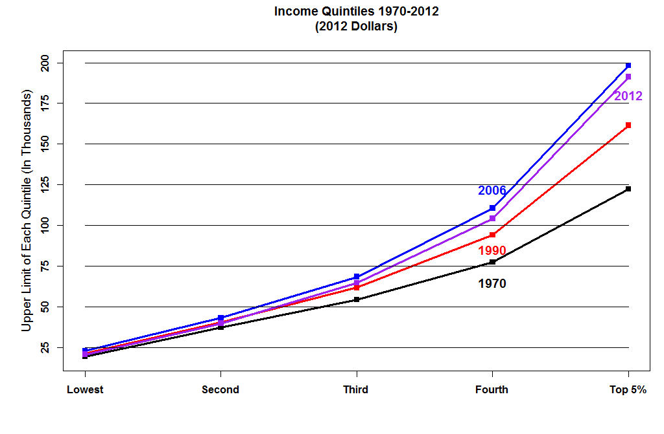

Slide 6
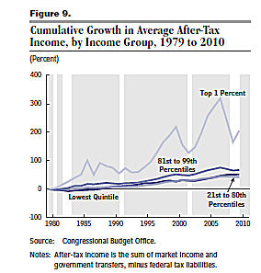

Slide 7
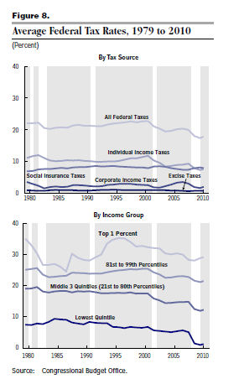

Slide 8
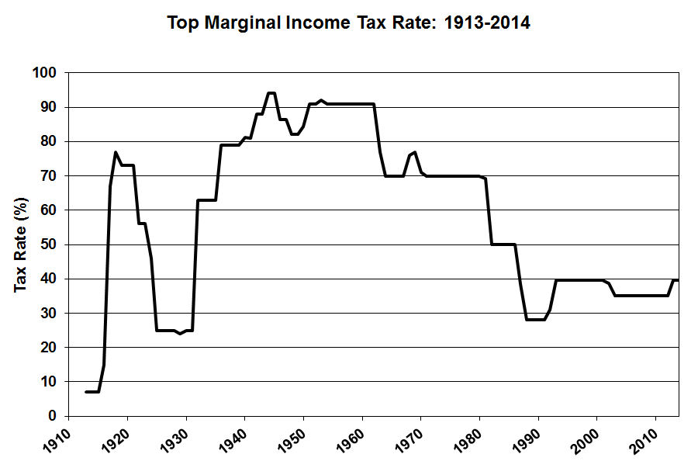

Slide 9
2011: Accumulated from Smallest Size of Adjusted Gross Income
No adjusted gross income | 2,450,924 | 1.7
$1 under $5,000 | 10,692,838 | 7.4
$1 under $10,000 | 23,079,555 | 15.9
$1 under $15,000 | 36,005,386 | 24.8
$1 under $20,000 | 47,885,444 | 32.9
$1 under $25,000 | 58,096,150 | 40.0
$1 under $30,000 | 67,083,763 | 46.1
$1 under $40,000 | 81,603,842 | 56.1
$1 under $50,000 | 92,587,815 | 63.7
$1 under $75,000 | 111,537,092 | 76.7
$1 under $100,000 | 123,463,493 | 84.9
$1 under $200,000 | 138,219,259 | 95.1
$1 under $500,000 | 142,020,900 | 97.7
$1 under $1,000,000 | 142,618,425 | 98.1
$1 under $1,500,000 | 142,753,332 | 98.2
$1 under $2,000,000 | 142,809,318 | 98.2
$1 under $5,000,000 | 142,888,681 | 98.3
$1 under $10,000,000 | 142,907,871 | 98.3
$1 or more | 142,919,316 | 98.3
All returns | 145,370,240 | 100.0

Slide 10
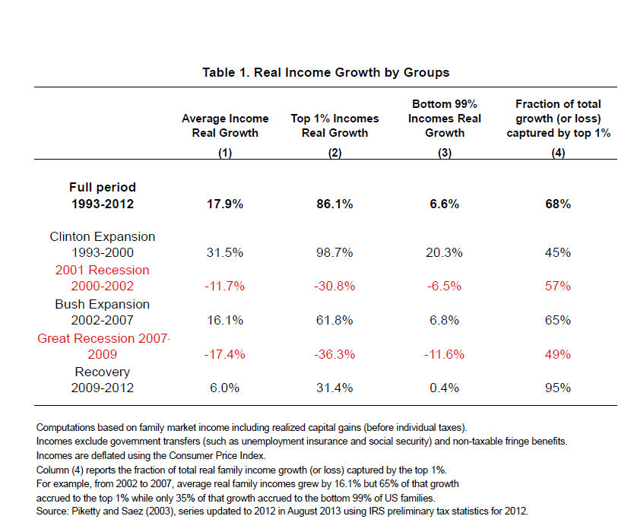

Slide 11
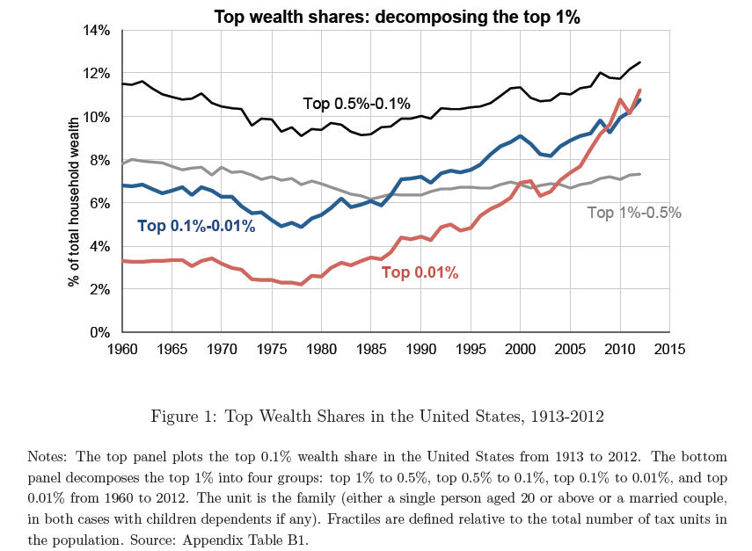

Slide 12
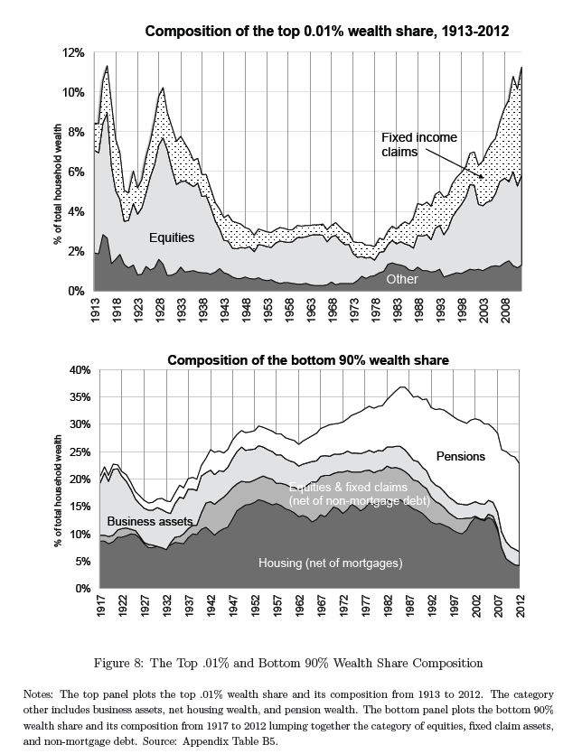

Slide 13
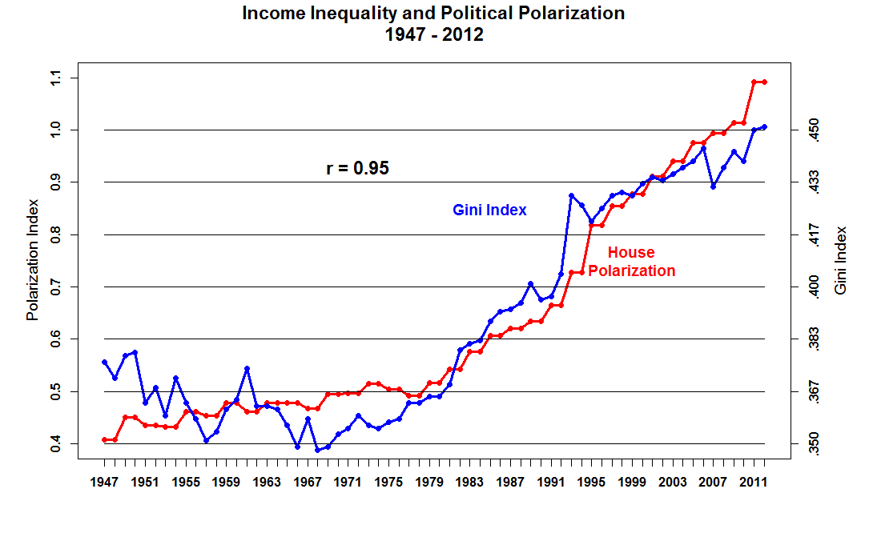

Slide 14
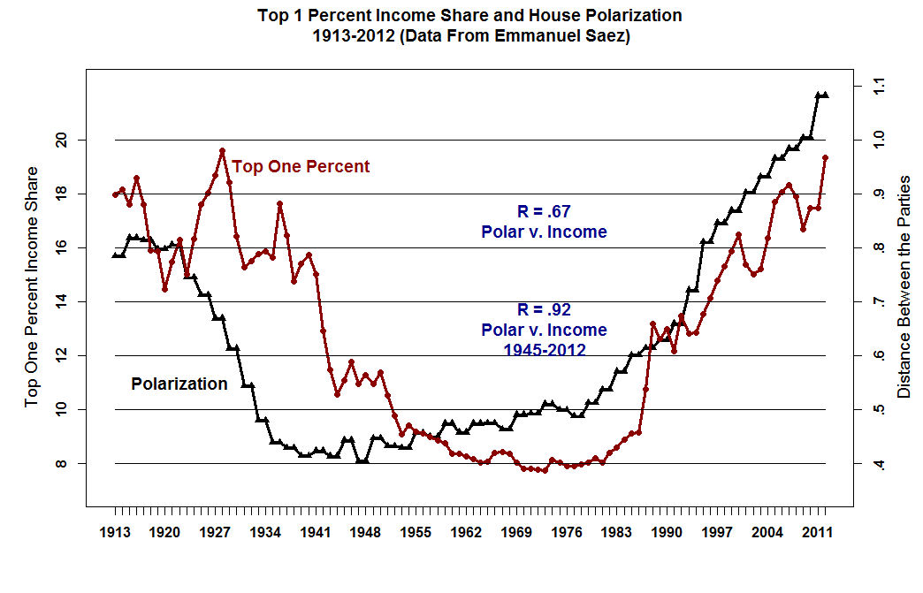

Slide 15
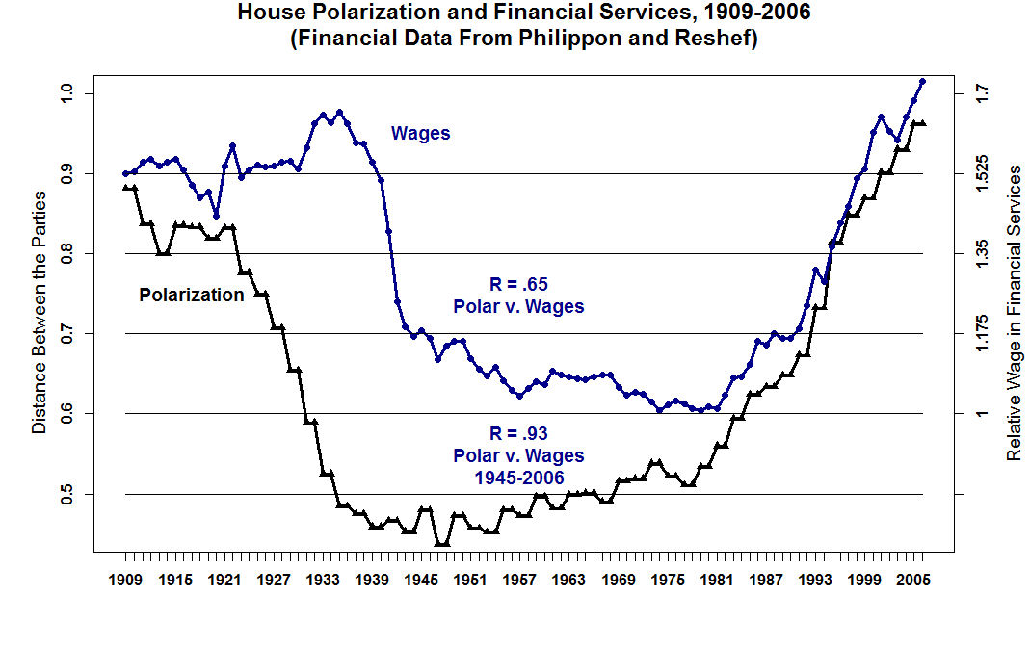

Slide 16
Figure 5: Concentration of income and campaign contributions in the top 0.01% of households and voting age population

Slide 17
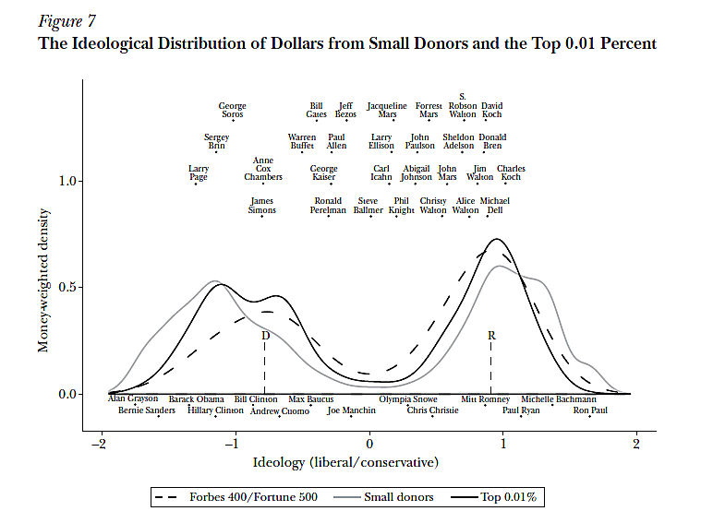

Slide 18
2) The Automakers and the Unions
What Caused Detroit’s Demise?

Slide 20
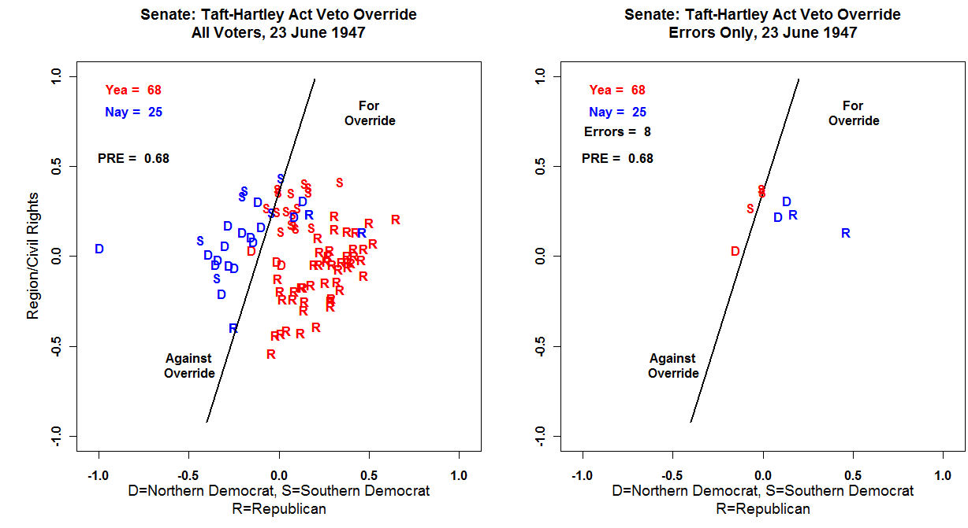

Slide 21
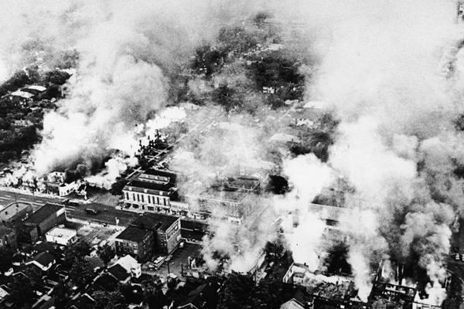
1967 Detroit Riot – 23-27 July 1967
82nd Airborne Used to stop the rioting

Slide 22

43 Dead (35 Black, 8 White), 1,189 Injured, 7,200 Arrests

Slide 23


Slide 24
Foreign Automakers built assembly plants in the USA and are all non-union. They have, roughly, $10 - $20 an hour labor cost advantage due to the fact that they have no legacy retiree medical costs. Also, the decline in the quality of American cars enabled companies such as Toyota to charge higher prices for equivalent cars.

Slide 25
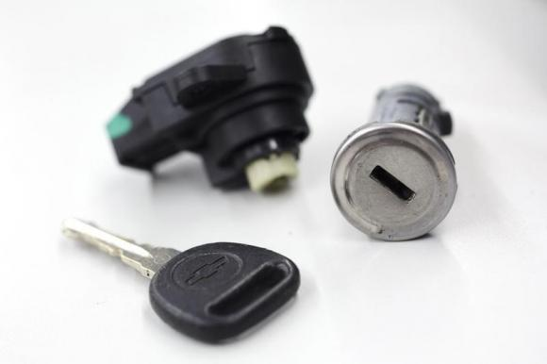
The General Motors Ignition Switch Recall: (Reuters) - The deadline to file claims under General Motors Co's faulty ignition-switch compensation program has been extended by one month to Jan. 31, said Kenneth Feinberg, the program's administrator.
Feinberg's office on Monday updated its list of claims submitted, saying it had approved compensation for the families of 33 victims killed in GM cars with faulty ignition switches.
Notice of the deadline extension was sent to about 4.5 million current and previous owners of eligible vehicles, Feinberg said in a statement.

Slide 26
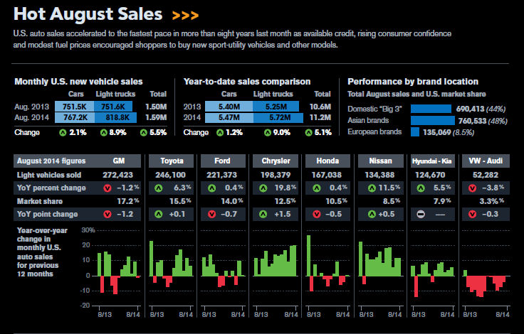

Slide 27
