Slide 1
The Partisan Sort
Chapters 1 and 2

Slide 2
  Mass Public
      Party and Ideology more aligned than 30-40 years ago
      Liberals are Democrats and Conservatives are Republicans
      Decline of Split Ticket Voting

Slide 3
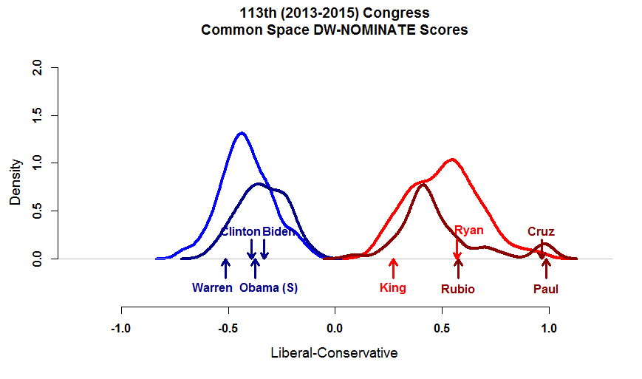
Elite Polarization: Congress

Slide 4
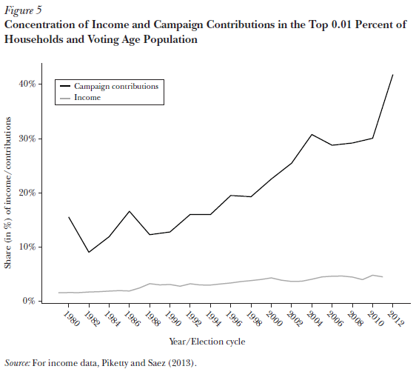

Slide 5
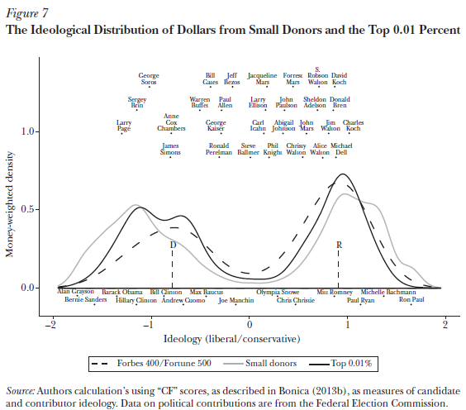

Slide 6
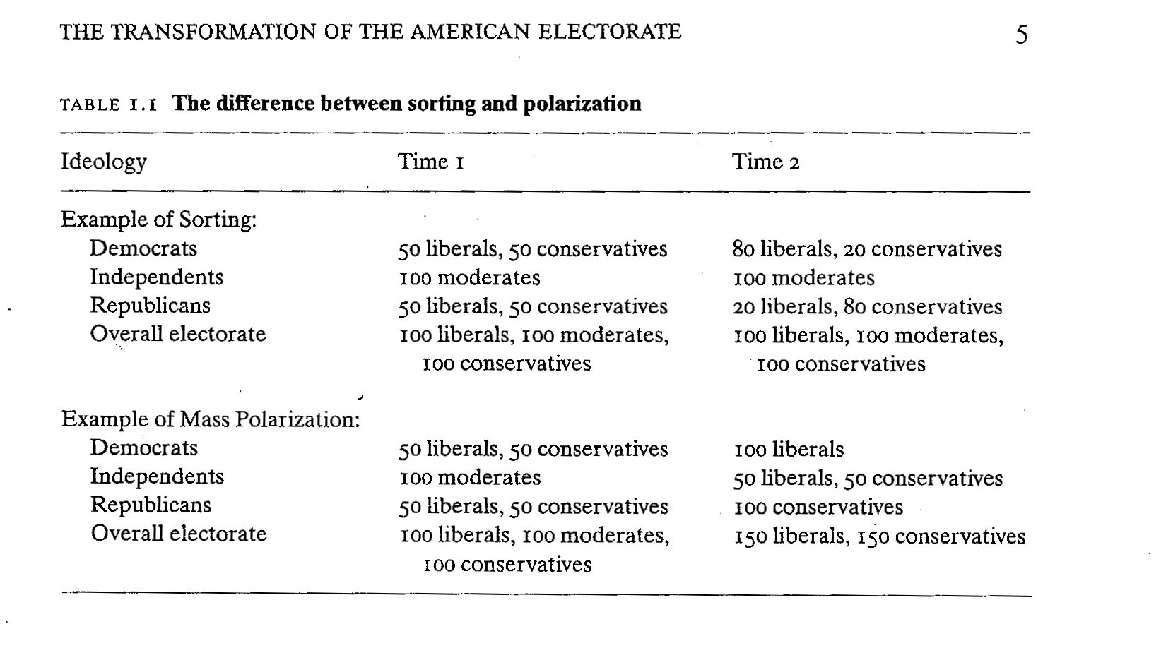

Slide 7
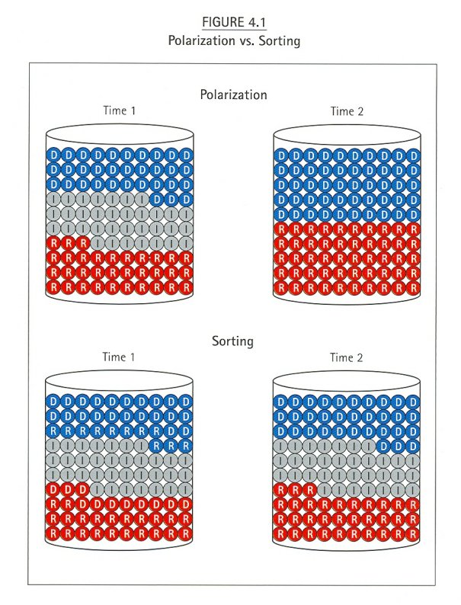

Slide 8
“Moderates”/”Independents” May Not Be Well Informed

Slide 9
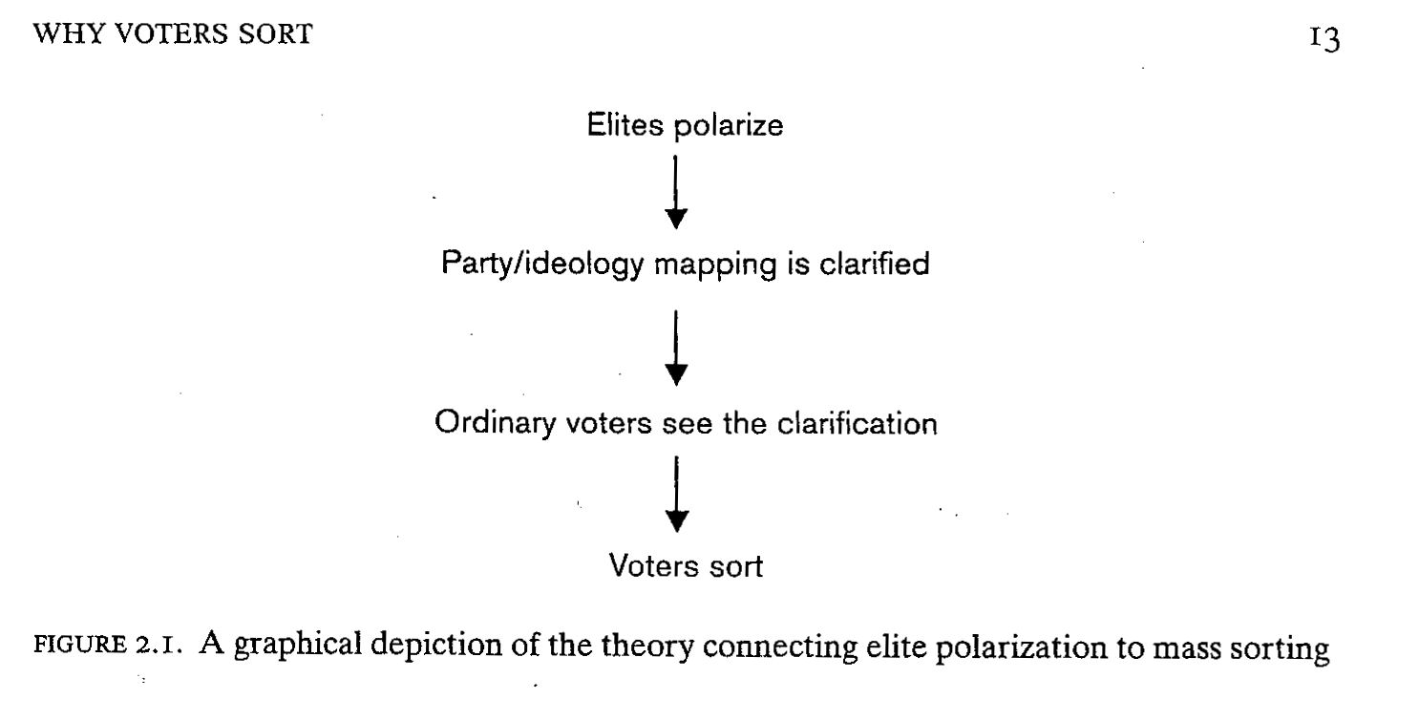

Slide 10
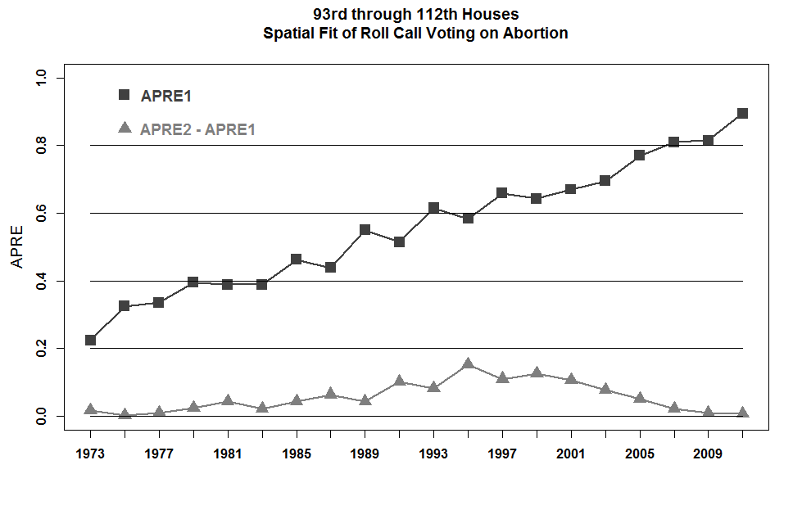

Slide 11
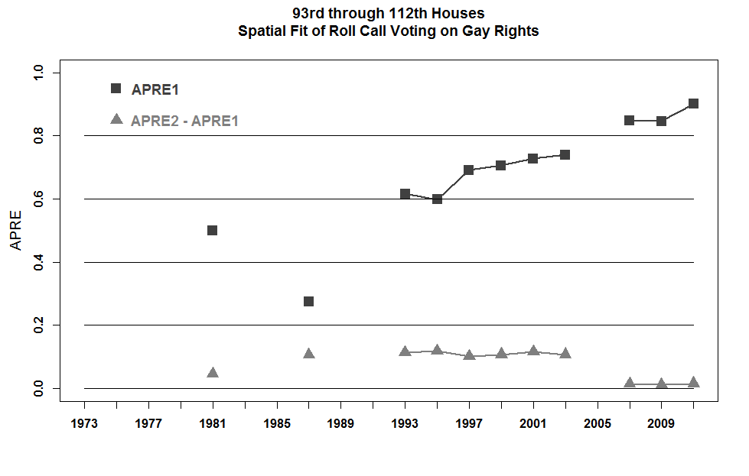

Slide 12
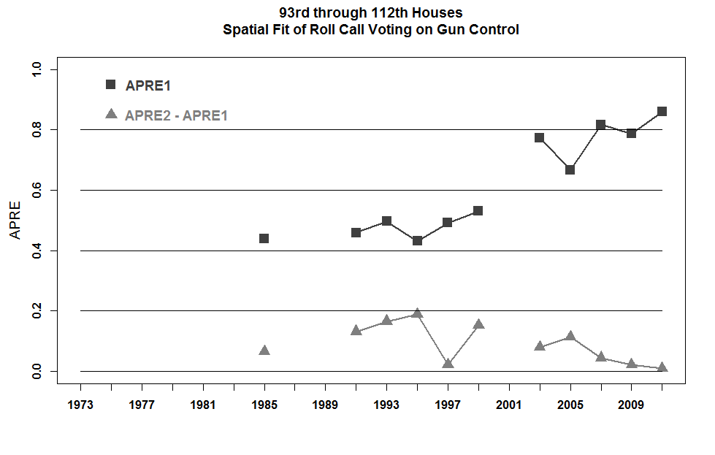

Slide 13
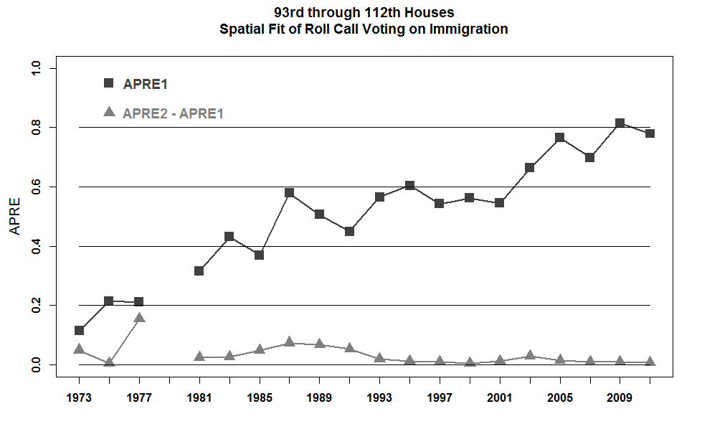

Slide 14
In past 30 years huge increase in media outlets.
Increase in media outlets has led to narrowcasting – “programmers tailor their content to the partisan and ideological disposition of their audience”
3. “Media coverage of politics and elections has become increasingly negative”

Slide 15
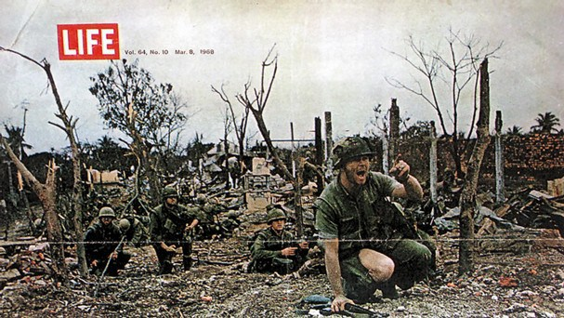

Slide 16
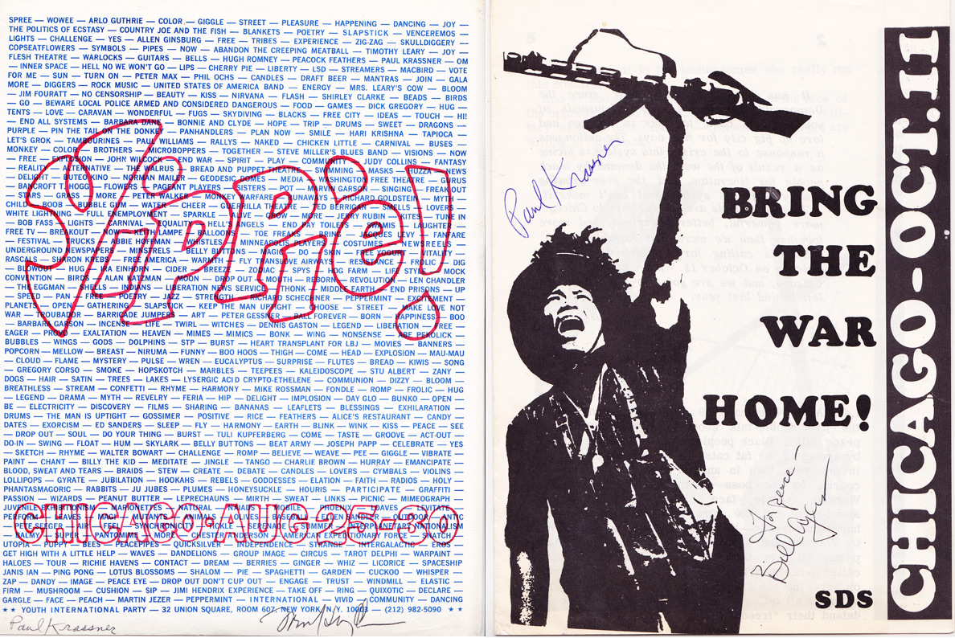

Slide 17
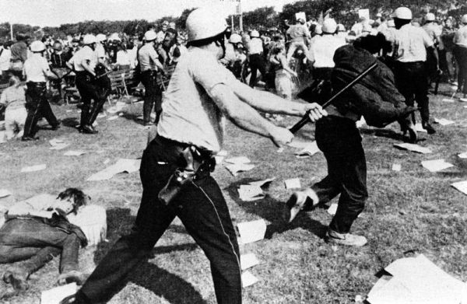

Slide 18
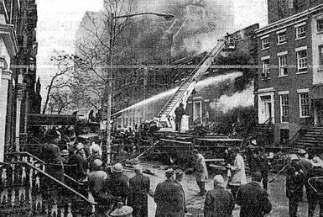

Slide 19
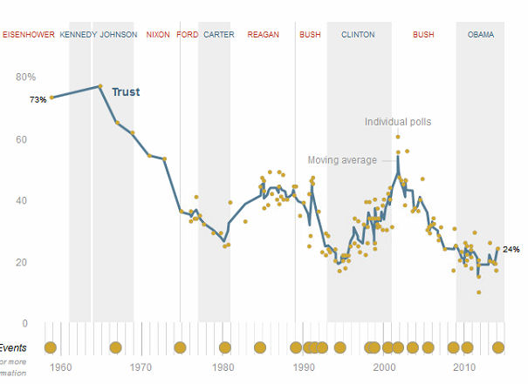
From Pew

Slide 20
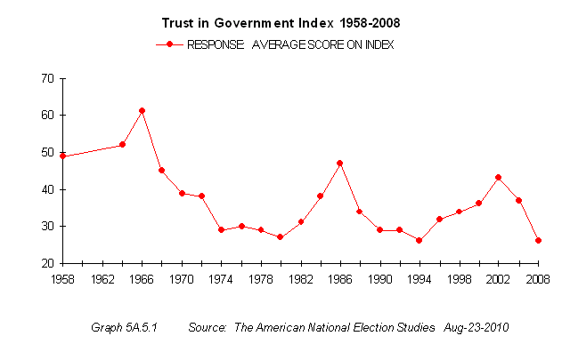

Slide 21
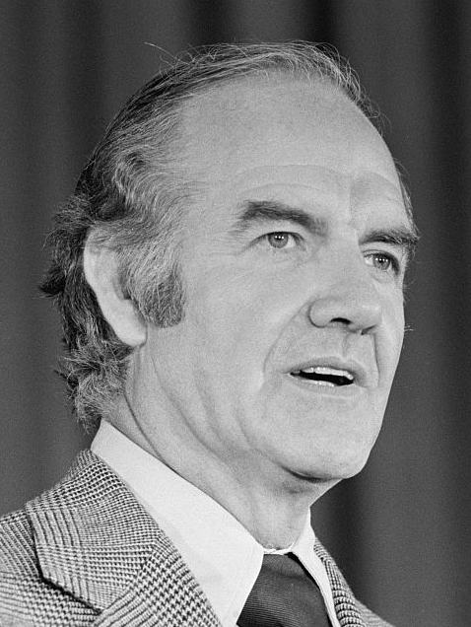
George McGovern, 19 July 1922 – 21 October 2012

Slide 22
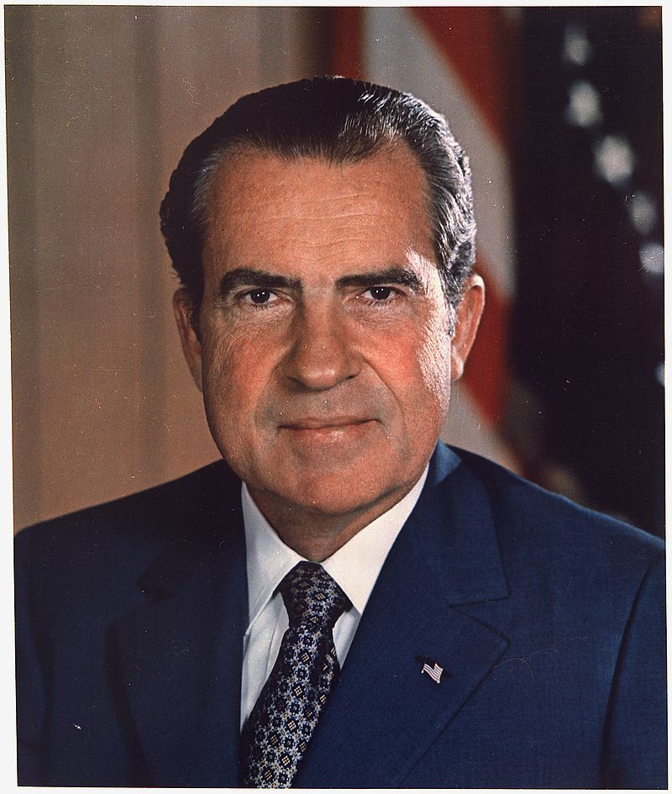

Slide 23
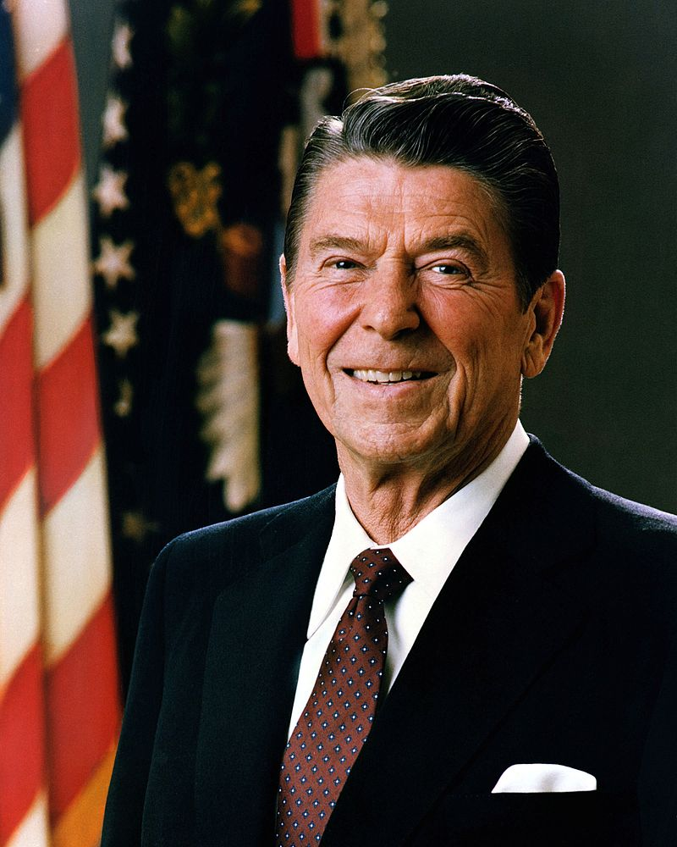

Slide 24
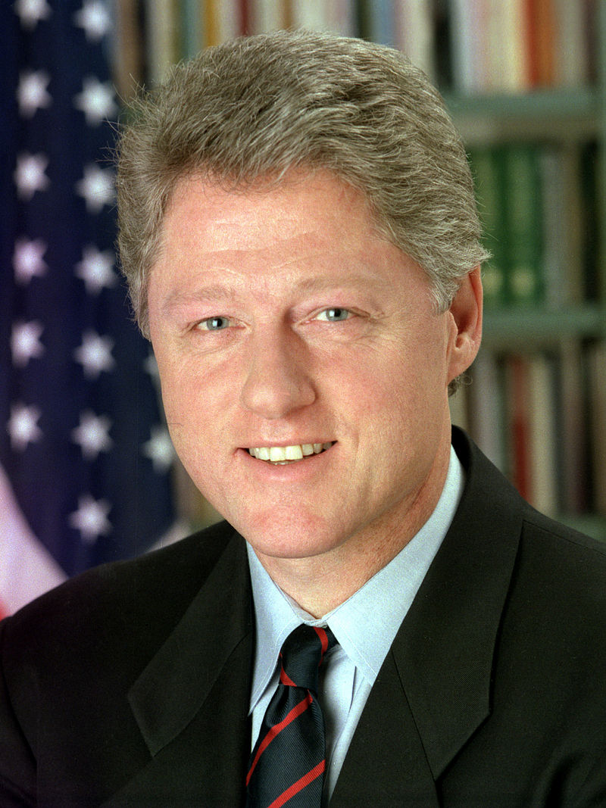

Slide 25
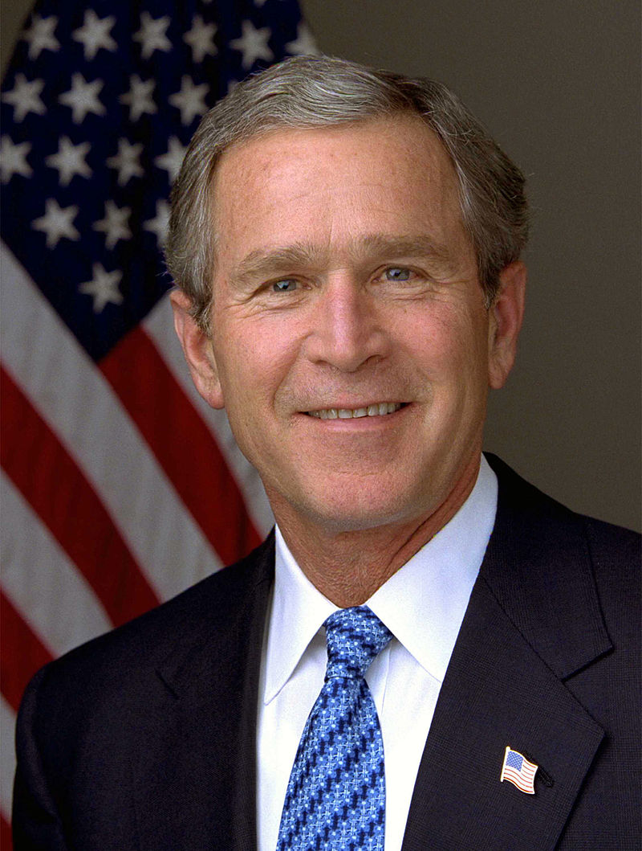

Slide 26
      The Limits of Sorting/Polarization – Valence Issues:
          Honest Leadership and Open Government;
          Real Security
          Energy Independence
          Economic Prosperity and Educational Excellence
          A Health Care System that Works for Everyone
          Retirement Security

Slide 27
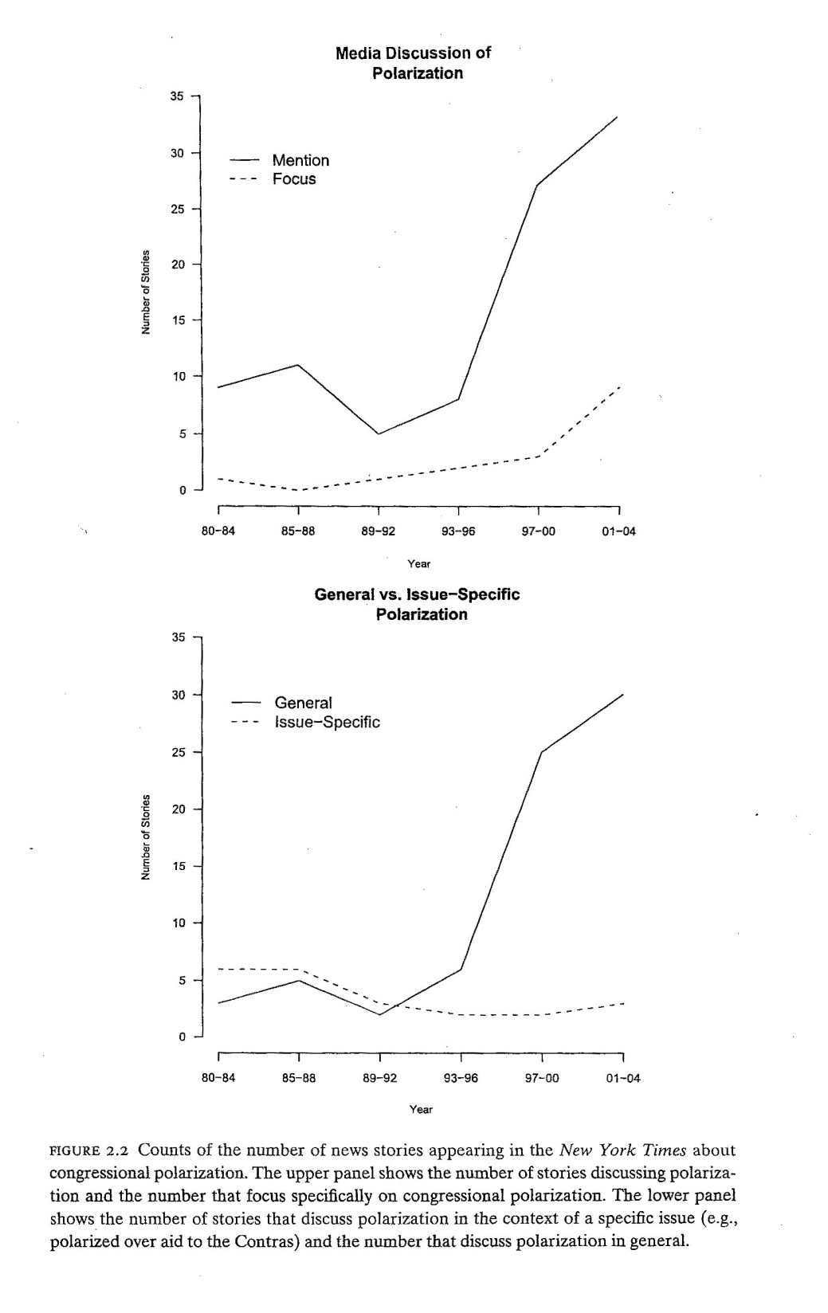

Slide 28
  Hypotheses About Sorting
      As elites polarize, more voters should understand where the parties stand relative to one another.
      With a greater awareness of Party positions, voters will be more likely to align their own partisanship and ideological beliefs.
      Top Down or Bottom Up??

