Slide 1
The Partisan Sort
Chapter 4
Testing Competing Explanations for Sorting

Slide 2
Competing Explanations:
Recognition of Elite Party Differences
The Changing Southern Democrat
General Political Information
Variation by Birth Cohort
Demographics – Race, Gender, Income

Slide 3
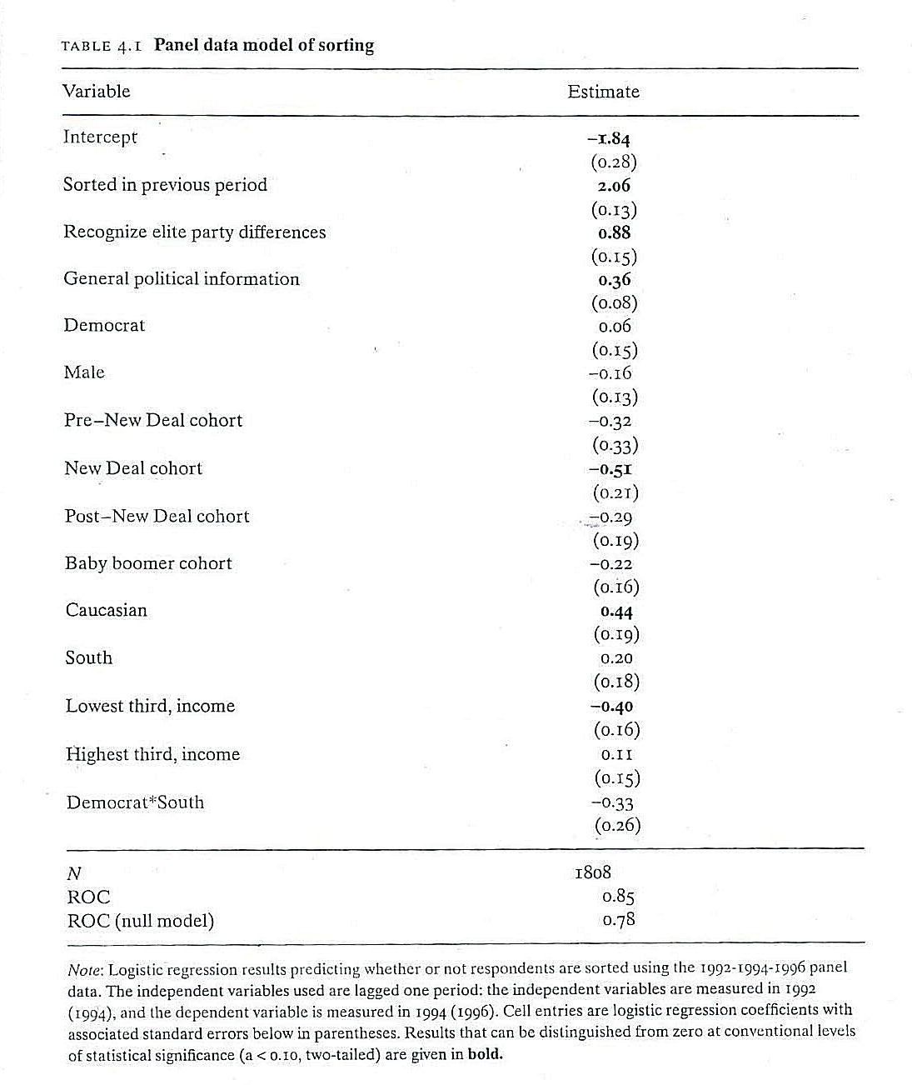

Slide 4
From Table 4.1 (1992-94-96 Panel) – Three Hypotheses supported:
Recognition of Elite Party Differences
General Political Information (D < R)
Cohort Effects

Slide 5
What this means is that:
Seeing elite polarization in 1992 generates sorting in 1994 and seeing sorting in 1994 generate sorting in 1996
Seeing that D < R in 1992 generates sorting in 1994 and seeing D < R in 1994 generates sorting in 1996
Older Voters are less likely to be sorted – especially the New Deal Era voters (born 1915 – 1931).

Slide 6
Of the Proposed Causes, Elite Party Differences, Political Information, and Cohort Effects are Supported. But Differences between the North and South are not Supported! Sorting since the 1990s has been the same in both regions.

Slide 7
Finally, none of the Demographic variables appear to affect sorting except for White Respondents being more likely to sort; and Low Income Respondents being more likely to be sorted.

