Slide 1
The Partisan Sort
Chapter 5
Untangling the Causes of Sorting

Slide 2
Problem – Association is not Causation. Correlation does not equal Causation. Sorting in the mass public clearly moves with polarization of the elites but this does not prove causation in either direction.

Slide 3
Case Study – Stem Cell Research.
Embryonic Stem Cells first isolated in 1998. Federal Funding for Research on human embryos was banned by law in the 1990s.
The funding of this research was not from the Federal Government.
In August 2001 President Bush changed the rules and agreed that the Federal Government would fund Stem Cell research using existing Stem Cell lines
By 2004 the Issue became Partisan with Senator Kerry criticizing the Bush restrictions.

Slide 4
Table 5.1: Sorting on Stem Cell Research – 2001 vs. 2005
Party ID becomes important and Religion increases in Importance.

Slide 5
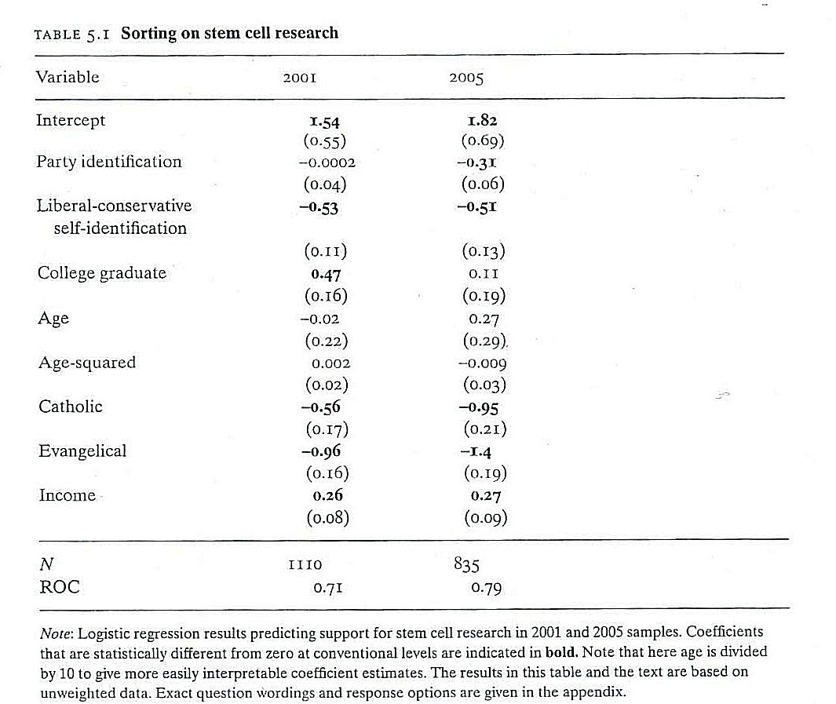

Slide 6
Experimental Evidence
First Group just reads a paragraph about an issue and asked for their opinion.
Second Group reads the paragraph and given information about low-polarization of elites.
Third Group reads the paragraph and given information about high-polarization of elites.

Slide 7
Findings: No difference in sorting between the control and the low polarization condition (first vs. second group). There is a difference in sorting between the low vs. the high polarization condition (second vs. third).

Slide 8
