Slide 1
The Election of 1800
The First Peaceful Transfer of Power From One Party to Another in History

Slide 2
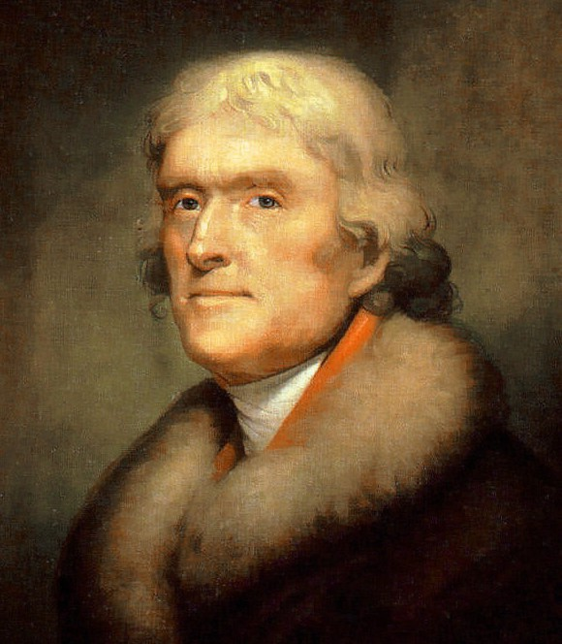
Thomas Jefferson 13 April 1743 – 4 July 1826

Slide 3
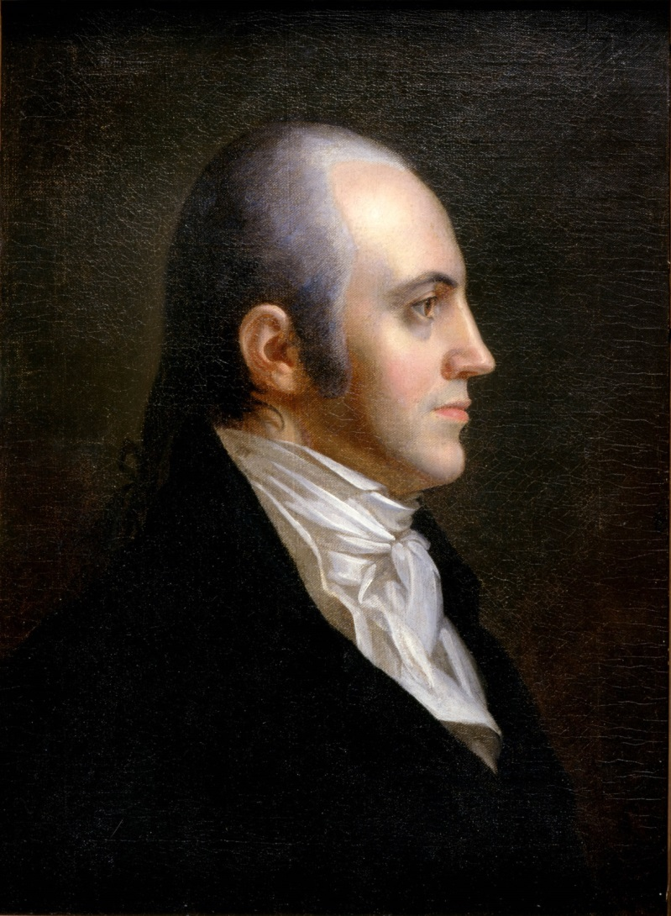
Aaron Burr 6 February 1756 – 14 September 1836

Slide 4
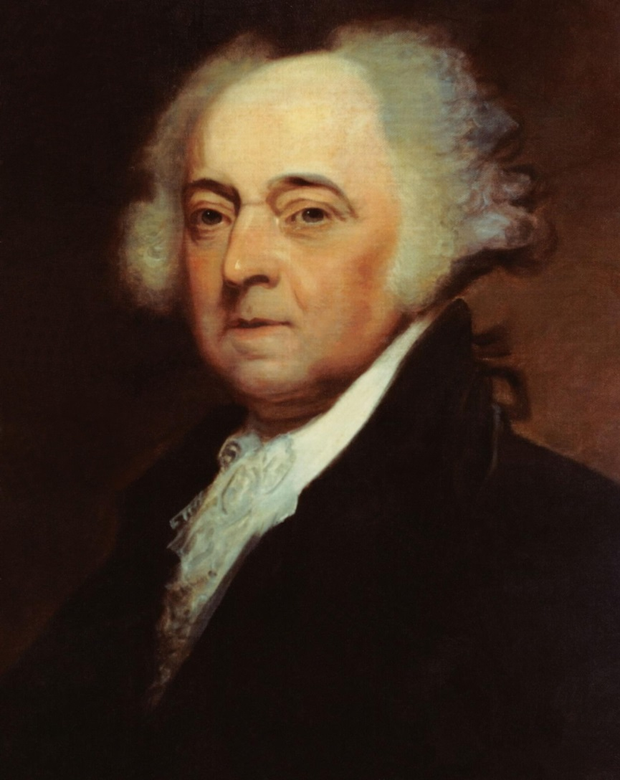
John Adams 30 October 1735 – 4 July 1826

Slide 5
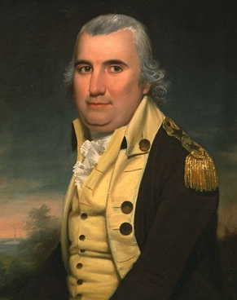
Charles Cotesworth Pinckney 25 February 1746 – 16 August 1825

Slide 7
Balloting started 11 February 1801 – Under original Constitution “if such Number be a Majority of the whole Number of Electors appointed; and if there be more than one who have such Majority, and have an equal Number of Votes, then the House of Representatives shall immediately chuse by Ballot one of them for President.” Voting was by States and a majority of States was necessary for election.

Slide 8
First 35 Ballots – Jefferson 8 States;
Burr 6 States; 2 States Undecided
17 February 1801 – Some Federalists abstain
within State delegations:
Jefferson 10 States; Burr 4 States; 2
undecided. Federalists in Vermont and
Maryland abstained within their states and
the States went over to Jefferson.

Slide 9
