Slide 1
Party Realignment Theory
What is a Political Party and How do they Change?

Slide 2
What is a Political Party?
1) Practically Every Nation State has organizations which describe themselves as Political Parties.
2) We are only interested in Political Parties in free societies! The keys:
a) Freedom of Association
b) Freedom of Speech

Slide 3
3. The Chicken-Egg Question -- Political Parties/Free Society
Does a democratic free society allow the development of political parties?…or
Do political parties allow the development of a free society?
c. Answer: You have to have an institutional structure in place that allows Freedom of Expression and Freedom of Association and the Rule of Law (Political Culture). This allows both to Evolve.

Slide 4
4. The Uniqueness of the United States
a. In the United States Representative Government (basic freedoms established from the beginning by force of circumstances!) and Private Property Rights (Capitalism) cohabitated from the beginning (they co-evolved).
b. The basic freedoms are a NECESSARY CONDITION for REAL (see below) Political Parties – Capitalism is not [China has a form of Capitalism without freedom].

Slide 5
c. BIG QUESTION – can you have true entrepreneurial capitalism without Democracy?
d. 2nd BIG QUESTION – Given the close relationship between Science and entrepreneurial capitalism (why is this so? –INDUCTIVE REASONING), can you have either without Democracy (in the long run)?
e. How are Economic Growth and Democracy Related?

Slide 6
5. A real Political Party Must Have a Realistic Chance to Take Power!
a. Definition (E. E. Schatschneider): A Political Party is an Organized Realistic Attempt to Get Power
b. Anthony Downs: A team of individuals seeking to gain control of the governing apparatus through gaining office in an election.

Slide 7
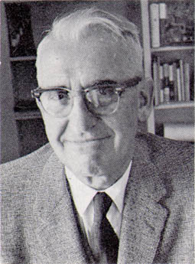
Elmer Eric Schattschneider (1892 - 1971). Author of Party Government, 1942, and The SemiSovereign People, 1960

Slide 8
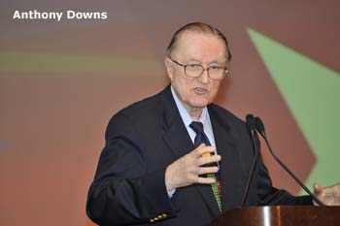
Anthony Downs (1930 - ) Author of An Economic Theory of Democracy (1957)

Slide 9
6. How do you decide what a Real Political Party is? According to Schattschneider (Party Government) there are two tests:
Does the Political Party now Control the Government?
If not, has it been able to Create the General Belief that it will take control of the Government in the Reasonably Near Future?

Slide 10
7. How Many Real Political Parties have there been in American History?
8. Where do you Draw the Line Between an Interest Group and a Political Party (Freedom of Association and Freedom of Speech allow both to flourish!).
9. Definition of an Interest Group: An Interest Group is a Voluntary Association of Individuals with a Shared Concern (economic or idealistic) that Tries to Influence Decisions of the Political System.

Slide 11
10. The Two Types of Interest Groups -- Economic and Idealistic. Where do you Draw the Line?
11. Are Political Parties Simply Coalitions (Confederations) of Interest Groups? Or Do They Stand for Something?

Slide 12
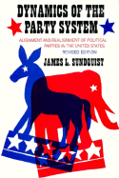

Slide 13
Definition of Realignment -- "A realignment is a durable change in patterns of political behavior."
A Model of Realignment – An Ideal Society that divides first over an irrigation system and then over a saloon.

Slide 14
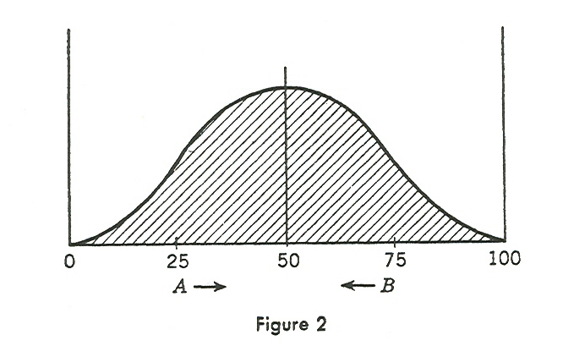
1. One dimensional public-works dimension.

Slide 15
2. Progressives vs. Conservatives – They eventually divide into two groups over a proposal to build an irrigation system.
Progressives are activists and believe the role of government should be an activist one and the government should take risks to better society. Progressives see Conservatives as people without vision who are more concerned about personal short-run material satisfaction than long-run public good.

Slide 16
b. Conservatives fear the consequences of these risks and are suspicious about the “new” society that the Progressives want to build. Conservatives see Progressives as reckless and profligate spenders of the people’s money.

Slide 17
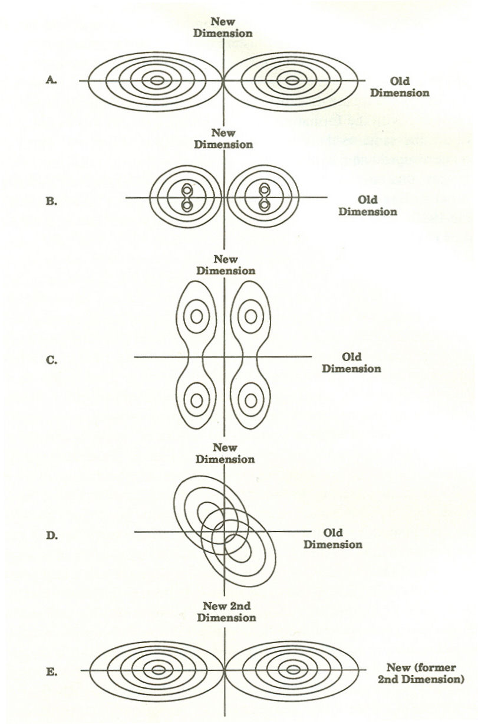
3. Saloon – Someone wants to build a saloon. This splits both parties.

Slide 18
Realignment Scenarios
1. No Realignment – The two parties take the same position on the issue and the salience of the issue declines as a result.
(System freezes at B or C in Previous Figure.)
2. Realignment in which Neither Party is Replaced – Pro-Salooners take over the Progressive Party and the Anti-Salooners take over the Conservative Party. (System freezes at D in Figure.)

Slide 19
3. Realignment in which One Party is Replaced – A new party enters – the Liberal Party – as Pro-Saloon and absorbs members of both the Progressive and Conservative party. (System freezes at D or E in the Figure.)
4. Realignment in which Both Parties are Replaced – Two new parties enter – the Liberal Party and the Prohibition Party – System completely realigns on saloon issue. (System freezes at E in the Figure.)

Slide 20
D. The Essential Dynamic – The Center Does Not Hold – The new issue produces two polar blocs and a centrist bloc. If the Centrists in both old Parties can retain control then realignment is avoided.
E. Five Variables That Affect Realignment
Breadth and Depth of the Underlying Grievance
a. How long does the issue last?
b. Is the Issue a Moral One? If it is perceived as “the forces of light” versus “the forces of darkness” then people are more likely to switch parties.

Slide 21
c. Slavery and Abortion vs. Gay Rights
2. Capacity to Provoke Resistance –
Is the issue zero-sum?
Does solving one problem create a new problem? Does it create a new “injustice”? (Redistribution of Wealth; Comparable Worth [Equal Pay Laws].)

Slide 22
3. Leadership –
The power and capacity of the established party leadership are matched against the strength and momentum of the issue.
If the Issue is a moral one then compromise may be seen as reprehensible – one cannot compromise with evil.

Slide 23
4. Division of Polar Blocs Between the Parties
If the opposing blocs polarized around an issue fall mostly into the existing parties then realignment will be easy. The new issue is simply absorbed into the current alignments. (This is something like Figure D.)
b. If the blocs are about evenly split between the parties the realignment will be delayed. (The A to E process shown in the Figure.)

Slide 24
5. Strength of Existing Party Attachments – The weaker the identification that people have with a political party, the easier it is to separate them from the party and trigger a realignment. Factors:

Slide 25
Age – Partisan attachments get stronger with age. Young people who do not remember the issue conflict that created the current alignment tend to be weaker party identifiers (The New Deal was 80 years ago).
Reference Groups – Most groups in society have some degree of partisan bias which sometimes is embedded in the group’s tradition and most people belong to one or more such references groups – family; racial; ethnic; religious.

Slide 26
C. Personal (Economic) Philosophy – This causes cross-pressure – Catholic Businessmen (at least until the 1980s – but revived again with the Contraception Mandate in the ACA).

