Slide 1
The First Political Party System: 1829 - 1852
Whig vs. Democrat

Slide 2
The Founders Tried to Duck The Issue:
1. Section. 2. Clause 3: Representatives and direct
Taxes shall be apportioned among the several States which
may be included within this Union, according to their
respective Numbers, which shall be determined by adding
to the whole Number of free Persons, including those bound
to Service for a Term of Years, and excluding Indians not
taxed, three fifths of all other Persons.

Slide 3
Section. 9. Clause 1: The Migration or Importation of such Persons as any of the States now existing shall think proper to admit, shall not be prohibited by the Congress prior to the Year one thousand eight hundred and eight, but a Tax or duty may be imposed on such Importation, not exceeding ten dollars for each Person.

Slide 4
3. Amendment XIII. (ratified 6 December 1865)
Section 1. Neither slavery nor involuntary servitude, except as a punishment for crime
whereof the party shall have been duly convicted, shall exist within the United States, or any place subject to their jurisdiction.
Section 2. Congress shall have power to enforce this article by appropriate legislation.

Slide 5
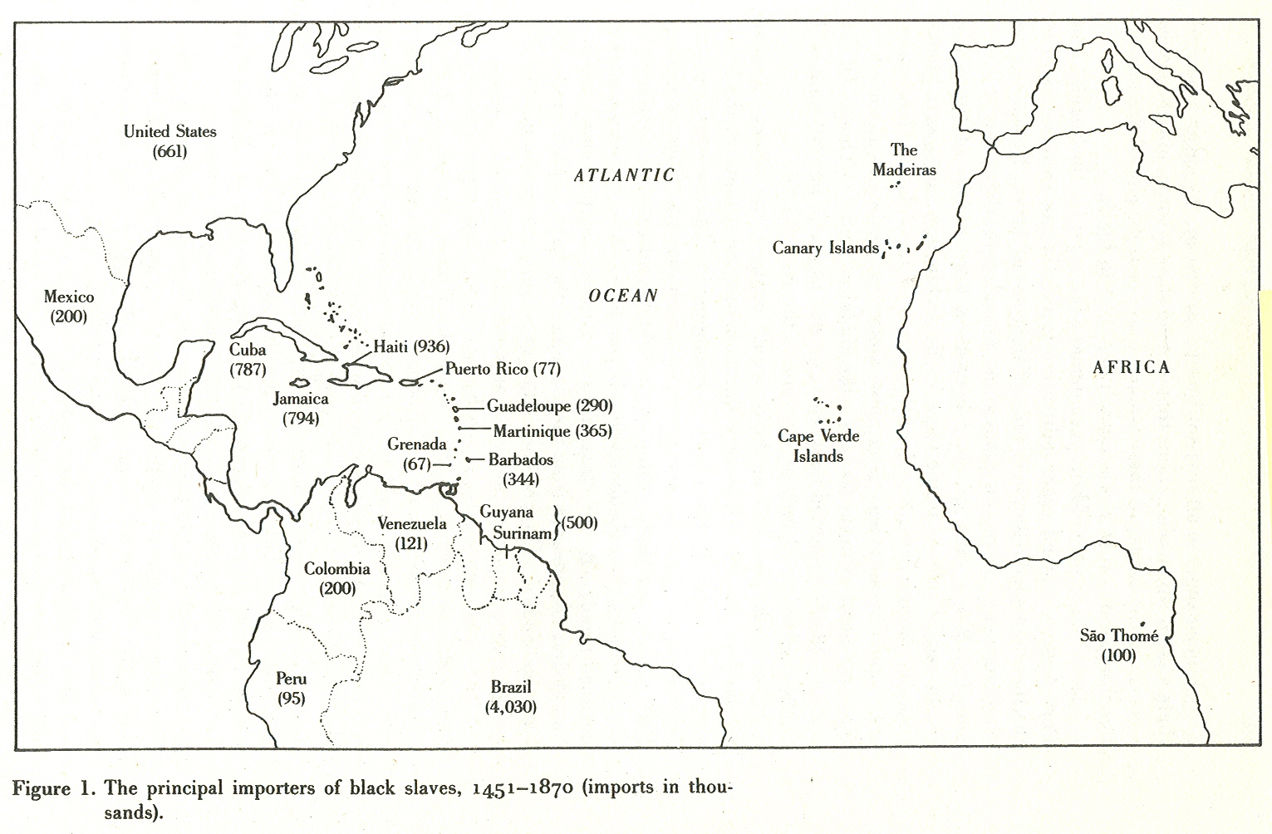

Slide 6


Slide 7
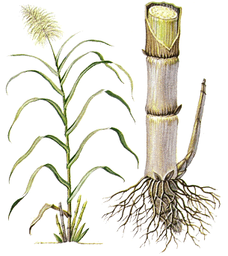

Slide 8
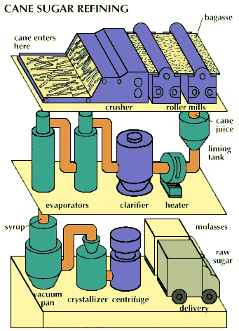

Slide 9
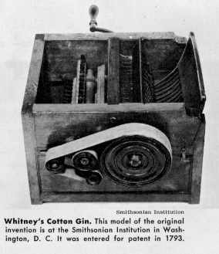
The Invention of the Cotton Gin by Eli Whitney in 1793
The Invention of the Cotton Gin by Eli Whitney in 1793

Slide 10
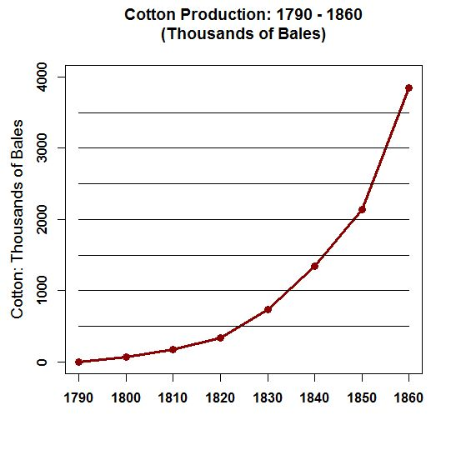

Slide 11
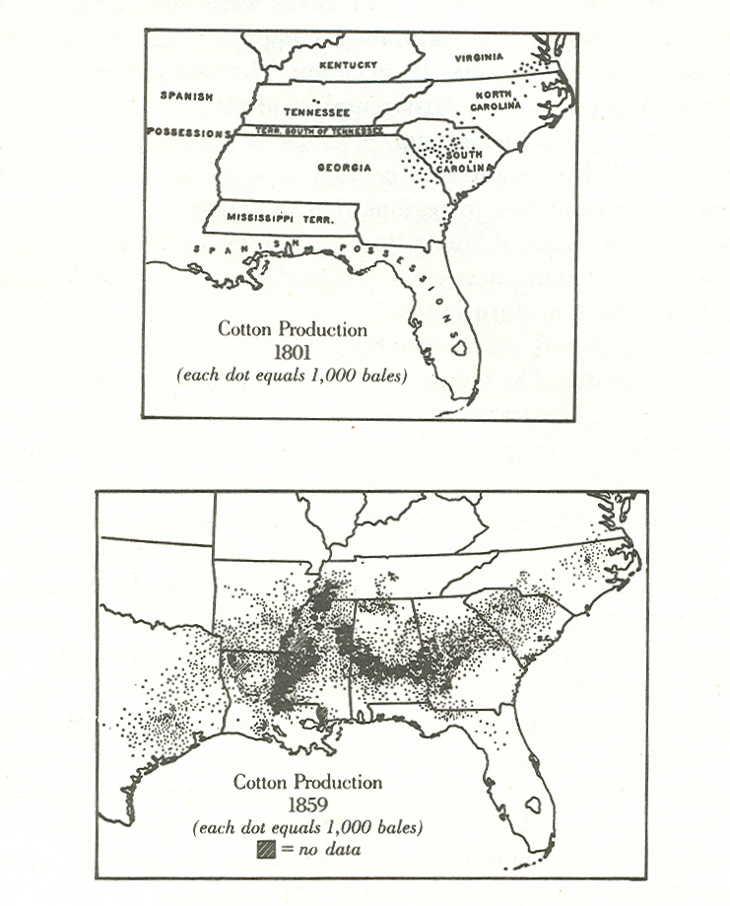
By 1860 Cotton Exports were $192,000,000 or four times U.S. Government revenues. About 86% of the Cotton was grown on farms of 100 or more acres. England imported about 80% of its Cotton from the South and about 1.5 million people were employed in the English Textile mills.

Slide 12
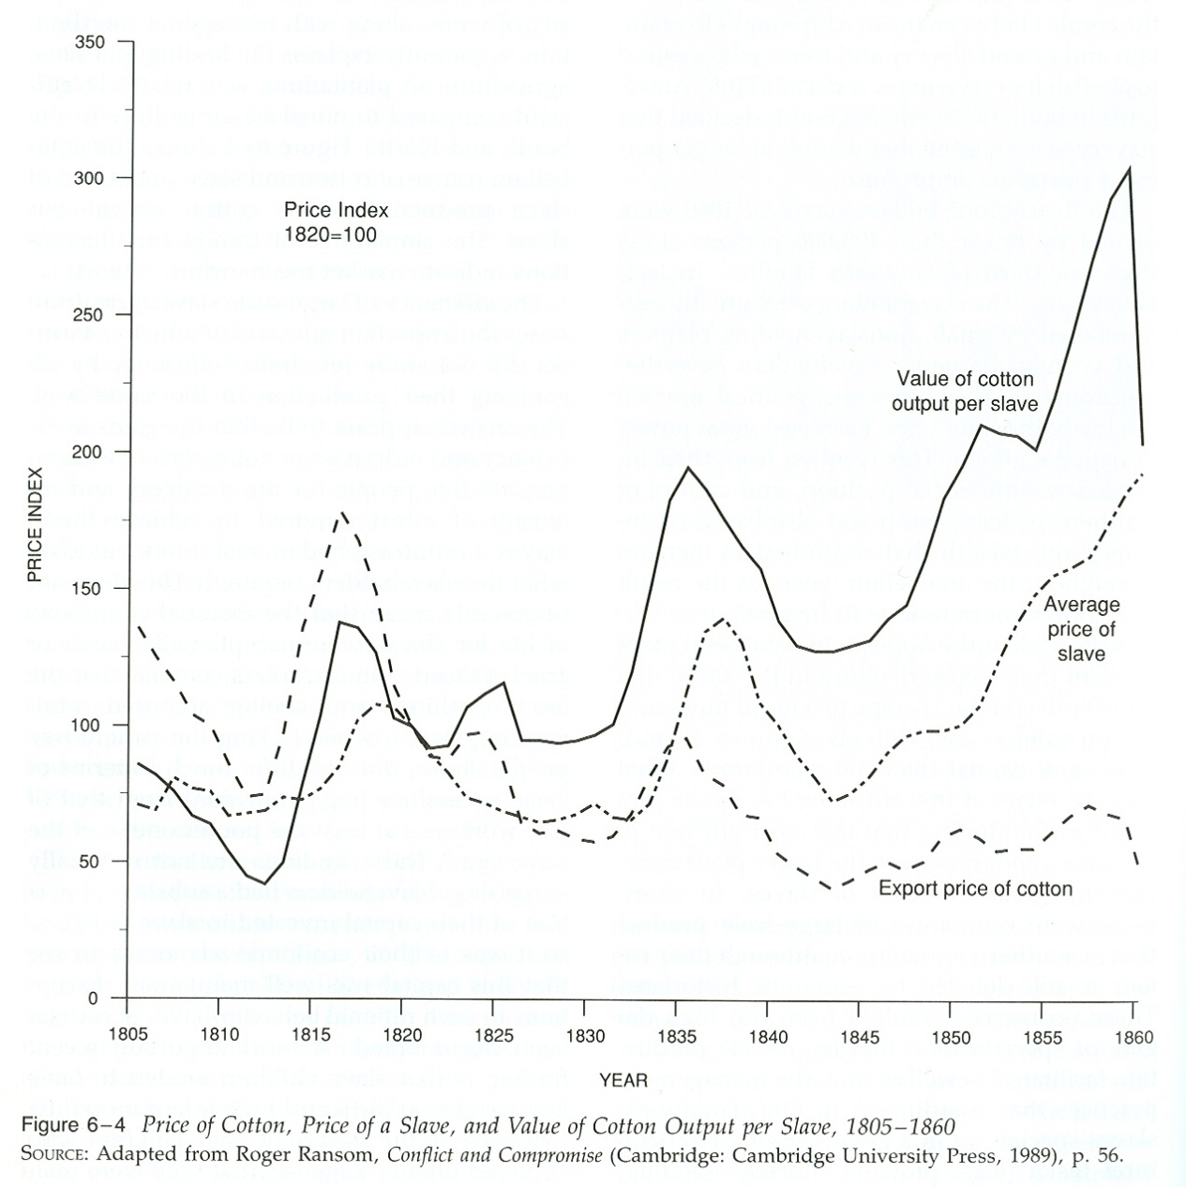
The expansion of the Cotton-based Slavery system into the Southwest accounts for much of the potency of the Territorial Issue.

Slide 13
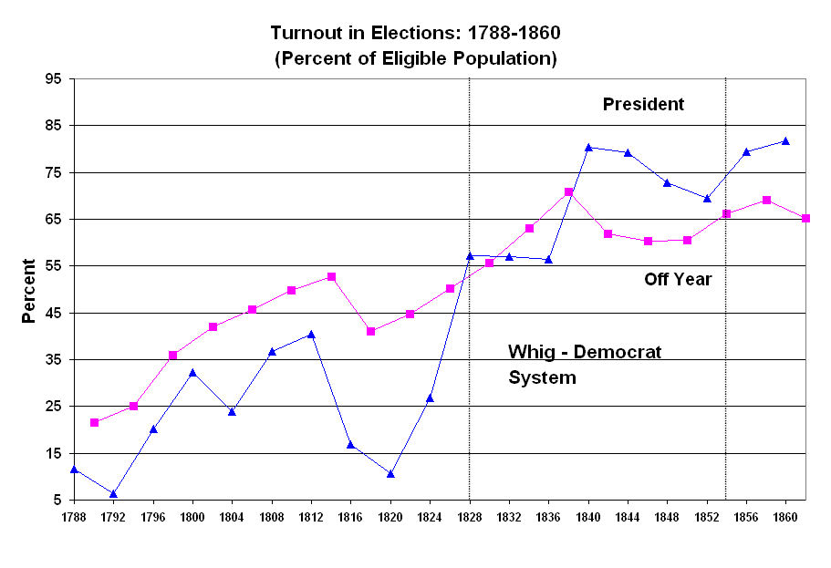

Slide 14
The Whig-Democrat Political System – 1826 – 1852 (Whigs collapsed after the Compromise of 1850).
  Basically Competitive With a Slight Advantage to the Democrats.
  Both Parties had Support in the North and the South.
  Two Basic Issues – Economic Regulation and Slavery.

Slide 15
John Gerring (1998): Whig-Republicans – valorized work and social harmony; mercantilists – the state had an important role in ensuring economic development; statists – believed in strong government which properly channeled the voice of the masses through institutions rather than direct expression; order – against unrestrained individualism; Yankee Protestants – believed that humans had a responsibility to reform themselves; Nationalists – preeminence of American interests and ideals. Favored aggressive trade policies, internal improvements, and industrial policies to stimulate economic growth.

Slide 16
John Gerring (1998): Democrats: “From 1828 to 1892, Democratic leaders steadfastly defended a pre-industrial economic order, limited government, and the liberties of white people. Forged from the unlikely combination of racism, anti-statism, and civil republicanism, this ideology is most accurately and concisely described as Jeffersonian.” Democrats did not condone slavery – rather, they were pro-White.

Slide 17
“Throughout most of the 19th century, Democratic leaders adopted tight fiscal, currency, and monetary policies: hard currencies (gold and/or silver), balanced budgets, little government borrowing (and quick repayment), low spending and low tariffs.” Democrats opposed the National Bank and Internal Improvements – such policies FAVORED BUSINESS AND THE MERCHANT CLASSES. Democrats opposed Tariffs because they were a TAX (ALSO HURT THE SOUTHERNERS).

Slide 18
Democrats favored state and local government because they saw them as being more under popular control. The Federal Government was remote and should be small and should protect private property. They opposed an activist Federal government. The party was anti-corporate and anti-capitalist – the protector of the common people. “…the economic philosophy of the early Democratic party is perhaps more accurately encapsulated in the terms agrarianism, producerism, or … civic republicanism …”

Slide 19
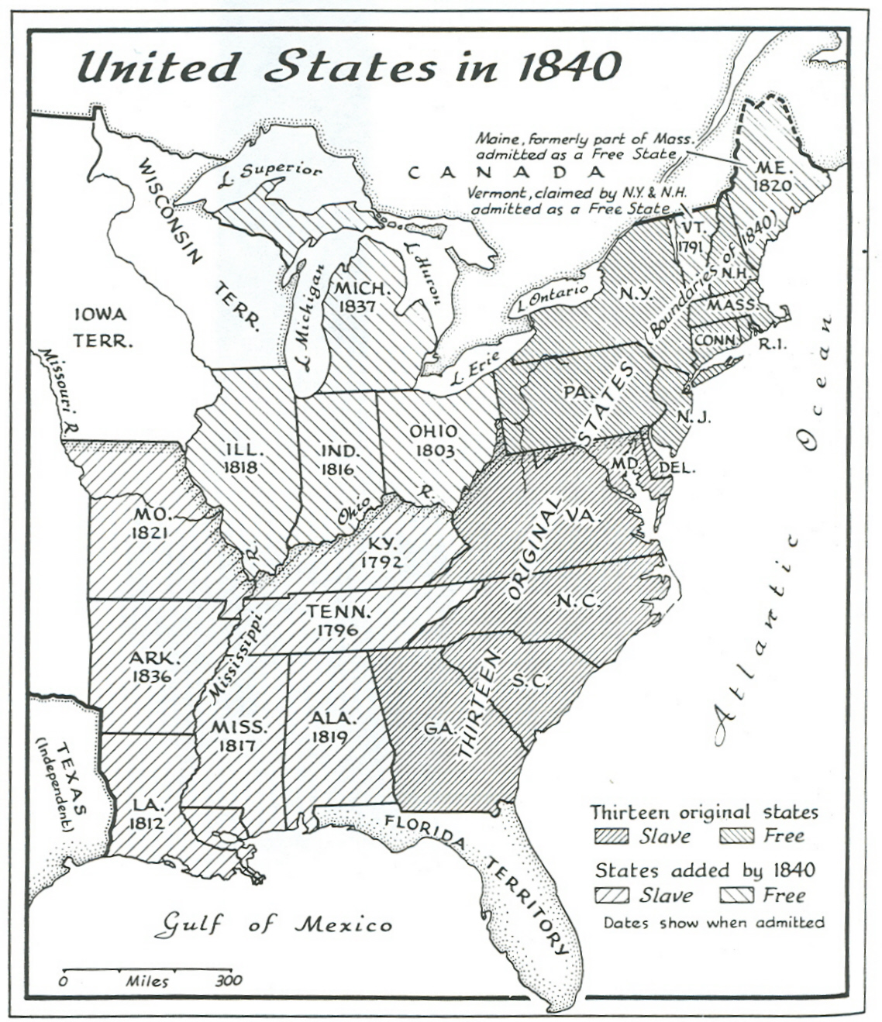

Slide 20
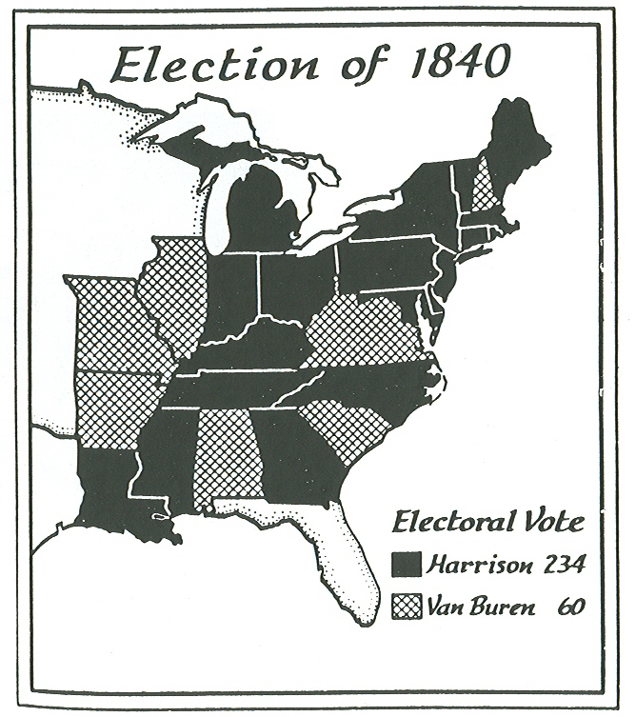

Slide 21
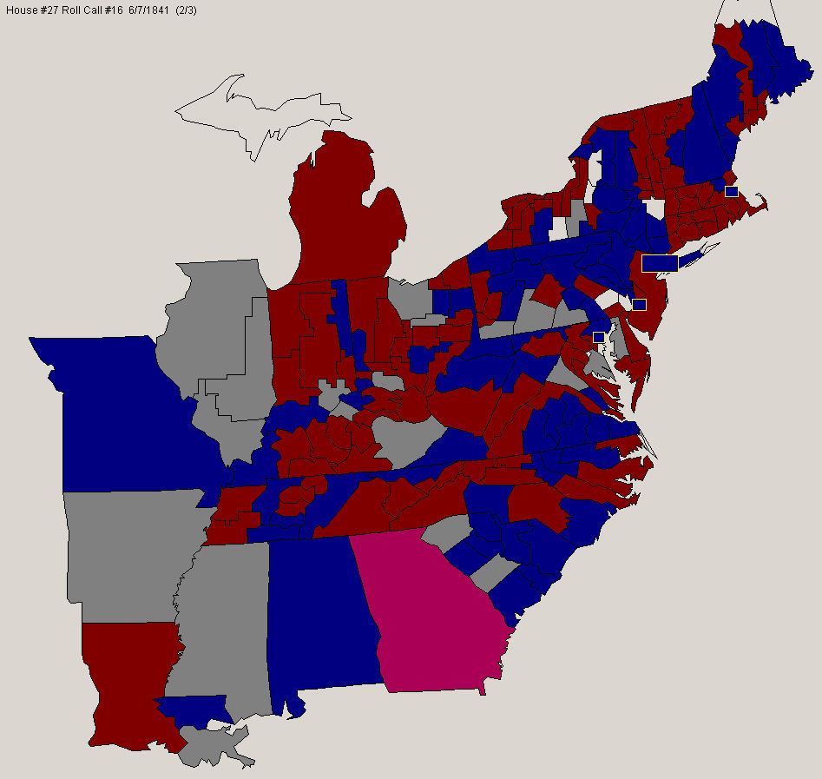
A (near) Party-Line Roll Call Vote in the House in 1841 -- Red are Whigs and Blue are Democrats
A Near Party Line Vote in the House in 1841

Slide 22
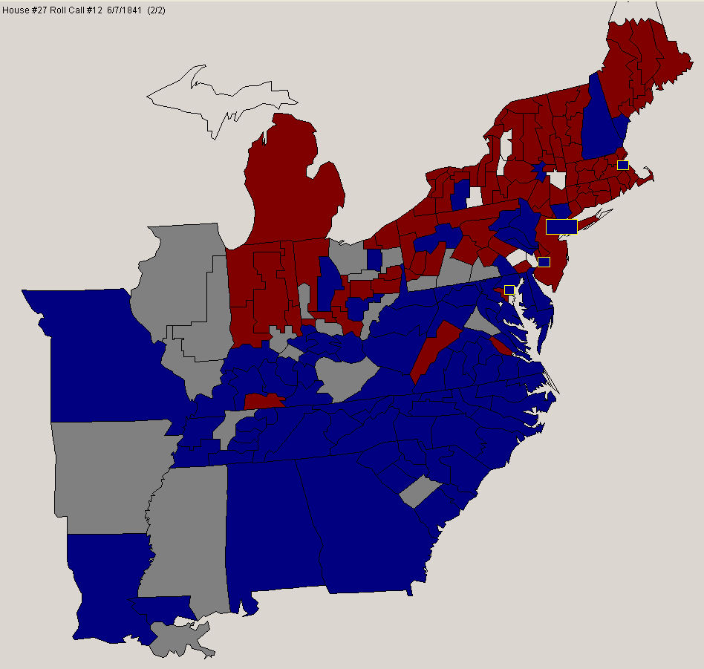
Slavery Petition Vote, 1841

Slide 23
Presidential Elections: 1828 - 1860
Democrat Whig
----------------------------------------------------------------
1828 Jackson 178 642,553 Adams 83 500,897
1832 Jackson 219 701,780 Clay 49 484,205
1836 Van Buren 170 764,176 Harrison 73 550,816
1840 Van Buren 60 1,128,854 Harrison 234 1,275,390
1844 Polk 170 1,339,494 Clay 105 1,300,004
1848 Cass 127 1,223,460 Taylor 163 1,361,393
1852 Pierce 254 1,607,510 Scott 42 1,386,942
----------------------------------------------------------------
Republican American/Whig
1856 Buchanan 174 1,836,072 Fremont 114 1,342,345 Fillmore 8 844,032
1860 Douglas 12 1,004,042 21.47% Northern Democrat
Lincoln 180 1,855,276 39.67% Republican
Breckinridge 72 672,601 14.38% Southern Democrat
Bell 39 590,980 12.64% Unionist
(Fusion) 0 553,570 11.84 Misc. Fusion Tickets

Slide 25
    The Economy Before the Civil War – How it Interacted with the Democrat-Whig Political Party System
      U.S. Long on Resources and Short on Population -- Result, capital intensive development.
      The Creation of the modern economy during the 1840s to the 1890s was due to cheap energy in the form of coal, mass transportation in the form of the railroads, and mass communication in the form of the telegraph.

Slide 26
      3. Different Patterns of Economic Development in the North and South.
      4. North – Expansion of Transportation Systems and Industrialization.
      5. South – EXPANSION OF COTTON-BASED SLAVERY

