Slide 1
The Second Political Party System: 1856 - 1896
The Economy After the Civil War:
The Farmers

Slide 2
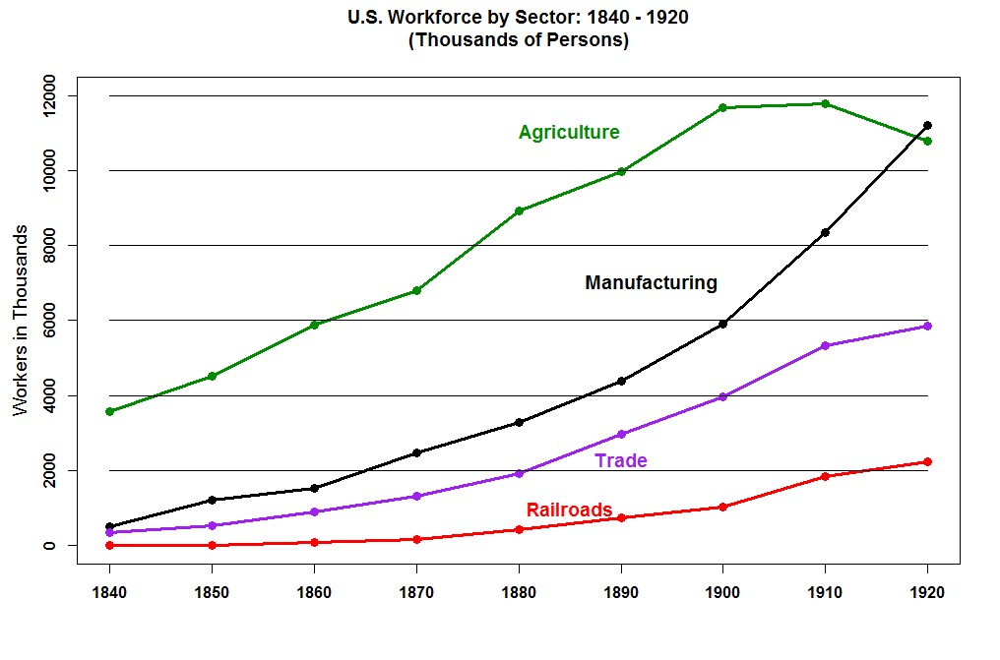

Slide 3
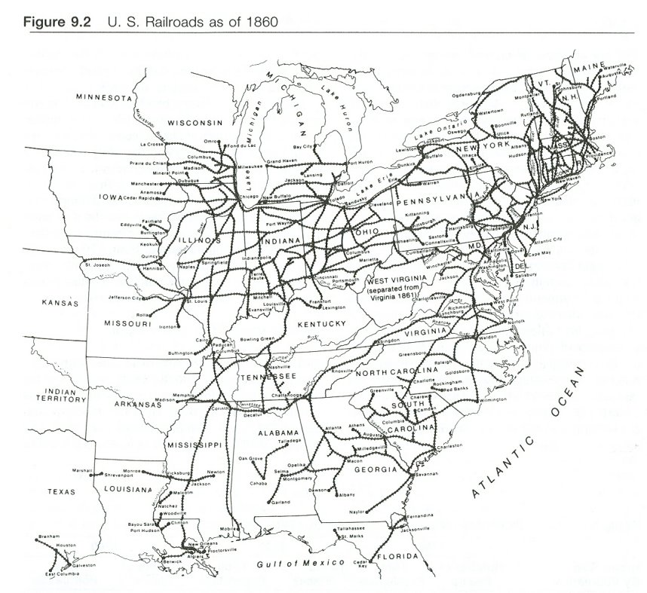

Slide 4
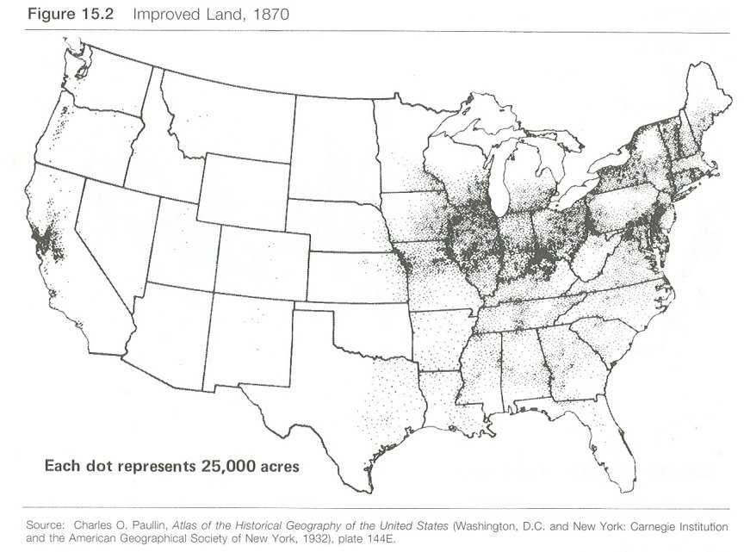

Slide 5
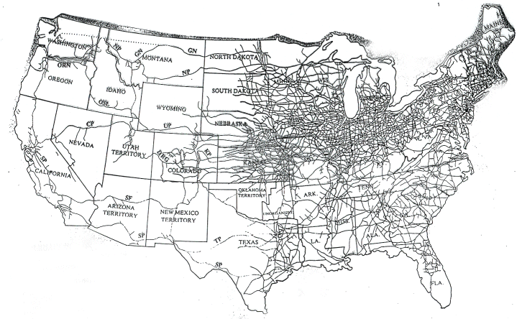
Railroad Network in 1890

Slide 6
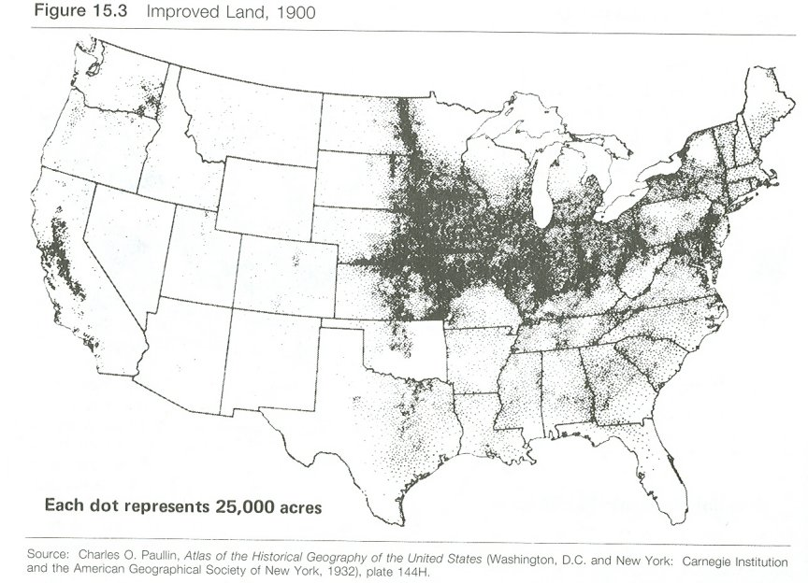

Slide 7
Between 1850 and 1870 the expansion of the rail net into the Midwest led to a dramatic increase in grain output. For example, wheat production increased from 15.2 million bushels to 104 million bushels and corn production increased from 68.3 million to 218.6 million bushels. This increase was not due to productivity gains, rather it was due simply to more land being brought into production because of the railroads.

Slide 8
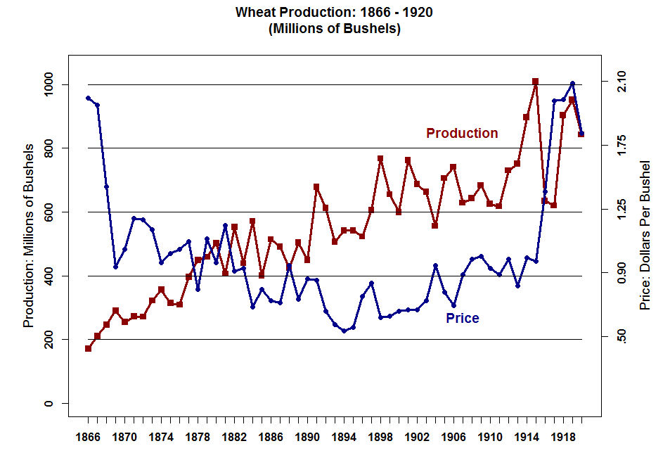

Slide 9
The period 1865 and 1896 was marked by a persistent deflation. Commodity prices fell steadily with a few ups and downs until the latter half of the 1890s. The farmers complained bitterly about this and blamed their problems on:
High railroad freight rates.
Grain elevator companies and Futures Markets.
Middlemen in general.
Monopolies in general
Banks and Moneylenders.

Slide 10
One of the First Farmer Organizations to form to press their grievances was The National Grange of the Order of Patrons of Husbandry. It was founded in 1867 as a fraternal organization that encouraged families to band together to promote the economic and political well-being of the community and agriculture. It grew rapidly. By 1873 the Grange had 200,000 members and by 1875 it had about 850,000 members.

Slide 11
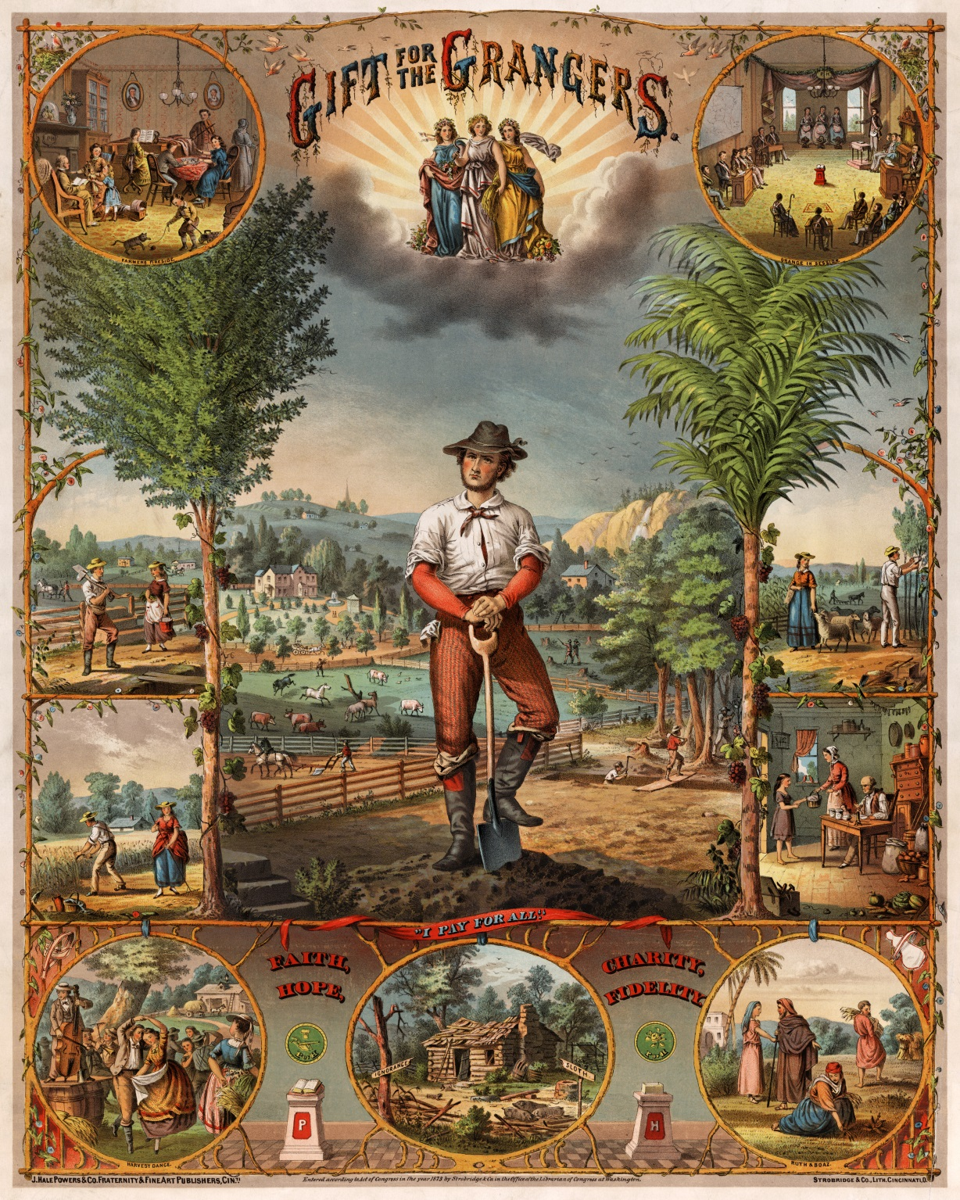
The Good Life that the Grangers Hoped to Restore for the Farmers

Slide 12
The Biggest Targets of the Grangers were the Railroads and the Monopolies. D. C. Cloud, a spokesman for the Farmers Movement declared that an “all-powerful interest” had arisen in the USA:
“It has corrupted legislatures and congressmen, until the law-making power has become a party to schemes of robbery and plunder. By corrupt legislation and ex parte judicial Decisions, it has destroyed all the old republican

Slide 13
landmarks, overridden the provisions of the constitution, and substituted for the government prepared by us by our forefathers an oligarchy that rules the land and holds the people at its mercy, and their property as its lawful booty. This great oppressor of the people is the railroad corporations and their associates…”

Slide 14
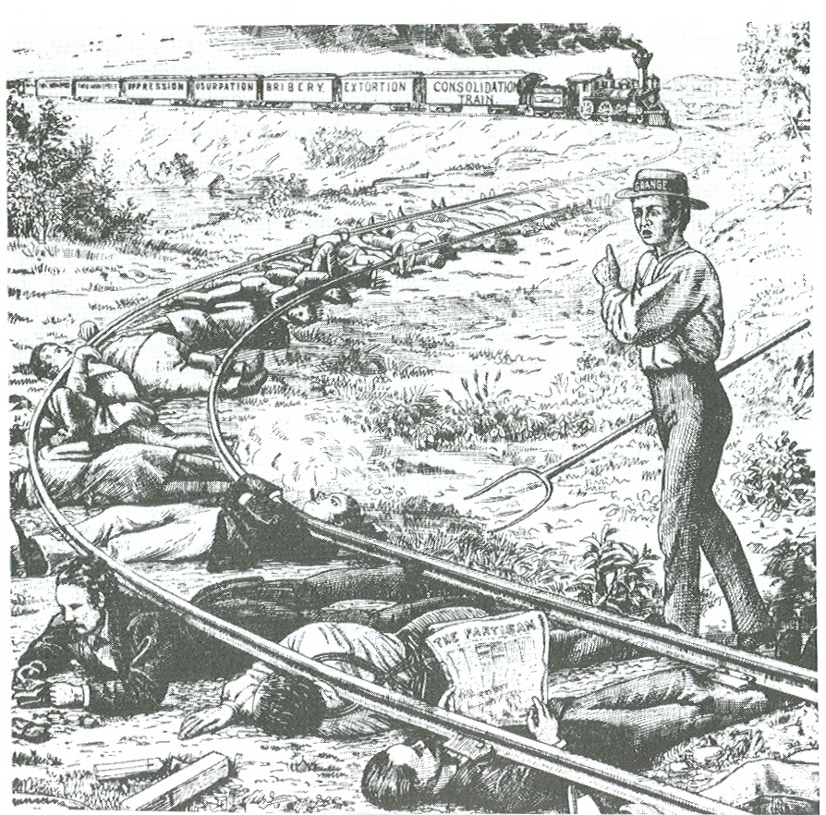

Slide 15
In 1873 and 1874 the Grangers and other Farmers’ Parties (Anti-Monopoly, Independent, Reform) called for state control of corporations – particularly railroads – and for reform of Government.
Their biggest victories were the “Granger Laws” that regulated Railroad Freight Rates and Grain Elevator (Warehouse) Rates.
These Laws were enacted in Illinois, Minnesota, Missouri, Nebraska, Iowa, Wisconsin, and California.

Slide 16
The biggest victory for the Grangers and their allies was the Supreme Court decision Munn vs. Illinois in 1877.
1. In 1877 the Supreme Court upheld the right of the states to regulate railroad rates.
2. Chief Justice Waite used the old 17th Century custom in English jurisprudence that accepted the regulation of a business clothed with a public interest. "When Private Property is devoted to public use, it is subject to public regulation." For example, a privately owned wharf.

Slide 17
3. One of the dissenters, Justice Stephen J. Field, argued that the regulation of railroad rates was in effect confiscation of private property. The railroads were being deprived of property without due process of law in violation of the 5th and 14th Amendments. This argument later became known as substantive due process.

Slide 18
Wabash, St. Louis, and Pacific Railroad vs. Illinois
1. In 1886 the Supreme Court in effect reversed the Munn case and struck down an Illinois law regulating railroad rates.
2. The Court argued that State railroad regulation violated the interstate commerce clause of the Constitution. Only Congress could regulate interstate commerce.
3. In a companion case, Santa Clara County vs. Southern Pacific Railroad, the Court defined the SPRR as a legal person! Hence, the 5th and 14th Amendments were applicable.

Slide 19
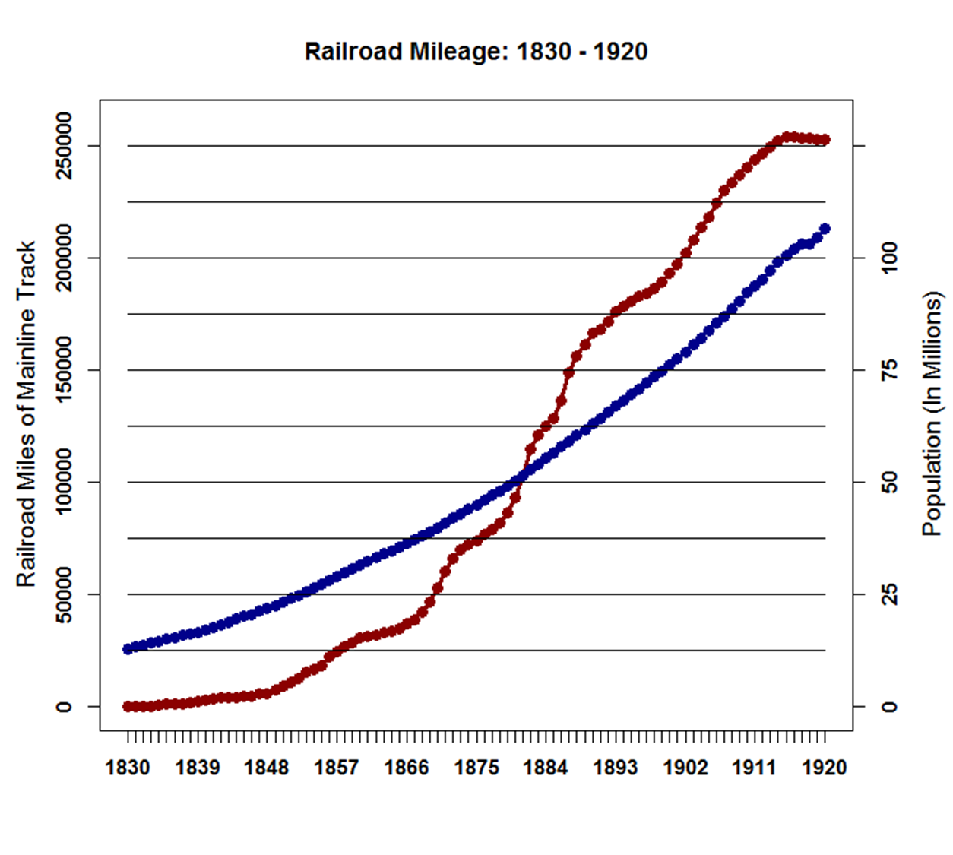

Slide 20
Provisions of the Interstate Commerce Act of 1887
The Act outlawed rebates, drawbacks, and pooling. It required the railroads to post the rates in every depot and station and required the rates to be "reasonable and just".
The Act contained a Short Haul Pricing Constraint.

Slide 21
3. Finally, the act set up a Commission to adjudicate disputes between shippers and the railroads. The Interstate Commerce Commission (ICC) was the first federal government regulatory agency.

Slide 22
In Fact, were Farmers being over-charged by the Railroads?
Were the Beliefs of the Farmers True?
Some Distinctions About Truth
1. What is True
2. What is Known to be True
3. What People Believe is True
Politicians Respond to (3) (2)
--------------------------------------------------------------
1. Known Knowns -- Things we know we know
2. Known Unknowns -- Things we know we do not know
3. Unknown Unknowns -- Things we do not know that we do not know
--------------------------------------------------------------
Tension Between
Deduction -- (How Politicians Reason)
Induction -- (How the Great Entrepreneurs and Scientists Reason)

Slide 23
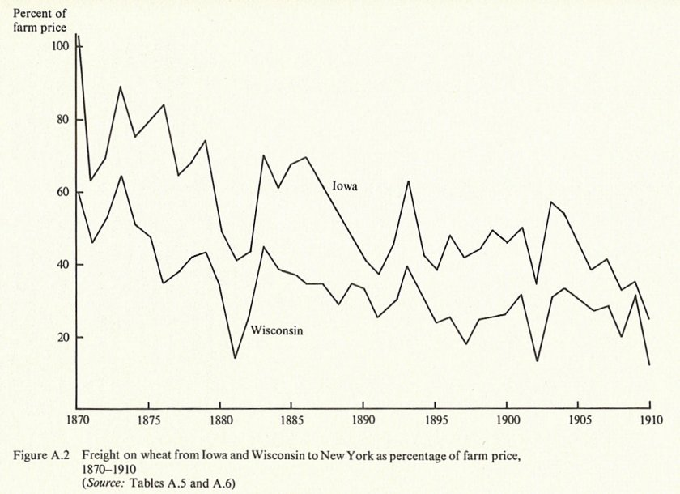
Spot Market Price Differentials as a Percentage of Price per Bushel

Slide 24
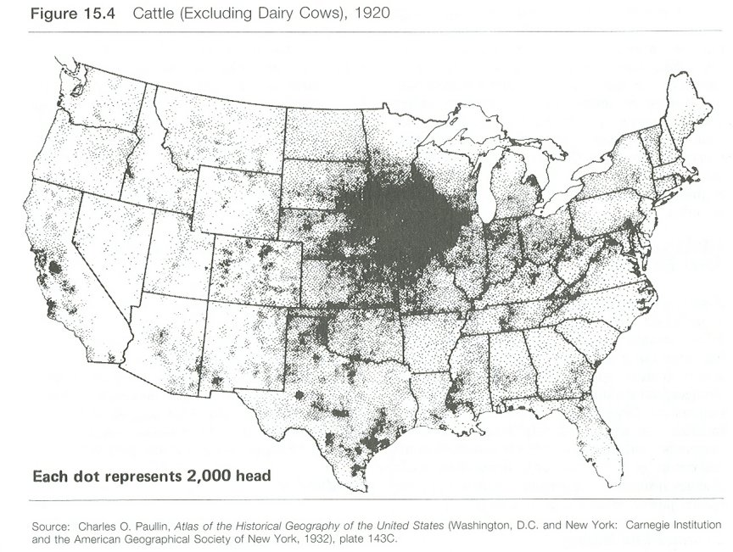

Slide 25
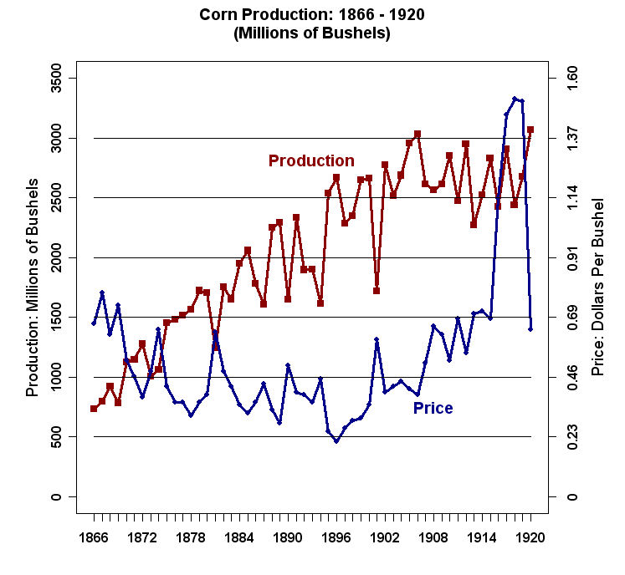

Slide 26
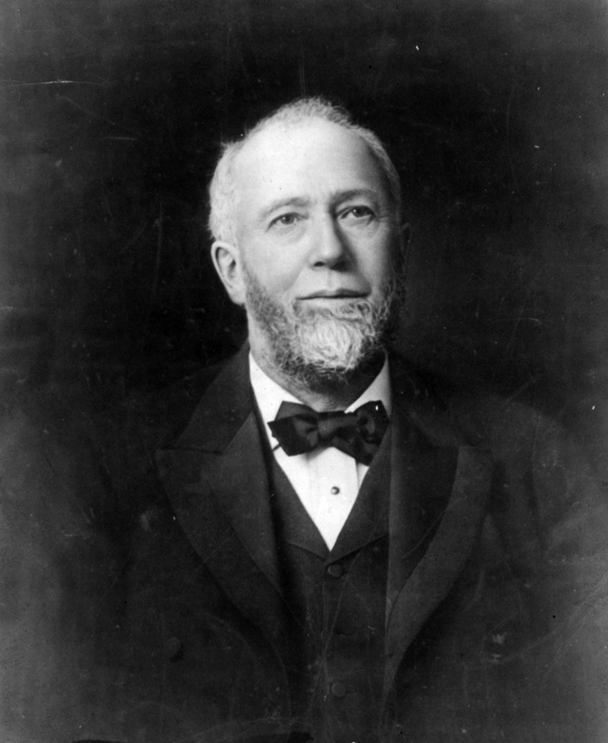
Gustavus Swift, 24 June 1839 – 29 March 1903

Slide 27
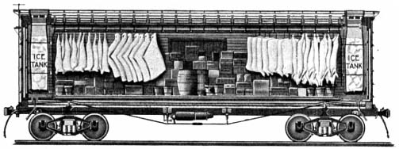
Gustavus Swift invented the refrigerated railroad car in the 1880s

Slide 28
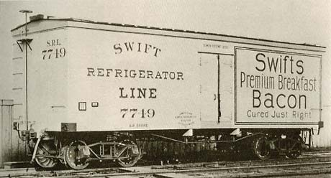

Slide 29
Although the Farmers and their Allies Succeeded in Regulating the Railroads, The primary demand of the farmers was currency inflation -- namely, Free Coinage of Silver.
Deflation caused great Political-Economic strain. Debtors, especially farmers, demanded that steps be taken to inflate the money supply mainly through the coining of silver.
In the 1840s and 1850s Gold was plentiful and Silver relatively scarce.

Slide 30
The "Crime of 73" -- Silver was demonetized by an act of Congress just as the Western mines came on line
Bland-Allison Act of 1878 -- Passed with the support of a coalition of farmers and mining interests. Obligated the Treasury to purchase $2m to $4m of silver bullion per month and coin it into dollars. Treasury always purchased the minimum amount and the price of silver kept falling.

Slide 31
Sherman Silver Purchase Act of 1890 -- Passed as the result of a deal to get the McKinley Tariff Bill passed. Obligated the Treasury to purchase 4.5m ounces of silver per month (essentially the entire output of the silver mines). The silver bullion was paid for with U.S. Notes. The Notes were redeemable in either gold or silver coin. Because the price of silver was falling relative to gold, the arbitrage opportunity was too good to pass up: Sell silver to get the notes; cash the notes for gold; use gold to buy silver; etc.

Slide 32
Sherman Silver Purchase Act repealed in 1893. The Depression and the outflow of gold came very close to bankrupting the U.S. Government.
Beginning in 1896 the development of the cyanide leaching process and discoveries of gold in the Yukon, South Africa, and Australia produced a sharp increase in the world-wide supply of gold.

Slide 33
