Slide 1
Topic 1. Part 2.
Hamilton’s Economic Program

Slide 3
  Tariffs (passed 1789)
  Debt Assumption (Confederation Debt, 1790; State Debt, 1791)
  National Bank (February, 1791)
  4. Excise Taxes (March, 1791)

Slide 4
  Debt Assumption (1791) – Total Debt – CC-Domestic (27.4 principle + 13.0 interest), CC-Foreign (10.1 principle + 1.6 interest), State 26.6; TOTAL CC and State = $78.7 million – Annual Interest on the Bonds was about $2m yearly 1791-95 = ½ government’s total expenditures!!
    Continental Congress Debt (1790)
      Domestic Debt: $40.4m ($27.4 principal, $13 interest) Paid With 3 Types of Coupon Bonds
      Foreign Debt: $11.7m ($10.1 principal, $1.6 interest) Paid With Specie to French and Dutch
    State Debt: $26.6m (1791)

Slide 5
      Foreign Debt: $11.7m ($10.1 principal, $1.6 interest)
      60% Was to the French, 40% to the Dutch
      Funds were borrowed from the Dutch between Dec. 1790 to Sept. 1792 to pay off the debt to the French. Because of depreciation of the French currency about 83% of the French debt was paid at full value.

Slide 6
      Domestic Debt: $40.4m ($27.4 principal, $13 interest)
      Paid with 3 types of coupon bonds:
      2/3 of the Principal in 6% Coupon Bonds
      2) 1/3 of the Principal in 6% Coupon Bonds deferred until 1800
      3) 3% Coupon Bonds for the Arrears of Interest

Slide 7
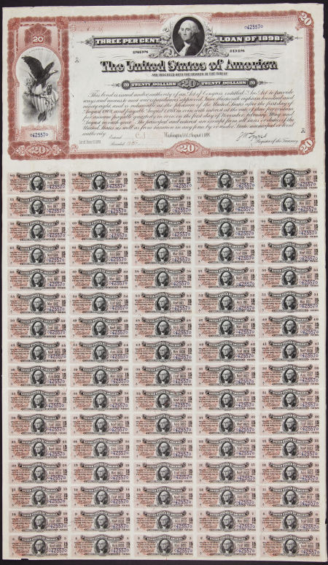

Slide 8
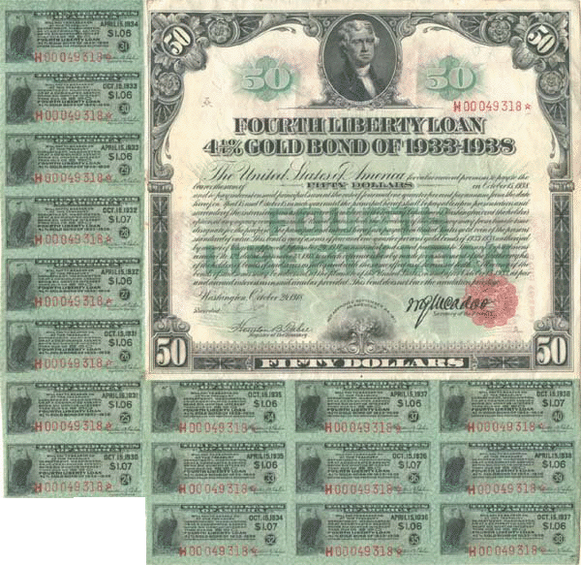

Slide 9
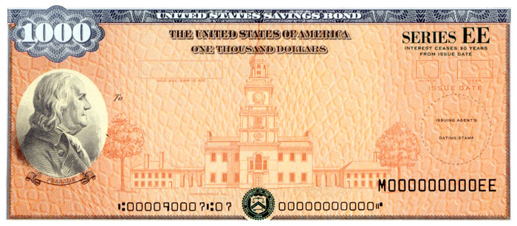

Slide 10
    State Debt: $26.6m (1791)
    81% of the State Debt was paid, or $22m
      Paid with 3 types of coupon bonds (all for Principal + Interest):
      3/9 in 3% Coupon Bonds
      2) 4/9 in 6% Coupon Bonds
      3) 2/9 in 6% Coupon Bonds Deferred until 1800

Slide 11
Importance of Bonds
-- In Nov. 1790 6% bonds worth $68.75, 6% deferred worth $28.75, and 3% bonds $35.42 (Market price per $100 face value)
-- By late 1792 the 6% Bonds for Continental and State Debt were trading near par.
This is Important Because these were negotiable securities and could be used to finance business transactions.

Slide 14
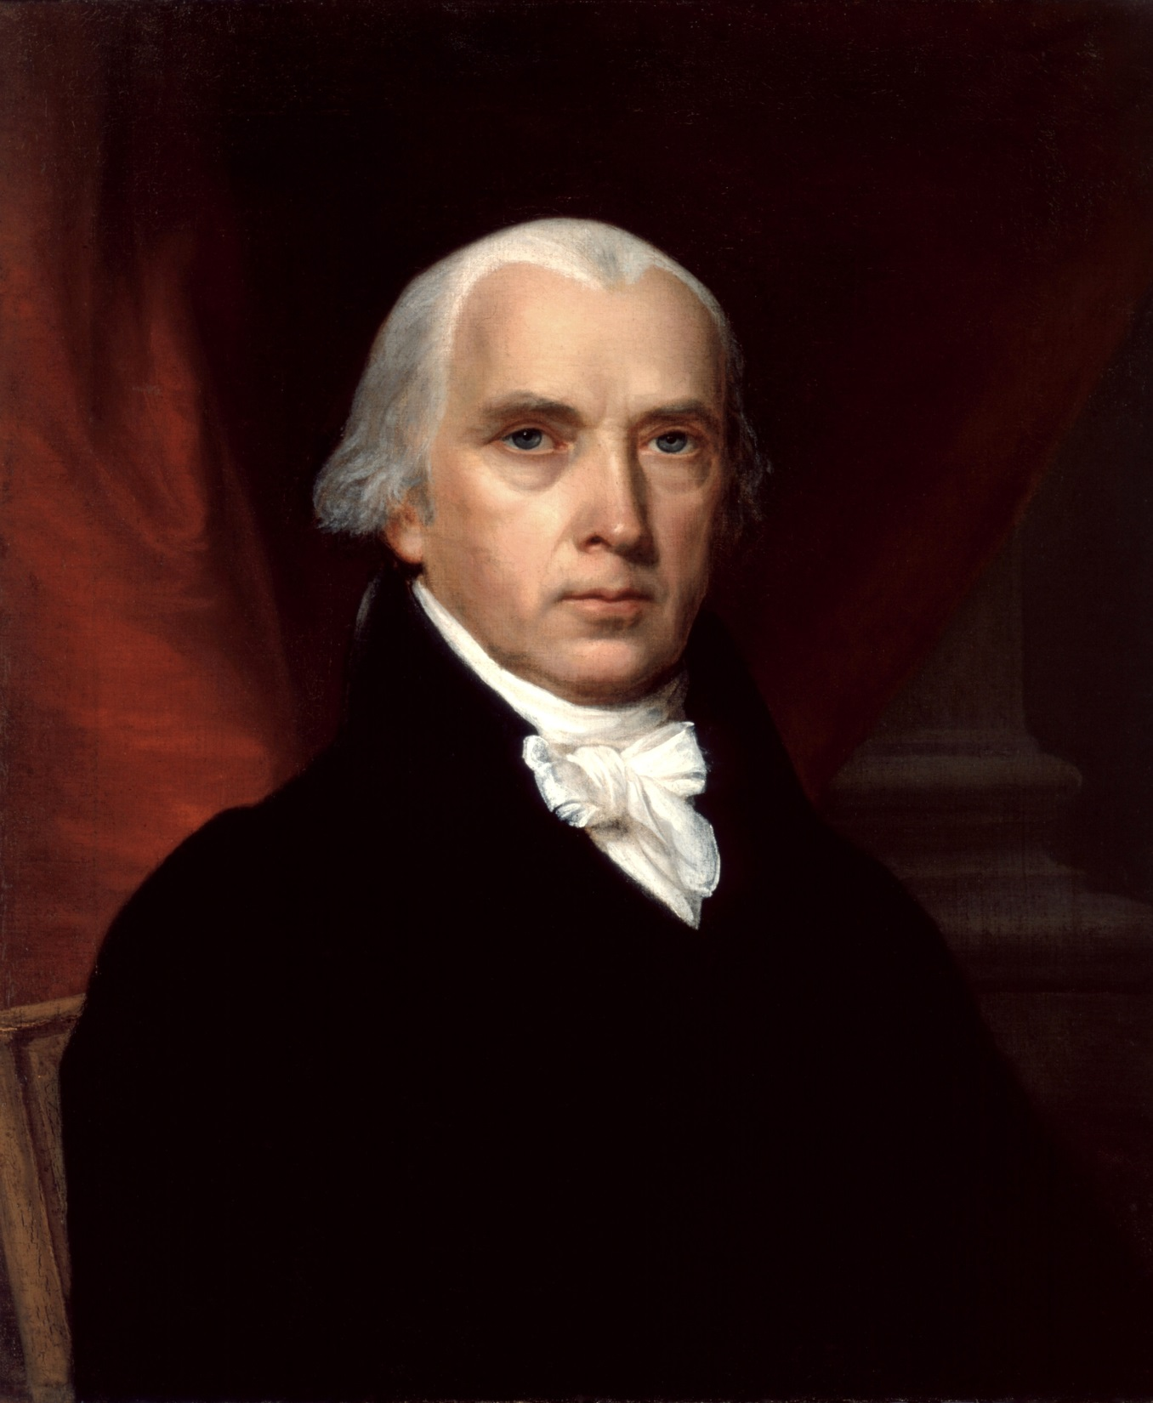

Slide 15
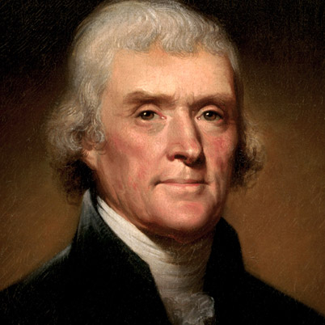

Slide 16
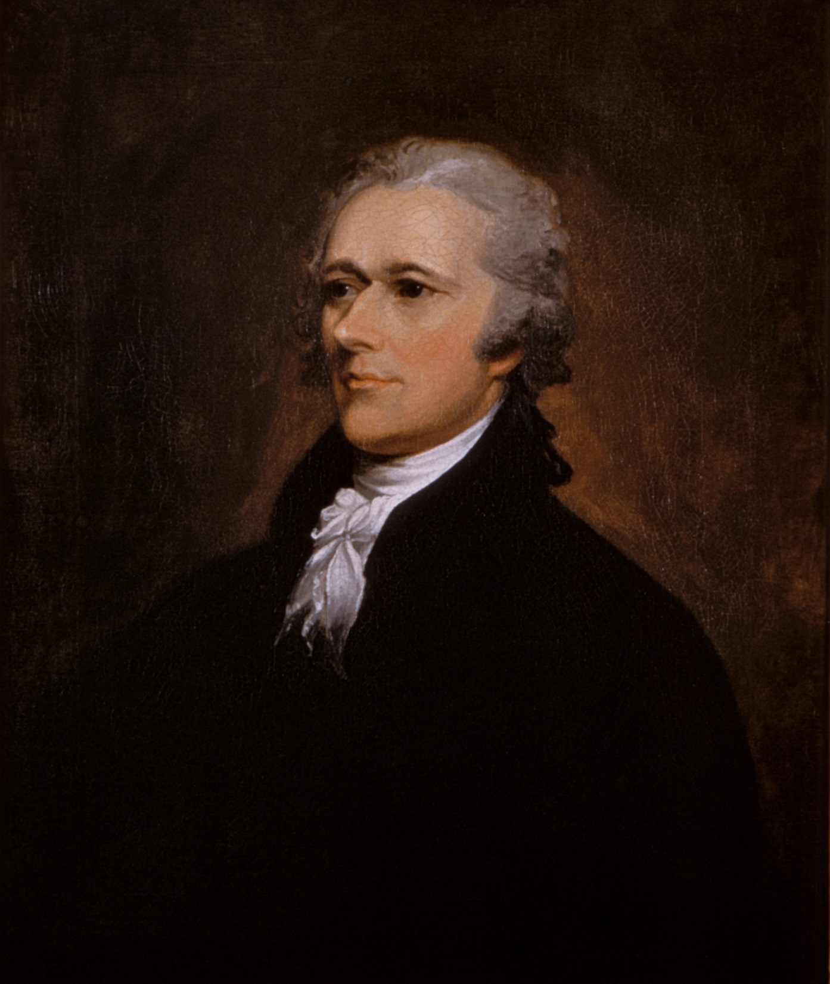

Slide 18
Whiskey Tax and Whiskey Rebellion (1794) – Opposition was strong in Western PA because it was easier to ship Whiskey than the grain and with hard money scarce, Whiskey was a medium of exchange. Hence, many viewed it as a tax on money! Violators were to stand trial in federal court. The nearest to Pittsburgh was Philadelphia, 350 miles by rough road! Later Congress permitted state Courts to hold the trials.

Slide 19
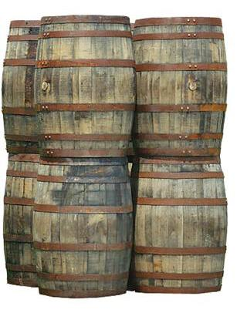

Slide 20
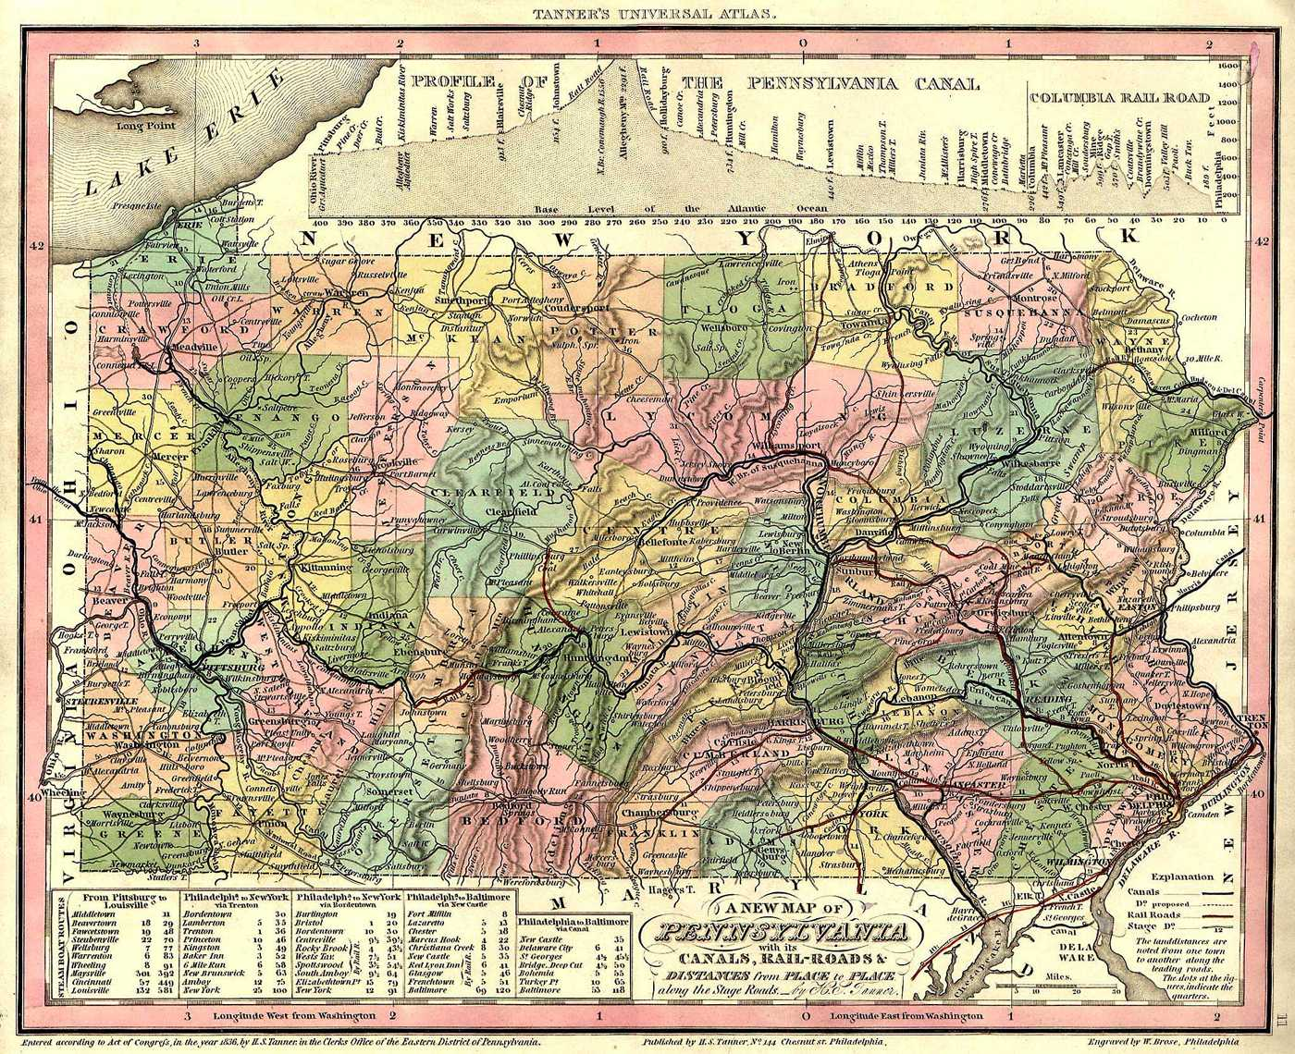

Slide 21
    Uprising in July, 1794 when federal marshals came to WPA
    with arrest warrants. A 13,000 man militia organized in
    August, 1794 to put down the “Whiskey Insurrection”.
    Hamilton rode west with the troops and Washington came out to
    Carlisle, PA to inspect. No organized opposition. About 100
    men rounded up, 2 convicted of Treason and sentenced to
    death, but Washington eventually pardoned them. Irony
    was that the cost of collection > receipts, especially by 1794.

Slide 22
    Excise Taxes on Salt, Coal, Boots, Shoes, etc.,
    used to pay Interest on Debt
    Hamilton's Policies Favored New England and
    Coastal Cities at Expense of Interior Farmers

Slide 23
  Tariffs (passed 1789)
    1789 - 1860 Over 90% of U.S. Government
    Revenue From Tariffs
    A Tariff is a Tax Paid by Consumers on
    Imported Goods

