Slide 1
Topic 1. Part 5.
The Political-Economy of Financial Panics and Bankruptcy 1789-1819

Slide 2
Financial Panics or Crises -- Include a variety of situations in which some financial assets suddenly lose a large part of their nominal value. Main Types:
Banking Crisis
Speculative Bubbles
International Crises

Slide 3
  Bank Run
  With Fractional Reserve Banking in the 18th and 19th Centuries, if too many depositors showed up and demanded their deposits back in specie, then banks with insufficient reserves and few liquid assets could not pay all their depositors and they collapsed.

Slide 4
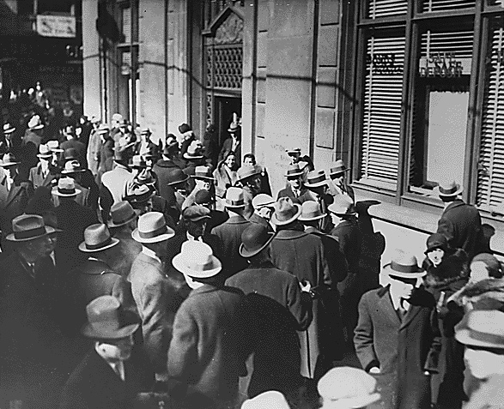

Slide 5
  Banking panic
  A banking panic is a financial crisis that occurs when many banks suffer runs at the same time, as a cascading failure (USA 1933).

Slide 6
Speculative Bubbles
A speculative bubble exists in the event of large,
sustained overpricing of some class of assets. One
factor that frequently contributes to a bubble is
the presence of buyers who purchase an asset based
solely on the expectation that they can later resell it
at a higher price, rather than calculating its Expected Value (the income it will generate in the future) (USA Stock market 1927-29; Housing 2001-2007).

Slide 7
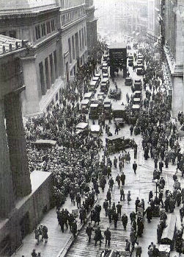

Slide 8
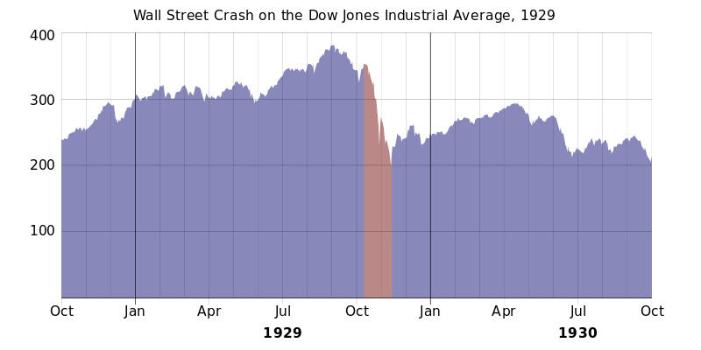

Slide 9
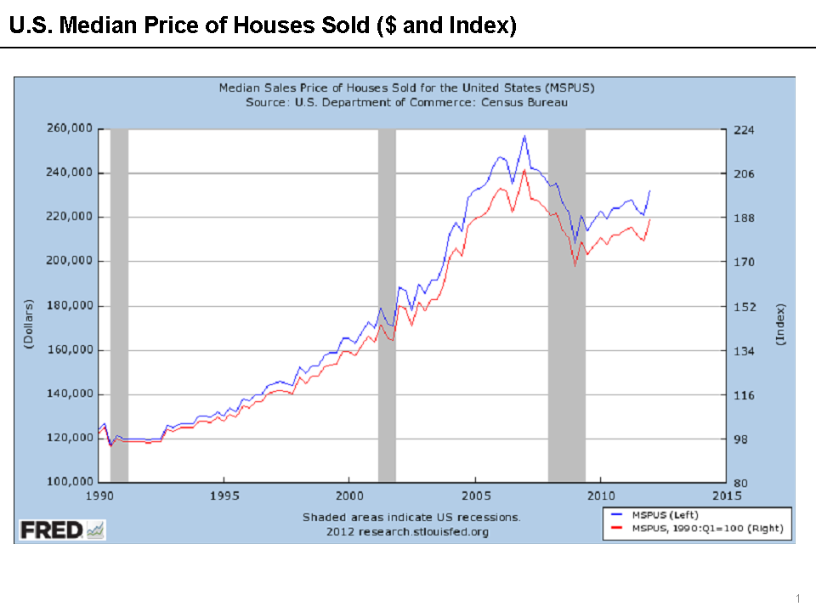

Slide 10
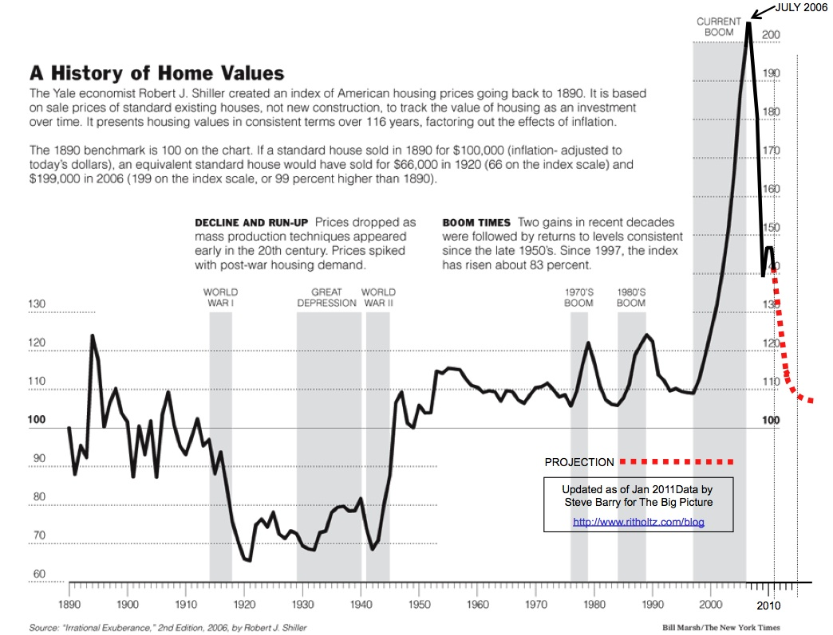

Slide 11
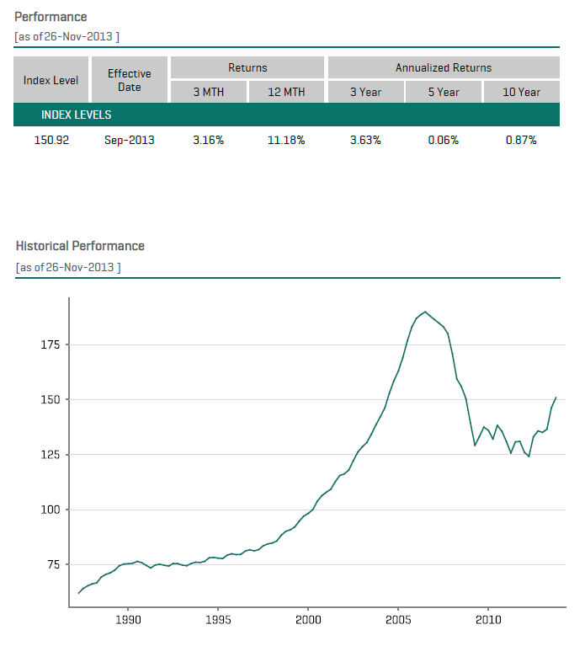

Slide 12
International Crises
Examples: A country that maintains a fixed exchange rate is forced to devalue its currency due to a speculative attack (this is how George Soros made a lot of money when he shorted the English Pound – That is, Soros bet that the £ would fall in value against other currencies.)
A country fails to pay back its sovereign debt and defaults (this is pretty common – Argentina is in default now).

Slide 13
The Panic of 1791-1792
Hamilton’s debt securities were so successful that the market price for the bonds kept going up. In late 1791 William Duer (a friend of Hamilton’s) raised large sums of money from friends and investors to buy up as many of the 6% Government Bonds as possible and also to start new banks.

Slide 14
By late January of 1792 the US Government and Private Bank securities peaked and began to fall precipitately. This bankrupted Duer and he ended up in Prison.
Hamilton shrewdly had brokers quietly buy up the Government Securities at reasonable prices and thereby stopped the panic and stabilized the markets.
For his trouble Hamilton was relentlessly attacked by Madison and Jefferson.

Slide 15
The Panic of 1797 and The Bankruptcy Act of 1800
USA: Land Speculation Schemes. Investors would issue Private Securities based on Western Land Claims (the Land was the collateral). They sold the securities for specie. The idea was to sell the land at a price high enough to pay off the securities and make a profit.
Britain: Specie Outflow due to endless Wars. Result was the Bank Restriction Act of 1797 that halted specie payments. This caused a severe commercial downturn in the port cities of the USA and bankrupted most of the Land Speculators.

Slide 16
The Bankruptcy Act of 1800 was the first federal legislation governing bankruptcy procedures. A result of the depression of 1797, the act provided only for
creditor-initiated proceedings and
applied only to traders, merchants, and brokers.
After receiving petitions from two creditors concerning debts of $1,000, a district court judge could appoint a commission to decide the case.

Slide 17
4) The main provisions of the act allowed the sale of the bankrupt's assets to satisfy creditors, permitted the bankrupt to keep a percentage of his assets, and established that the consent of two-thirds of the creditors could discharge the bankrupt from any unsatisfied indebtedness.
Though enacted as a 5-year measure, prosperity and public dissatisfaction with the act prompted its repeal in 1803.

Slide 18
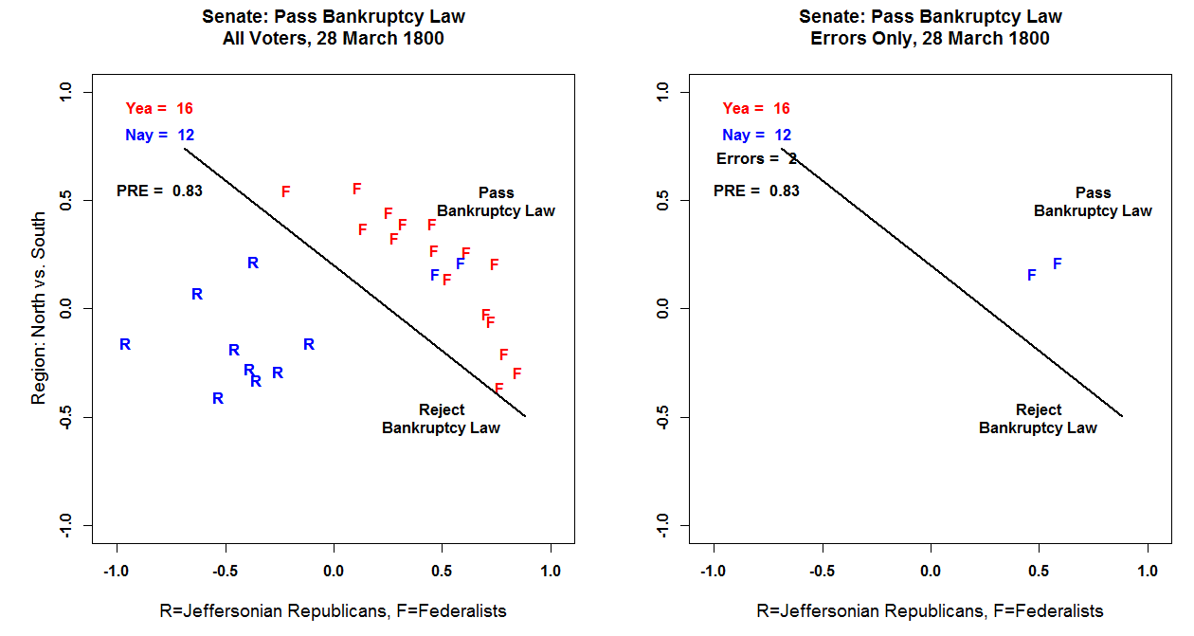

Slide 19
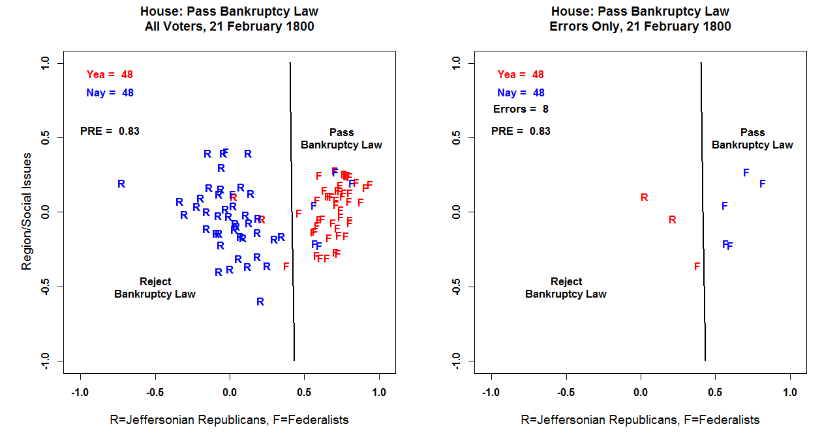

Slide 20
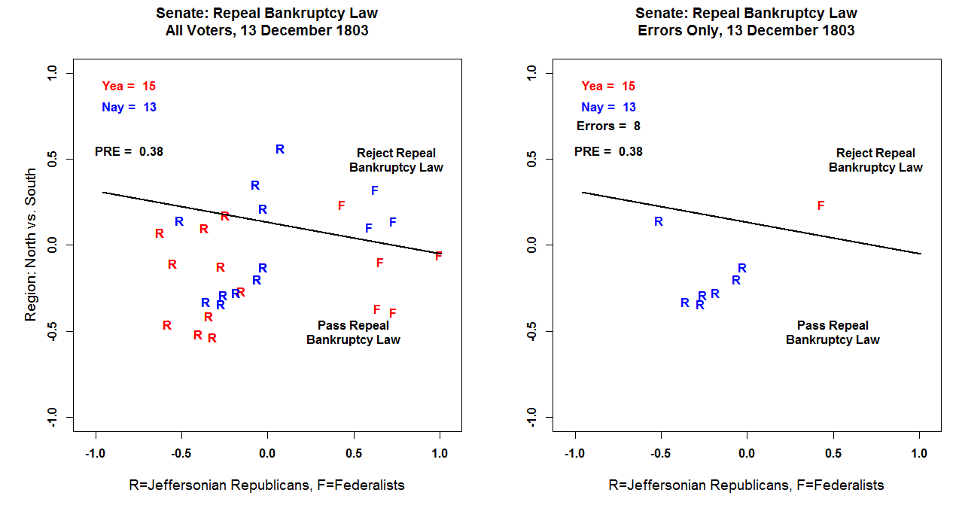

Slide 21
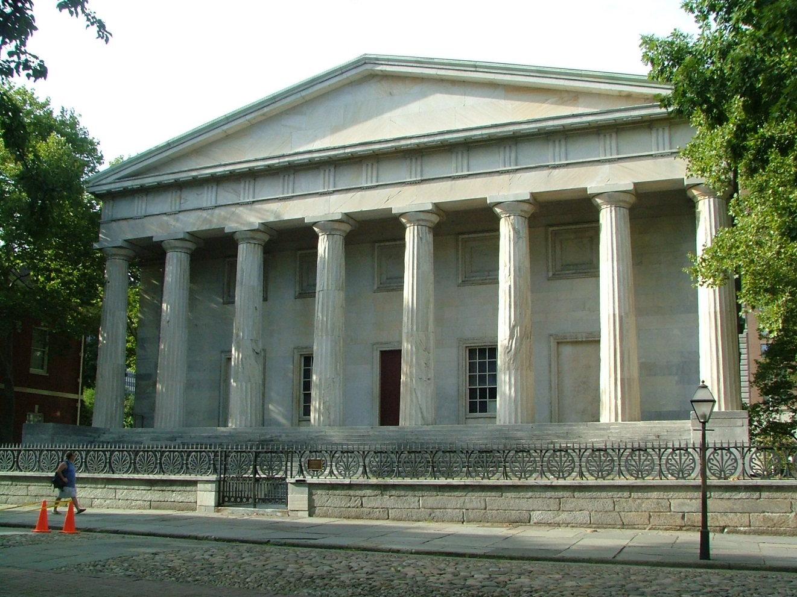
The Panic of 1819
A Land Bubble and Bank Runs

Slide 22
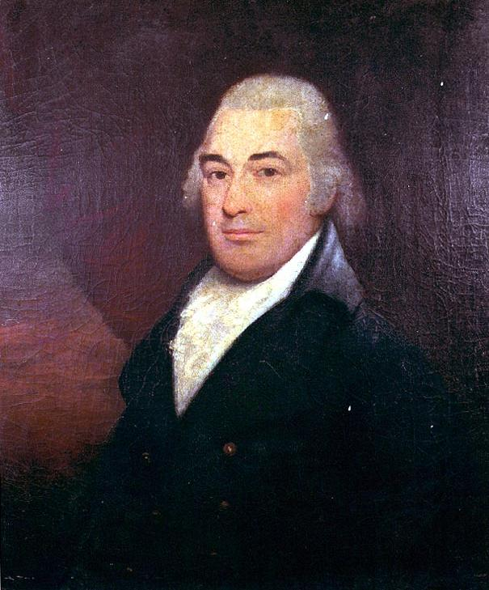
William Jones, First President of the Second Bank of the United States, 1816-1819

Slide 23
The first major American depression, the Panic of 1819 was rooted to some extent in economic problems reaching back to the war of 1812.
The Demise of the First Bank of the United States caused an explosion of State Banks many of whom engaged in uncontrolled land speculation.
During the War of 1812 the Federal Government was forced to turn to these banks for loans. This had the effect of adding to the proliferation of paper money (State Bank notes).

Slide 24
3) This practice tended to shift specie into the more conservative New England banks, depleting the newer “Wildcat” State banks of their hard money reserves.
4) The Federal government had to agree to a suspension of specie payments from state banks in order to prolong the wartime lending.
5) Politically, it was simply not possible to resume specie payments in the war’s aftermath, allowing old and new banks to profitably lend without regard to their metallic currency reserves. The economy was booming with large increases in the population of the “Western” States.

Slide 25
6) Because of the economic difficulties revealed by the War of 1812 – lack of transportation infrastructure, manufacturing, uncontrolled banking – leading merchants and financiers, Stephen Girard, John Jacob Astor, David Parish – along with major Jeffersonian political leaders John C. Calhoun, Henry Clay, and James Monroe advocated re-establishing the Bank of the United States. A bill was proposed in January 1816 and signed by President Madison in April 1816.

Slide 26
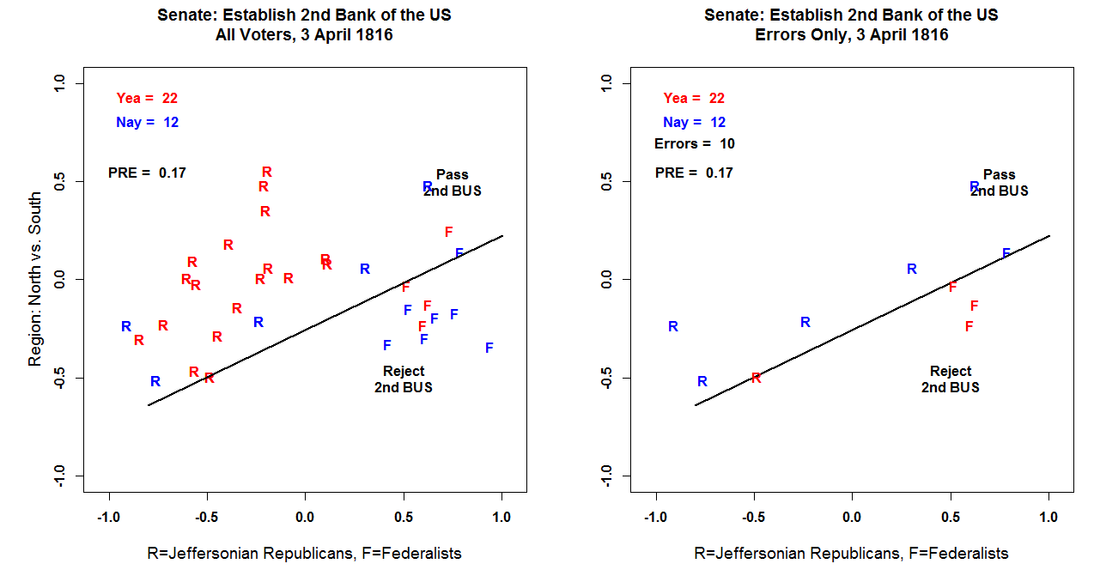

Slide 27
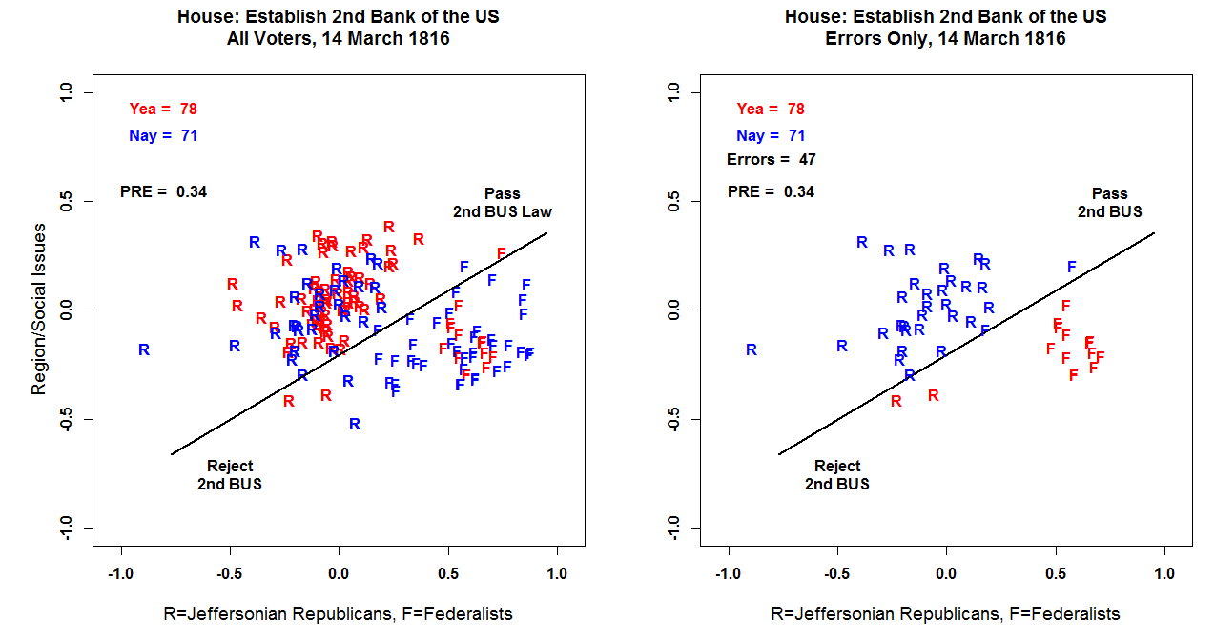

Slide 28
7) Under its charter guidelines, the BUS was expected to acquire species totaling $28 million by the time it opened for business; but with only $2 million secured when it commenced operations, the Bank was compelled to purchase species at usurious rates from the London financial markets in 1817 and 1818, overburdening BUS credit. In addition by 20 February 1817 the Bank was supposed to resume Convertibility – that is a return to specie banking of BUS notes. This was delayed for political reasons.

Slide 29
8) The 18 branch offices of the BUS in 1817 operated with little oversight from the Philadelphia headquarters, nor from the US Treasury. Indeed, they poured gasoline on the fire by flooding the West with BUS issued notes. This had the effect of draining even more specie from the well run State Banks and some of the BUS branches in the Northeast. By July 1818, the Second Bank of the United States had demand liabilities exceeding $22.4 million, whereas its species fund stood at $2.4 million. This was simply unsustainable.

Slide 30
9) The Dam broke in August 1818 when William Jones ordered BUS branch offices to reject all state-chartered bank notes, with the exception of those used as revenue payments to the US Treasury. In October 1818, The US Treasury demanded a transfer of $2 million in species from the BUS to redeem bonds on the Louisiana Purchase.

Slide 31
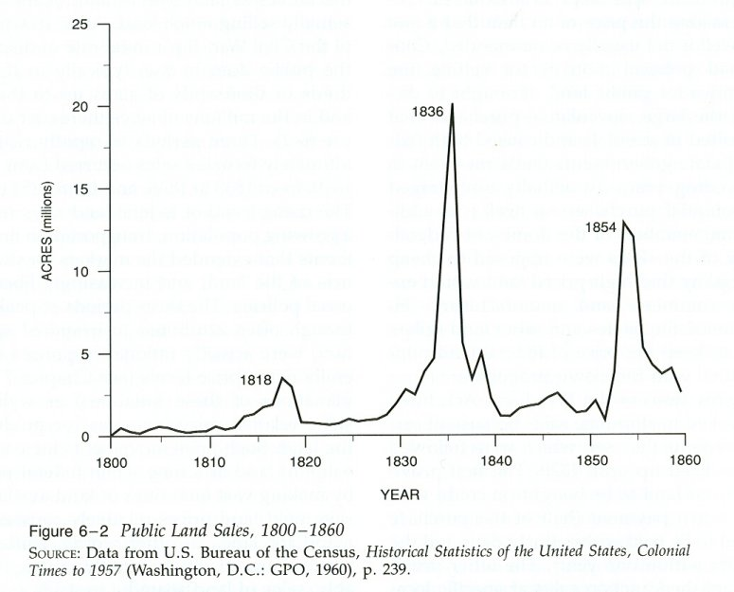

Slide 32
10) State banks in the West and South, unable to provide the required specie, began to call in their loans on the heavily mortgaged lands they had financed. Cash poor farmers and speculators found their land values dropping 50% to 75%. Banks began foreclosing on the properties and transferring them to their creditor: the Second Bank of the United States. Adding to the problem was the fall in the price of Cotton on the London exchanges. The combination of these events produced the Panic of 1819 and plunged the USA into a Depression.

Slide 33
11) In 1819 Langdon Cheves was elected President of the BUS, and during the next three years succeeded in restoring its credit through a rigorous tight money policy. The problem is that it deepened the Depression. Through public land debt relief legislation, Cheves managed to reduce the Bank’s land debt by $6 million within a year of assuming his position as BUS President. By 1821 specie reserves had risen to $8 million by 1821 and bank notes in circulation were reduced by about $23 million within a span of four years from 1816 – 1820.

Slide 34
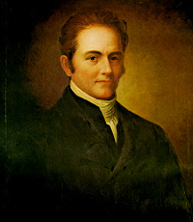
Langdon Cheves: President of the Second Bank of the United States from 1819-1822

Slide 35
