Slide 1
Topic 1. Part 7.
The Political-Economy of Financial Panics and Bankruptcy 1837-1860
Part 2

Slide 2
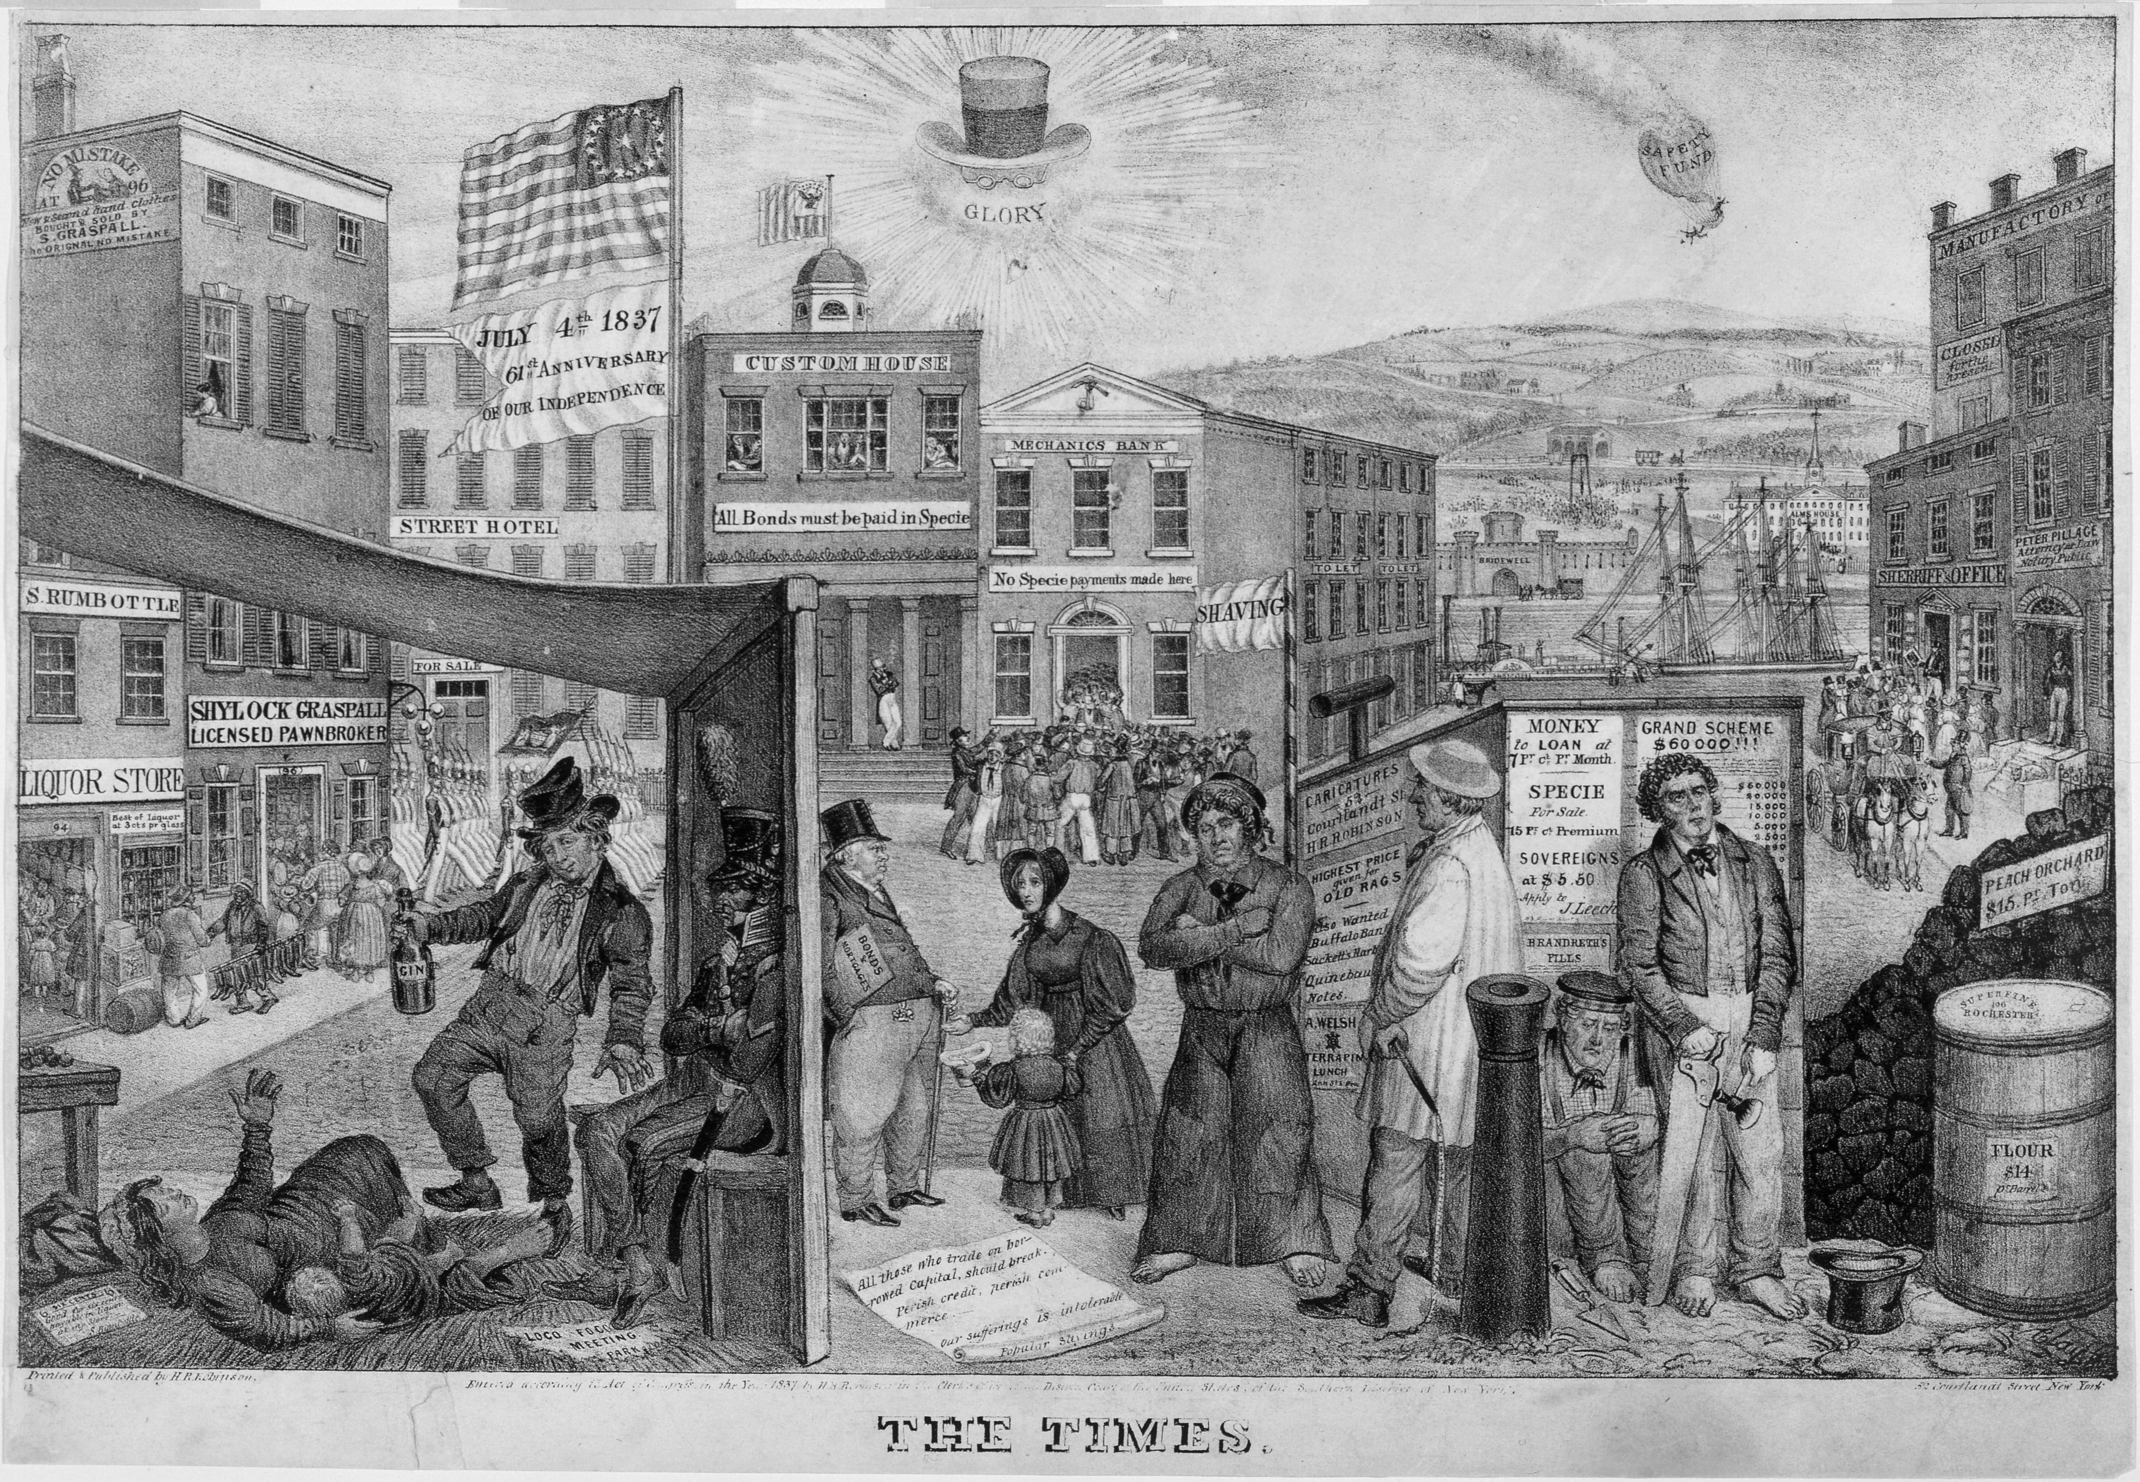
The Bankruptcy Act of 1841

Slide 3
Bankruptcy Act of 1841. This marked the first time debtors were able to voluntarily file for bankruptcy and receive a discharge of their debts. Before this Act, creditors held the keys to bankruptcy as in the 1800 Act.

Slide 4
In addition to discharging (eliminating) the debts of thousands of debtors during its short life, the Bankruptcy Act of 1841 introduced two crucial innovations to American bankruptcy law. The 1800 act had provided only for involuntary bankruptcy—that is, creditors but not debtors (those who owe a debt) could file a bankruptcy petition—and it covered only merchants and traders. The 1841 act was the first law to provide for voluntary as well as involuntary bankruptcy, and it covered all individual debtors, not just merchants and traders.

Slide 5
Berglof and Rosenthal: The Panic of 1837 had resulted in demand for bankruptcy legislation, but bankruptcy proponents, as shown by roll calls in the 26th Congress (1839-1841), were blocked by the Democratic majority. The Whigs made bankruptcy legislation a central issue in the 1840 presidential campaign, which put the Whig candidate William Henry Harrison in the White House and gave the Whigs control of Congress. But this alone was not enough to ensure passage of the act. Almost every Democrat opposed the proposed legislation, as did a small but potentially decisive group of Whigs.

Slide 6
The Whig leadership finally secured passage of the act by agreeing to support a land distribution bill in return for votes for the 1841 act. Warren (1935) [Warren, Charles (1935). Bankruptcy in United States History. Cambridge: Harvard University Press] claims that passage was secured by a logroll engineered by Henry Clay that included distribution of government lands, a high tariff, and a national fiscal bank, with the Bankrupt Bill as a byproduct. If this is the case, a deal had to be made with
Southern Whigs.

Slide 7
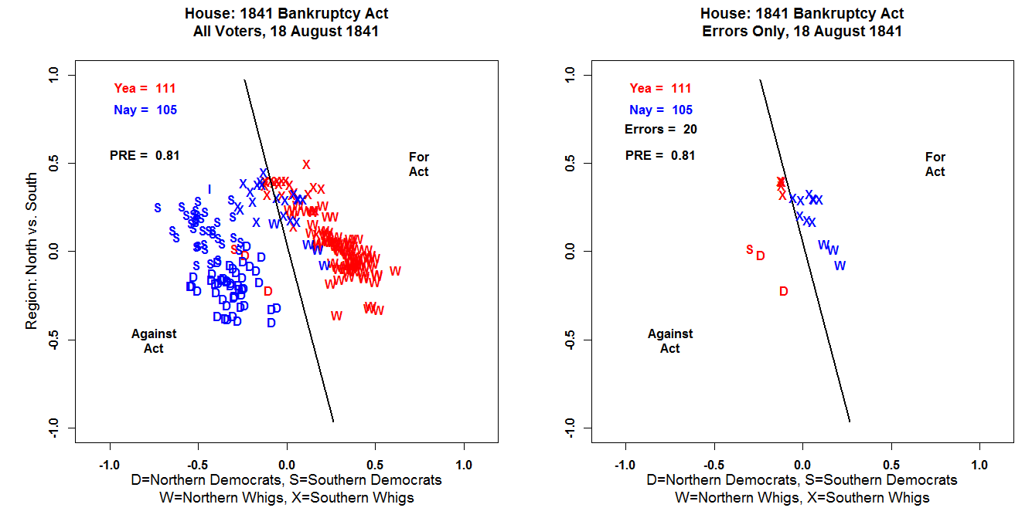

Slide 8
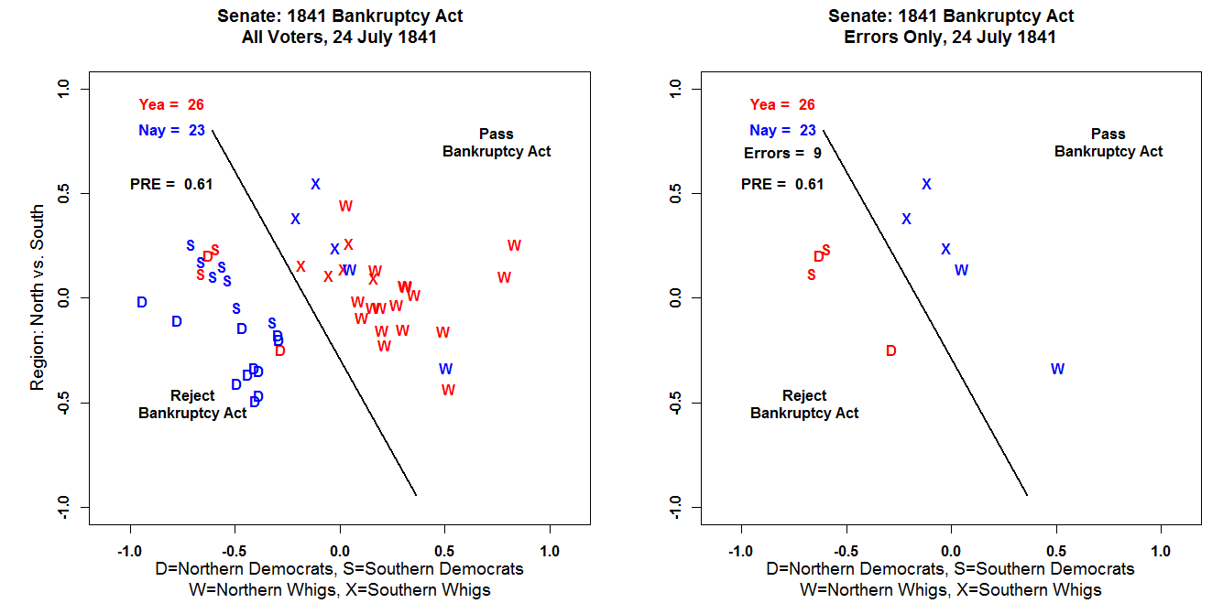

Slide 9
Almost as soon as it came together, the coalition that voted for the 1841 act started to unravel. When a small group of Southern and Midwestern Whigs defected, the 1841 Bankruptcy Act was doomed. John Tyler, who became president when Harrison died shortly after his inauguration, was much less enthusiastic about the legislation than his predecessor. Popular opinion had turned against the law, and Tyler signed the repeal legislation in 1843.

Slide 10
Berglof and Rosenthal: The 27th House votes on bankruptcy reveal that party and region were both significantly related to support for a national bankruptcy law. Northern Whigs represent the core support for legislation, Southern Democrats the core of the opposition. This is basically the same alignment that takes place on major economic issues for the remainder of the 19th century, with the Republicans replacing the Whigs after the Civil War. (See
Poole and Rosenthal, 1993, 1994, for a similar story on votes on railroad regulation between 1874 and 1887.)

Slide 11
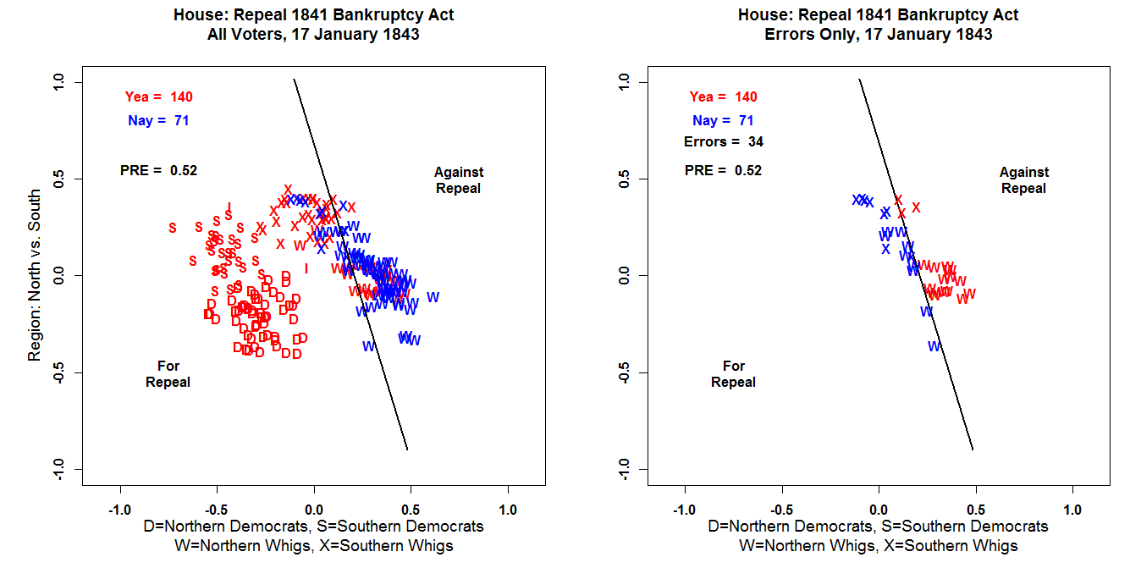

Slide 12
