Slide 1
Topic 2. Part 1.
The Economic Costs of the Civil War

Slide 2
DIMENSIONS OF THE WAR
1) Largest Land Armies assembled in Human history -- by 1863 the North had 1,000,000 men under arms and the South 650,000. 2) Battles involving over 100,000 men were commonplace and some reached 200,000. 3) In one day, nearly 5,000 men were killed at Antietam and 20,000 wounded. It is still the most American soldiers killed in one day. 4) Total Dead: 360,000 North + 258,000 South = 618,000 with at least 500,000 wounded.

Slide 3
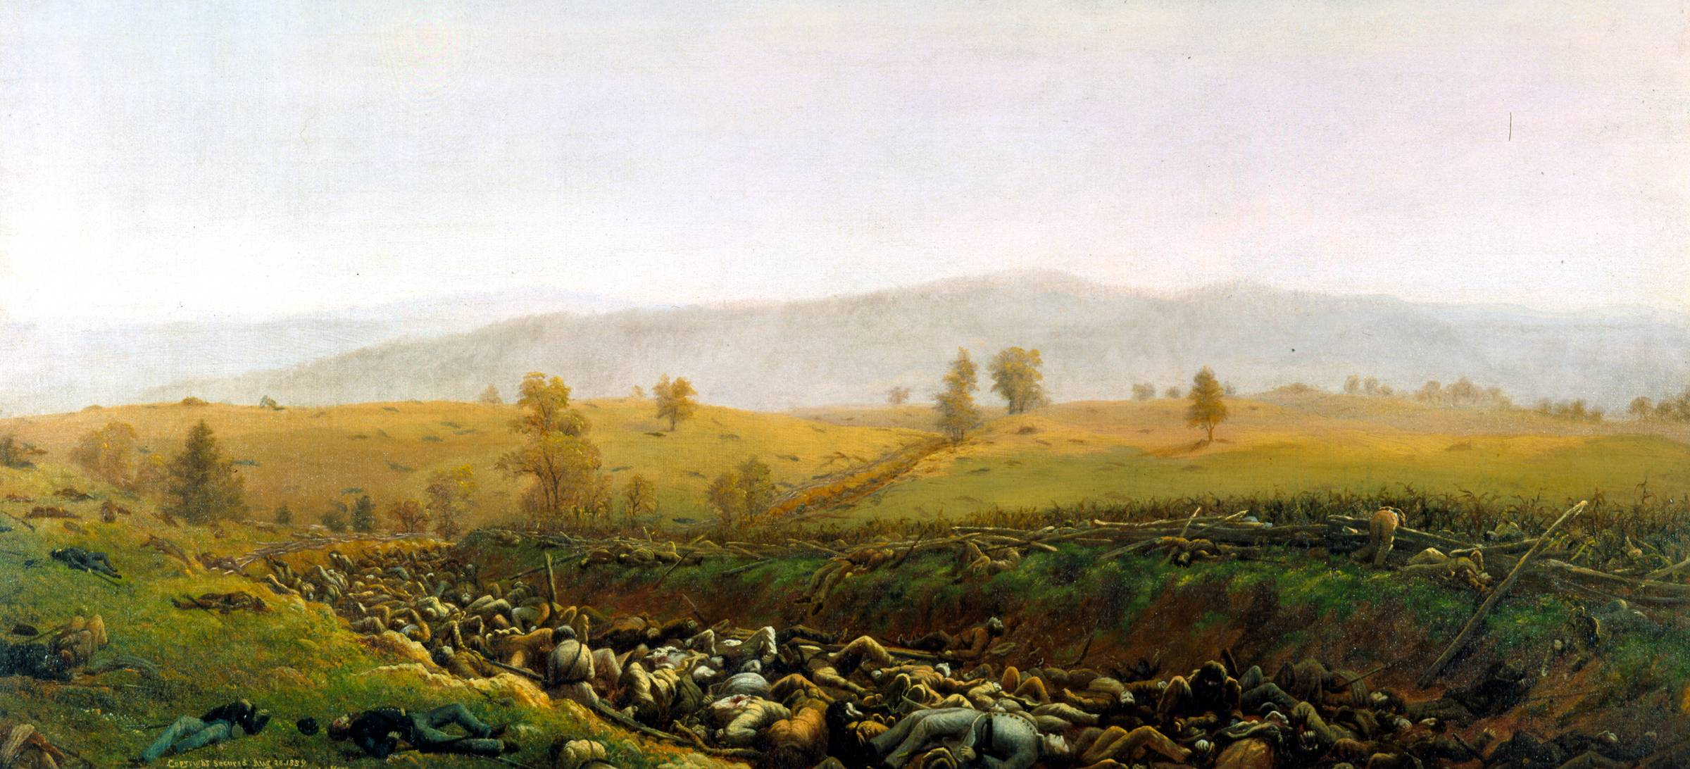
The Aftermath at Bloody Lane by Captain James Hope

Slide 4
Direct Costs of the War for North & South
Direct Cost = All War Spending by Government + Destroyed Physical Capital + Destroyed Human Capital.
Summary of Direct Costs (From Goldin and Lewis)
NORTH SOUTH
Government 2,292 1,011
Draft 11(162,000 men) 20(300,000 men)
Physical Capital Destruction -- 1,487
Human Capital
Destruction: Killed 955 684
: Wounded 365 261
Risk Premiums -256 -178
TOTAL $3.367b $3.285b
GRAND TOTAL $6,652,000,000

Slide 5
Magnitude of Direct Costs: 4 times all government expenditures, 1789 to 1860; 17 times 1860 export earnings; could have purchased all the Slaves at prevailing market prices, given each family 40 acres and a mule, and still have $3.5 billion left over.

Slide 6
Indirect Costs: Hypothetical (consumption if no War) versus actual consumption over time discounted by prevailing interest rate. This shows that the costs for the North were $5.2b and the South $9.5b for a total of $14.7b.

Slide 7
Williamson, 1974, p. 638: “…there seems to be no doubt that the Civil War decade in general, and the war years in particular, were ones of unusually poor growth performance. The period 1866-1870 reflects a resurgence in the North which eventually snowballs into a secular boom in the early 1870's.”
p.651 "...most of the poor capital formation performance during the Civil War decade can be readily explained by federal long term debt issue and the resulting diversion of private savings from capital formation activities."

Slide 8
p.647 Factors restricting growth during Civil War: 1) paper currency; 2) unequal & heavy taxation; 3) limited supply skilled labor; 4) federal long term debt driving down private investment.

Slide 9
How was the War Paid For?
1. Confiscation - Mostly by Southern Military
2. Direct Taxation
a. Tax Present Population Directly - Income taxes, excise taxes, tariffs, the National Bank Acts. In the North, about 20% of the cost of War was paid through direct taxes; about 12% in the South.

Slide 10
b. Tax Future Population - Bonds and Greenbacks In the North, about $2.7b in interest bearing bonds were issued along with $450m in non-interest bearing notes -- the Greenbacks. In the South, about $2b in bonds were issued -- these were repudiated in the 14th Amendment.

Slide 11
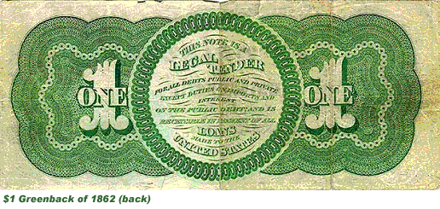
"This note is legal tender for all debts public and private except duties on imports and interest on the public debt and is receivable in payment of all loans made to the United States."

Slide 12
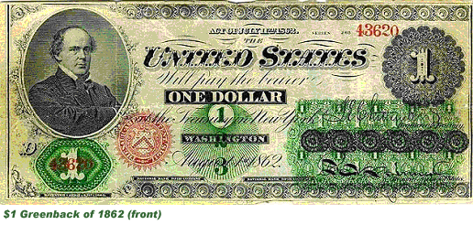
Because of the suspension of convertibility, it was only after resumption, in 1879 (on the basis, effectively, of a gold standard), that the bearer could actually obtain gold--that is, an actual dollar--for the Greenback notes.

Slide 13
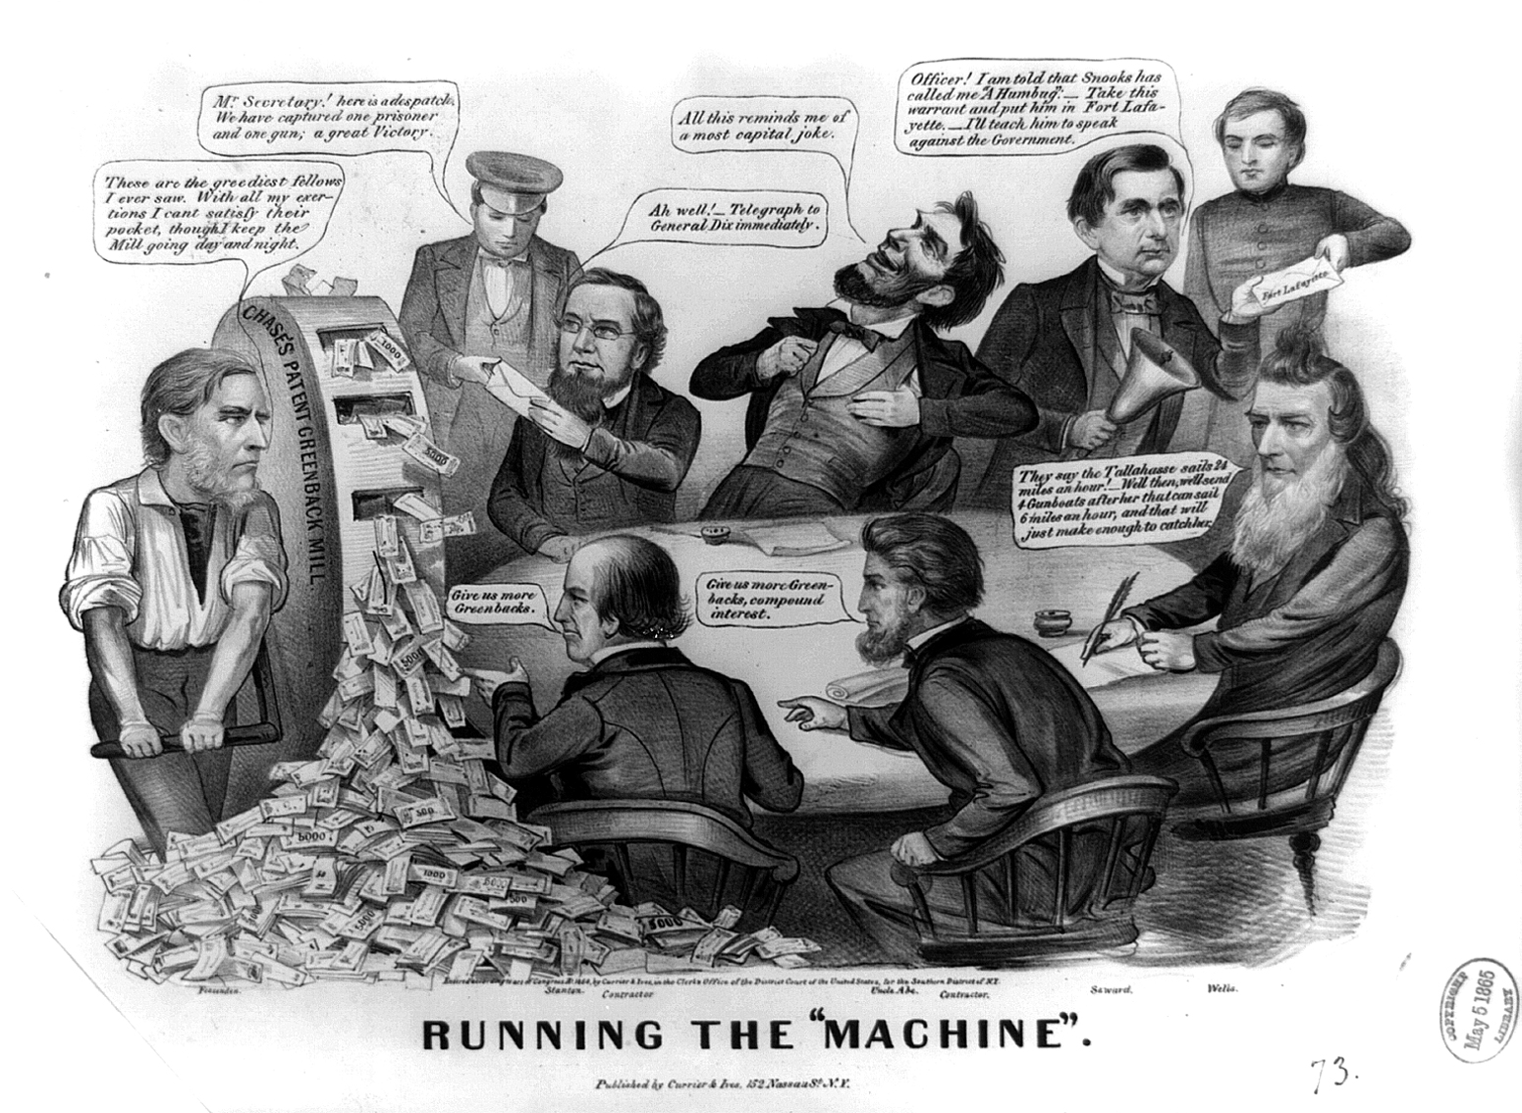

Slide 14
3. Indirect Taxation -- Inflation In the North the money supply went from $442m in 1860 to $1,180m in 1865 but inflation was less than the increase in the money supply (approximately 70%). In the South there was hyper-inflation. Confederate money was practically worthless.

Slide 15
Paying off the Debt
After the War the North left in place the very high tariffs passed during the War. The government ran surpluses nearly every year into the 1890s and the debt quickly declined. Indeed, there were political problems with calling in the Greenbacks too fast because there was a persistent deflation from the end of the War into the mid-1890s and many favored inflation.

Slide 16
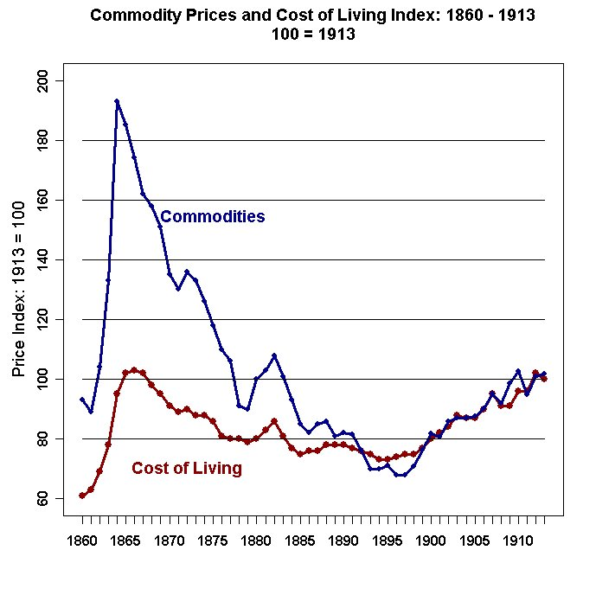

Slide 17
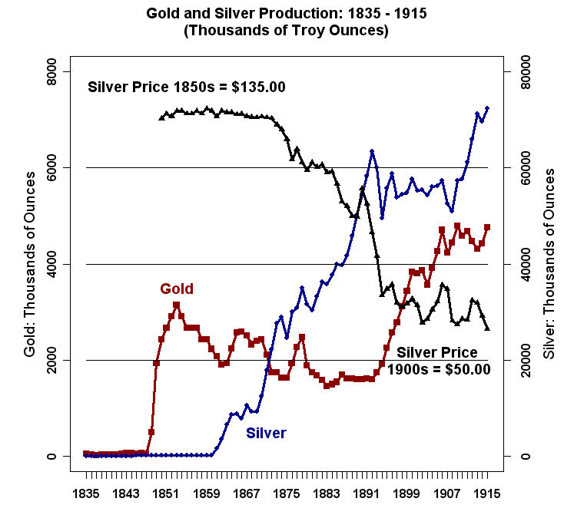

Slide 18
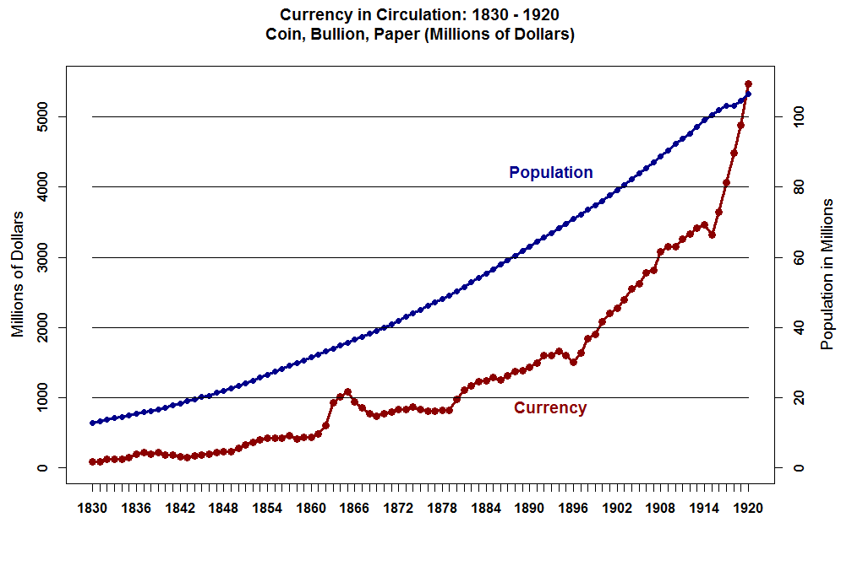

Slide 19
The National Bank Acts of 1863, 1864, and 1865 In 1860 there were about 1500 State Banks that circulated their promissory notes which were used as money (state bank notes).
This system was not adequate to finance the Northern War effort. The Response was the 1863 National Bank Act.

Slide 20
Sylla, 1969, p.658-659: “In the early 1850's incorporated banking was prohibited in a number of states and territories, either by the laws or by the sentiments of state legislatures.” … “free banking laws were a response to popular revulsion at the frequent corruption involved in older chartering procedures in which politicians accepted bribes or political favors from interested parties in return for allowing the establishment of new bank…” …

Slide 21
“Free banking laws made the chartering of banks an administrative rather than legislative function of state governments. The Federal banking laws of 1863 and 1864 which established the National Banking System were modeled on state free-banking laws, especially the New York law of 1838, and in a nominal sense they represented the extension of free banking to the entire country.”

Slide 22
The Aim of the National Bank Acts of 1863, 1864, and 1865, was to "nationalize" the State Banks and "force-feed" them federal securities thereby vacuuming up as much specie in the North as possible.
State Banks were to be re-chartered by the Federal Government.
Stiff Reserve Requirements ($50,000.00 [6000 or less pop], $100,000.00 [6000 – 50,000 pop], $200,000 [more than 50,000 pop])
Required 1/3 of Reserves be Invested in U.S. Bonds by Comptroller of the Currency.

Slide 23
U.S. Notes Issued to Banks at 90% of face value of Bonds.
Notes Made Legal Tender.
7. The 1864 Act levied a 2% Tax on State Bank Notes
and the 1865 Act increased the tax to 10% on State Bank Notes to Drive Them from Circulation.

Slide 24
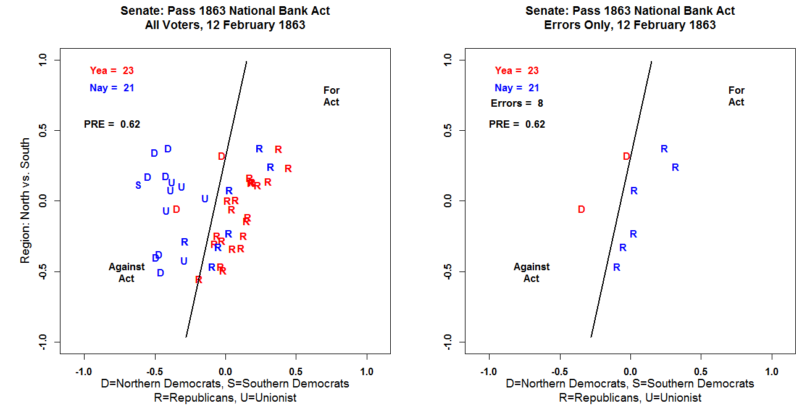

Slide 25
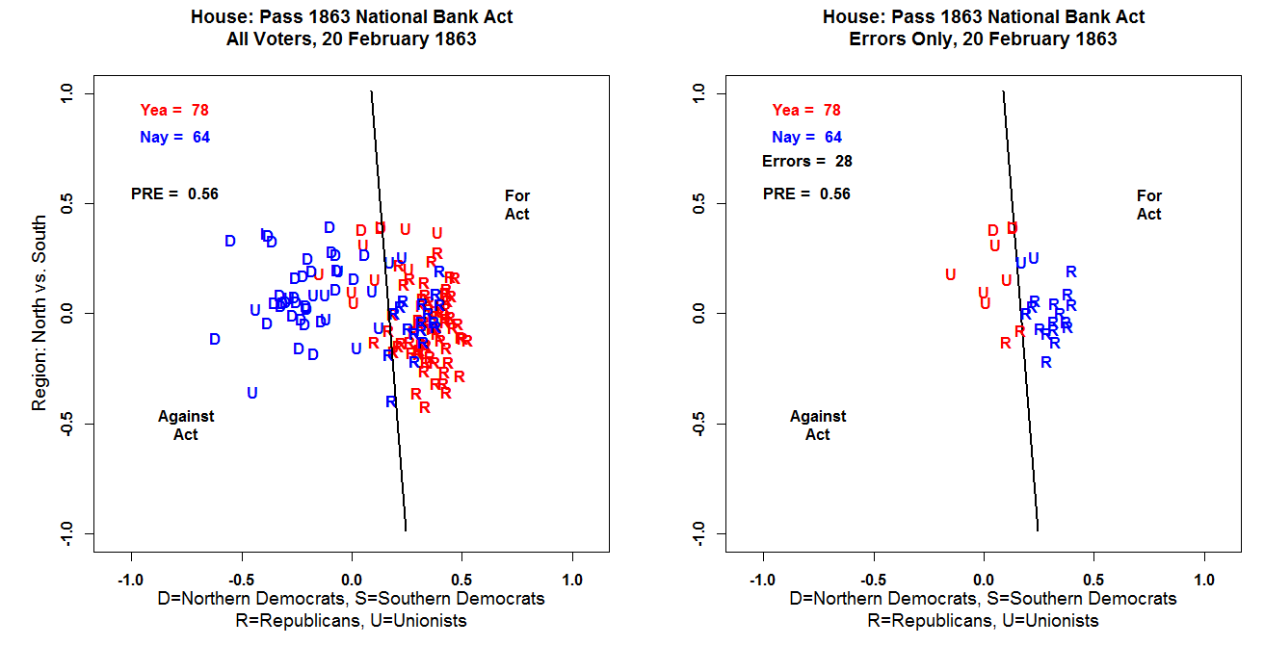

Slide 26
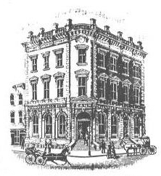
The First National Bank in Davenport, Iowa was the first bank in the country to open under the 1863 National Banking Act.

Slide 27
Disadvantages of Non-National Banks
Sylla (1969, p. 663): “This tax [1865 10% Tax] effectively removed the profitability of state bank note issue and once it was legislated the great majority of state banks did convert. The haste with which state banks took out national charters testifies to the central importance of note issue as a banking function at the time.”

Slide 28
Sylla (1969, p. 661): “…national bank capital requirements constituted a serious entry barrier … in many places -- especially small, agricultural communities -- the amount of deposits a bank could attract was not sufficient to allow the bank to earn a profit on $50,000 of bank capital equal to what could be earned on $50,000 employed in other uses.”

Slide 29
Advantages of Non-National Banks
Low Capital Requirements
Could Make Mortgage Loans (National Banks could not make Mortgage Loans).
Lax Local Regulation.
Ceiling on Total U.S. Note Issue Prevented Many State Banks From Switching when it would have been profitable.

Slide 30
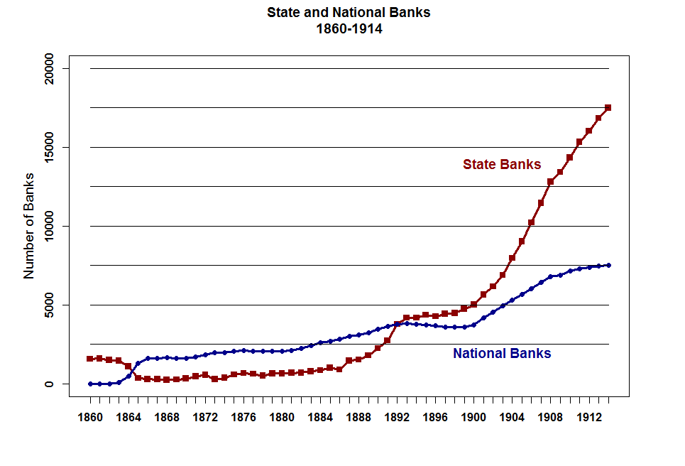

Slide 31
Why Did Non-National Banks Make a Huge Comeback? Demand Deposits!
1. Someone Hit upon the idea of making loans via individual Bills of Exchange -- Checks!
Instead of receiving a stack of Bank Notes in exchange for an IOU plus collateral, the borrower is given a checkbook!

Slide 32
A check is a Bill of Exchange -- When you write a check you are issuing an order (you are the principal) to your agent (the bank) to pay a third party.
Provided Business and individuals accepted the checks, they are money!

Slide 33
Davis (1965, p. 389): “Of all six regions, the South almost certainly had the poorest commercial banking facilities. The region was slow to adopt free banking, and what banks there were (dominated by the political and social elite) were not very competitive. Nor did the region receive much help from the National Banking Act. Since the region was almost un-represented in Congress when the Act was passed, the law was not well suited for the region's needs.”

Slide 34
“In particular, both the minimum capital requirements (too high for small agricultural banks) and the distribution of bank-note quotas discriminated against the region. Thus in 1870, when there were 1600 national banks, fewer than one hundred were in the South.”

