Slide 1
Topic 2. Part 3.
Post-Civil War Financial Panics: The Panic of 1893

Slide 2
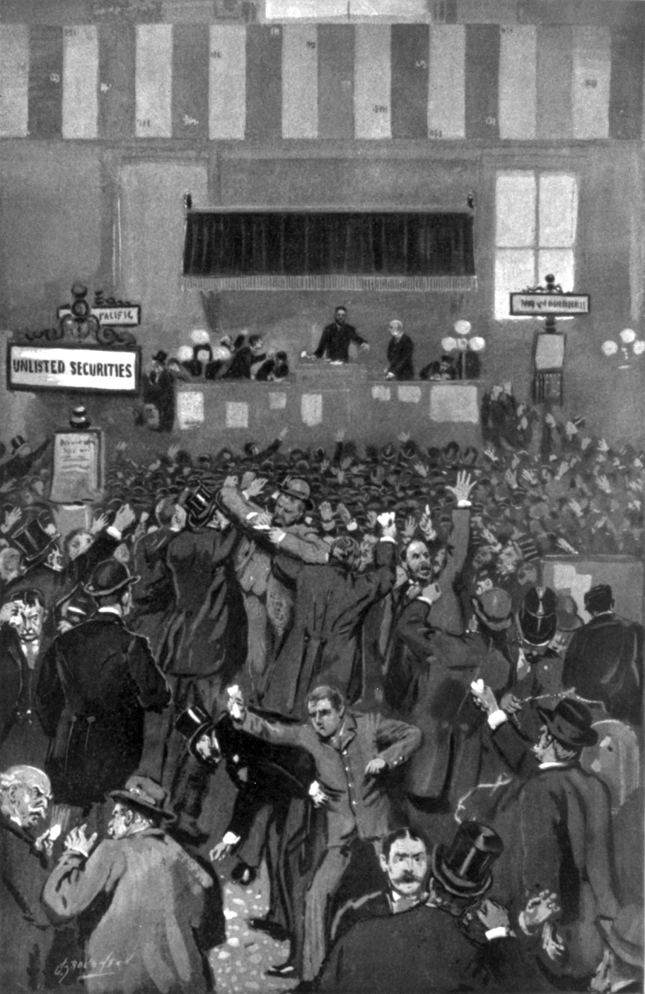
A Bubble in US Railroad Construction, a run on Gold, Bank Runs, and an International Crisis

Slide 3
Baring Brothers had been encouraging investment in Argentina. However, a failure in the wheat crop and a coup in Buenos Aires ended further investments. This shock started a run on gold in the U.S. Treasury, as investors were cashing in their investments.
The booming USA economy was generating an outflow of gold due to trade deficits.
Then on 23 February 1893, the Philadelphia and Reading Railroad went bankrupt.

Slide 4
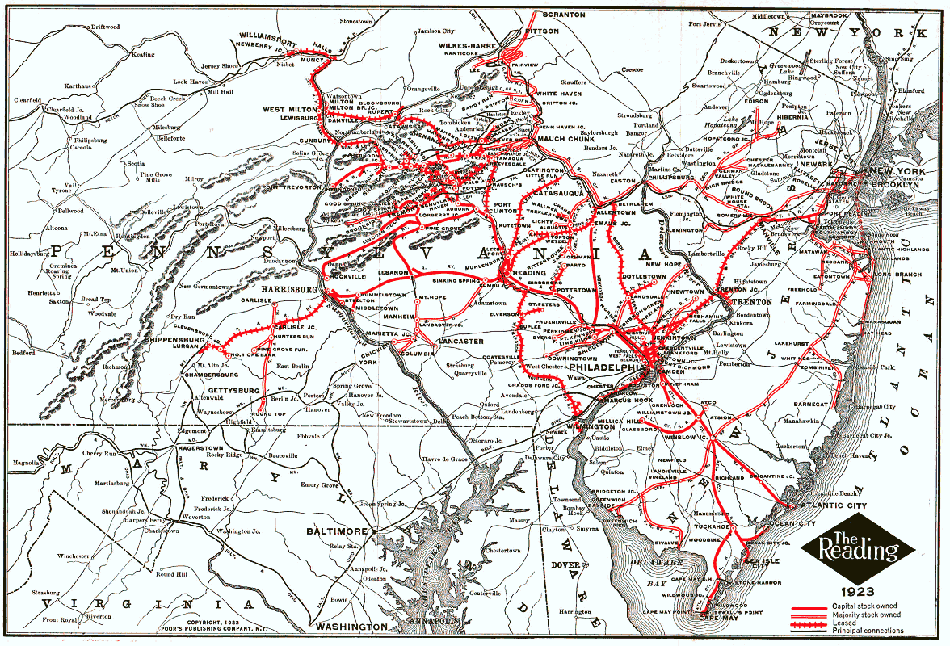

Slide 5
In early May 1893 the New York stock market dropped sharply, and in late June panic selling caused the stock market to crash.
A severe credit crisis resulted, and more than 16,000 businesses had failed by the end of 1893. Included in the failed businesses were 156 railroads and nearly 500 banks.
Unemployment spread until about 13-18% were unemployed.
The depression caused by the Panic of 1893 lasted for about four years, ending in 1896.

Slide 7
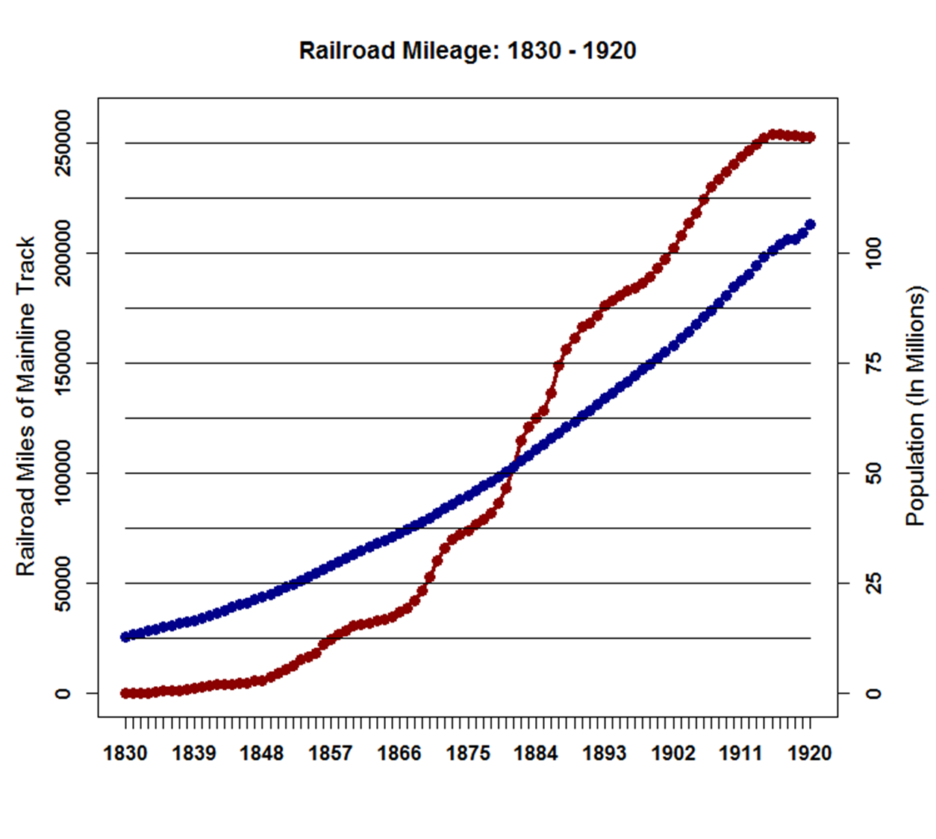

Slide 8
  Newly Reelected President Cleveland had to move quickly to stop the outflow of gold before the USA went bankrupt. This meant repealing the Sherman Silver Purchase Act of 1890.

Slide 9
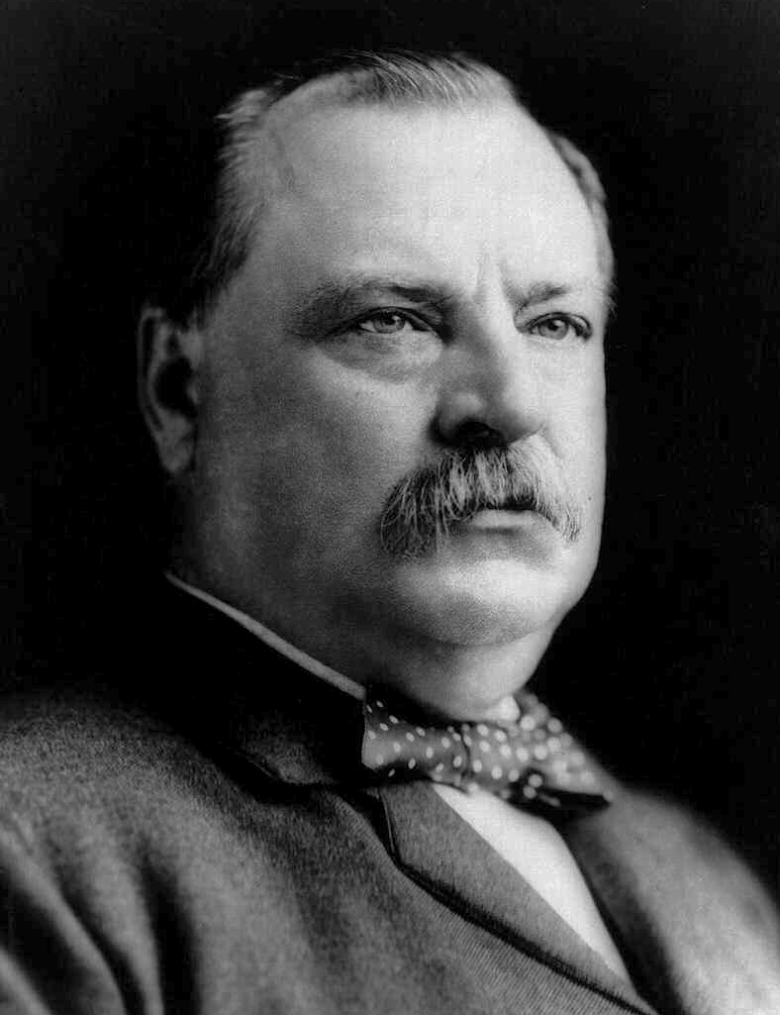
President Grover Cleveland
March 4, 1885 – March 4, 1889 and March 4, 1893 – March 4, 1897
18 March 1837 – 24 June 1908

Slide 10
  The Act obligated the Treasury to purchase 4.5m ounces of silver per month (essentially the entire output of the silver mines). The silver bullion was paid for with U.S. Notes. The Notes were redeemable in either gold or silver coin. Because the price of silver was falling relative to gold, the arbitrage opportunity was too good to pass up: Sell silver to get the notes; cash the notes for gold; use gold to buy silver; etc.

Slide 11
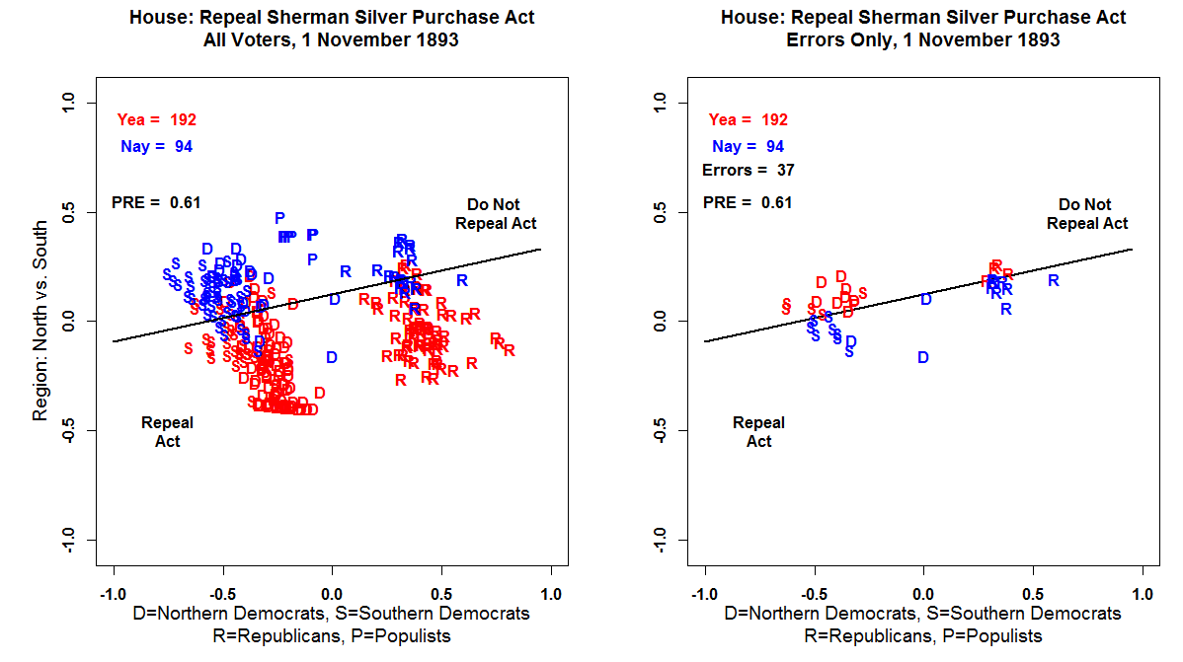

Slide 12
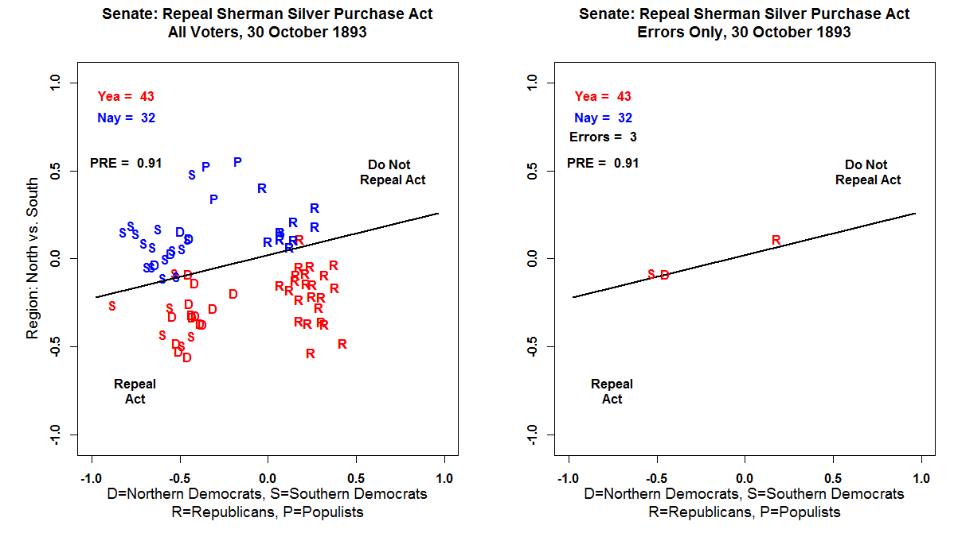

Slide 13
The Repeal of the Sherman Silver Purchase Act was not enough to stop the run on the USA Gold Supply. Investors, both foreign and domestic, unloaded their USA Treasury notes in exchange for gold. By February, 1894, Gold Reserves were only $65.7 million.
President Cleveland was forced to borrow $65 million in Gold from the Morgan and Belmont banking syndicate on terms unfavorable to the Government (which is not surprising given the circumstances).

Slide 14
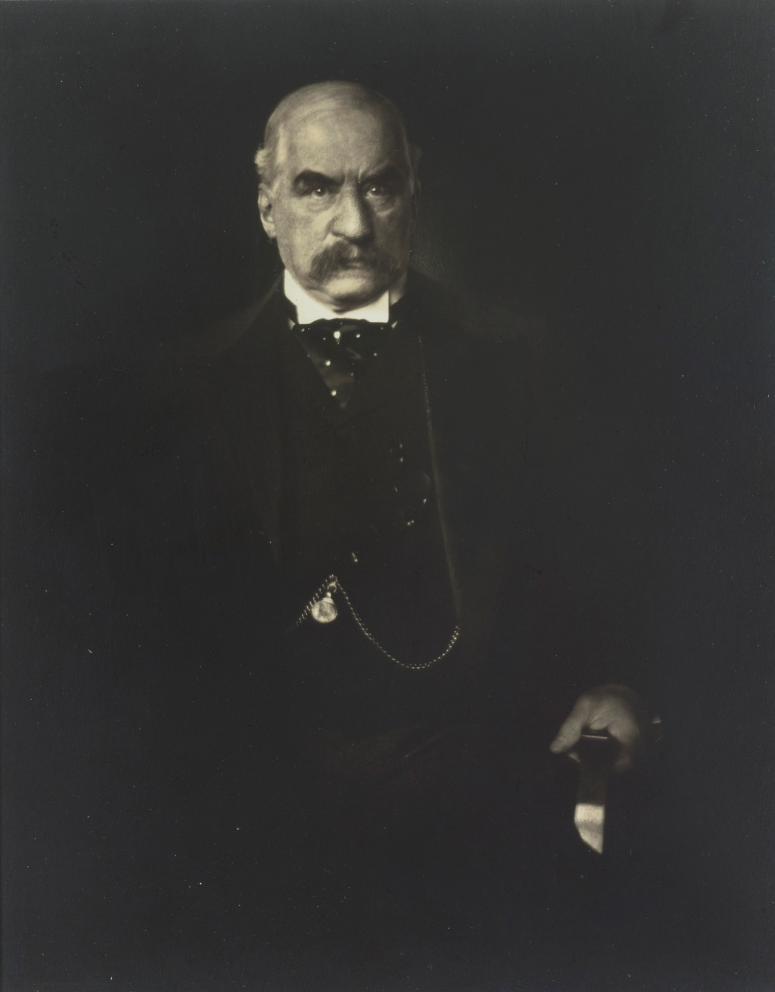
John Pierpont Morgan
17 April 1837 – 31 March 1913

Slide 15
This was politically unpopular but it did slow down the outflow of Gold enough so that the US Government was able to float a Bond issue of $128 million in February, 1896. That ended the Gold crisis.
Beginning in 1896 the development of the cyanide leaching process and discoveries of gold in the Yukon, South Africa, and Australia produced a sharp increase in the world-wide supply of gold and by 1897 The US economy began a decade long boom.

Slide 17
Presidential Elections: 1864 - 1896
Democrat Republican
---------------------------------------------------------------------------
1864 McClellan 21 1,836,072 44.91 Lincoln 212 2,220,846 55.08*
1868 Seymour 80 2,708,744 47.29 Grant 214 3,013,650 52.70*
1872 Greeley --- 2,835,315 43.82 Grant 286 3,598,468 55.63*
1876 Tilden 184 4,288,191 51.01* Hayes 185 4,033,497 47.87
1880 Hancock 155 4,445,526 48.21 Garfield 214 4,453,611 48.31
1884 Cleveland 219 4,915,586 48.49 Blaine 182 4,852,916 48.26
1888 Cleveland 168 5,539,118 48.68 Harrison 233 5,449,825 47.79
1892 Cleveland 277 5,554,617 46.07 Harrison 145 5,186,793 42.92
1896 Bryan 176 6,370,897 46.70 McKinley 271 7,105,144 51.02*
---------------------------------------------------------------------------

Slide 18
The Bankruptcy Act of 1898
Berglof and Rosenthal (p. 47): “The [1898] Act, as pointed out earlier, followed the usual nineteenth century pattern. A severe Panic in 1893, followed by the absence of legislation until Republicans get complete control of the executive and legislative branches, following the election of McKinley in 1896.”

Slide 19
The Act, which included a total of 38 rules, was the first Act of its kind to protect corporations from creditors. If a corporation felt that it was slipping into debt the Act presented the option of “equity receivership' to protect their assets. Corporations also had the option of complete liquidation of assets to avoid bankruptcy.

Slide 20
The 1898 act further established a bankruptcy referee to be appointed by the state judge. The responsibilities of the referee included attended all hearings and making decisions on any contested evidence. The referees worked to alleviate the work load of circuit judges so that they may attend to other matters.

Slide 21
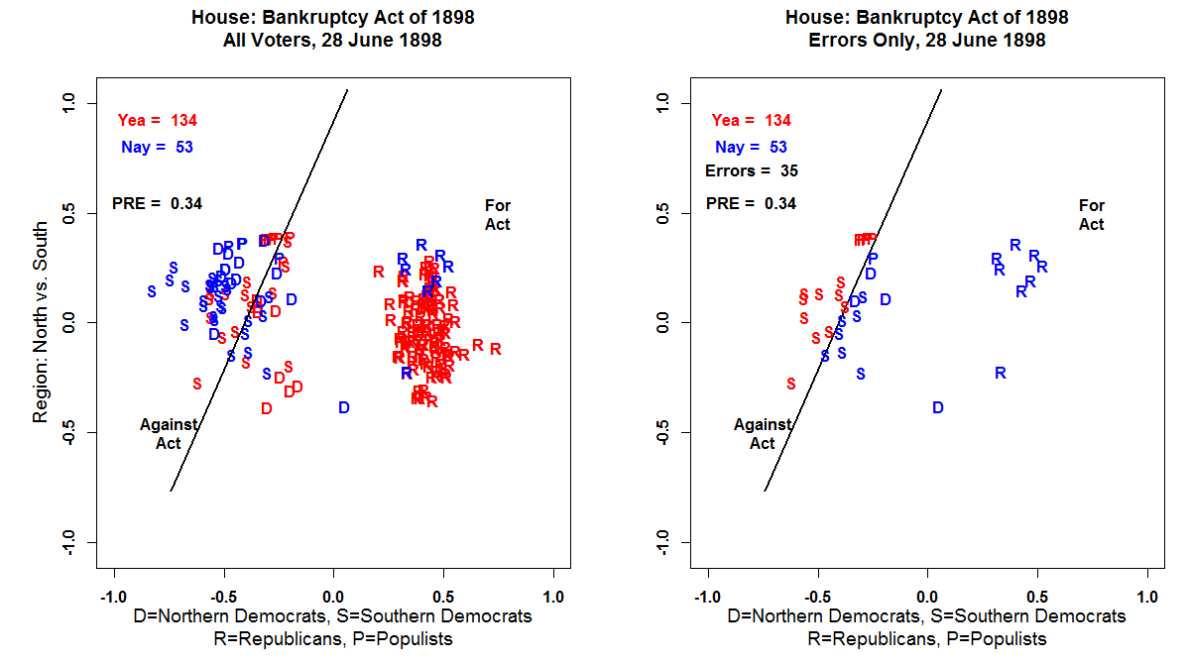

Slide 22
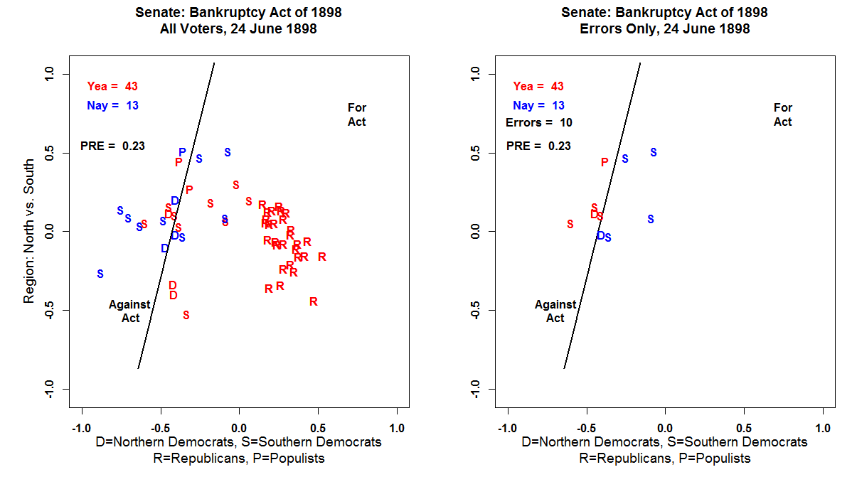

Slide 23
Unlike the 1841 Bankruptcy Act Passed by the Whigs, Why did the 1898 Act passed by their Conservative Descendants stick? Primarily because the Republicans Dominated Congress until 1910.

Slide 26
Berglof and Rosenthal (p.50): “Why did the 1898 legislation achieve stability? Skeel (2001) argues that the Act created entrenched interests in both the bankruptcy bar and bankruptcy judges (referees before 1973) who sought to maintain and expand the scope of bankruptcy proceedings. He also emphasizes the influence of committee jurisdictions within Congress, with Judiciary not wanting to surrender turf.”

