Slide 1
Topic 5.
The Crisis of 2008

Slide 2
1. Securitization, plus … 2. Huge World Capital Surplus produced … The Shadow Banking System

Slide 3
When the Housing Bubble Popped it triggered a classic Bank Run. Only it was a Run on the Shadow Banking System. This Brought the Economy Down.

Slide 4
THE BUBBLE POPS
A “Tipping Point” was inevitable. Lower and Lower quality securitized products – SUB-PRIME MORTGAGES – were being drawn into the system. IF YOU DO NOT THINK THE COLLATERAL IS AS GOOD AS GOLD YOU GO TO THE BANK AND GET YOUR MONEY BACK. IF ENOUGH OTHER FIRMS DO THE SAME THING YOU HAVE A BANK RUN!!! NO FDIC.

Slide 5
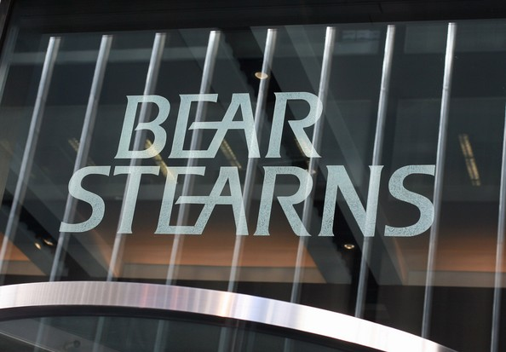
The First Wall Street Firm to fail was Bear Stearns. It collapses 16 March 2008. Bear Stearns signed a merger agreement with JP Morgan Chase and went out of existence.

Slide 6
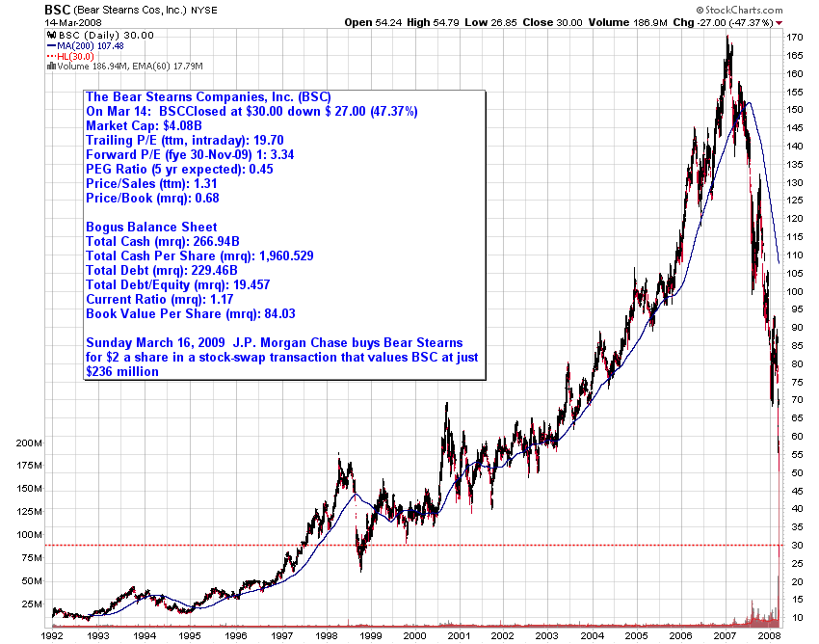

Slide 7
Bear Stearns signed a merger agreement with JP Morgan Chase in a stock swap worth $2 a share or less than 7 percent of Bear Stearns' market value just two days before. This sale price represented a staggering loss as its stock had traded at $172 a share as late as January 2007, and $93 a share as late as February 2008.

Slide 8
Fannie Mae and Freddie Mac seized by the government 8 September 2008.

Slide 9
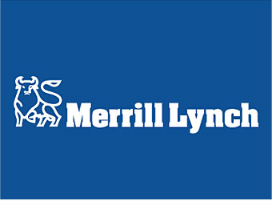
Merrill Lynch purchased by Bank of America
on 15 September 2008.

Slide 10
On September 14 and 15, two of the four largest investment banks failed. One, Lehman Brothers, declared bankruptcy. Lehman failed to find a buyer, and the government decided not to guarantee some of its underperforming assets in order to facilitate a sale. The other, Merrill Lynch, the country’s largest brokerage firm, was sold to Bank of America at a rock bottom price.

Slide 11
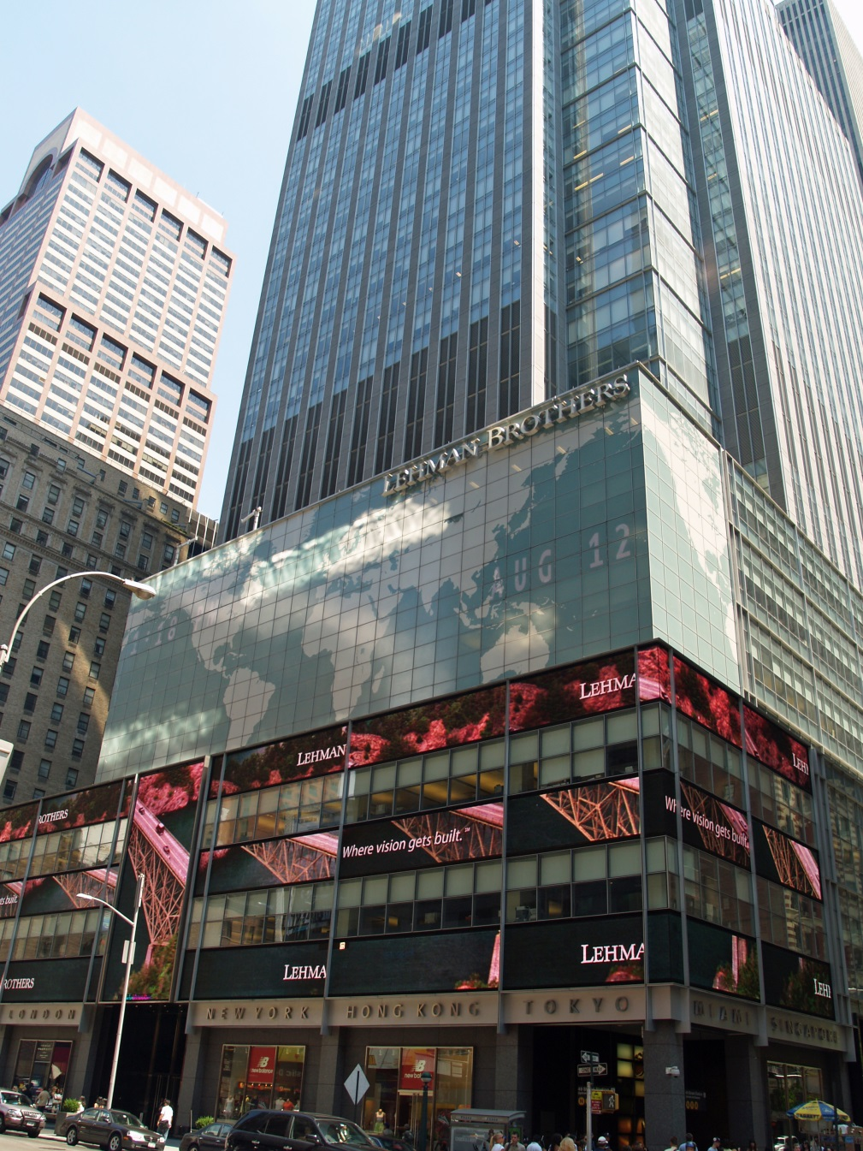
Lehman Brothers Declares Bankruptcy 15 September 2008. The Largest Bankruptcy in American History with $613,000,000,000.00 in Debt.

Slide 12
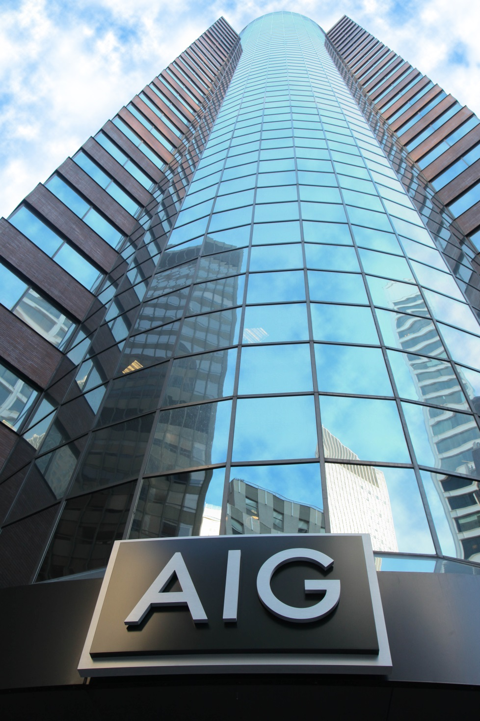
American International Group Begins to Fail in September, 2008. It is the World’s Largest Insurer.

Slide 13
AIG suffered from a liquidity crisis when its credit ratings were downgraded below "AA" levels in September 2008. The United States Federal Reserve Bank on 16 September 2008 created an $85 billion credit facility to enable the company to meet increased collateral obligations consequent to the credit rating downgrade, in exchange for the issuance of a stock warrant to the Federal Reserve Bank for 79.9% of the equity of AIG.

Slide 14
The Federal Reserve Bank and the United States Treasury by May 2009 had increased the potential financial support to AIG, with the support of an investment of as much as $70 billion, a $60 billion credit line and $52.5 billion to buy mortgage-based assets owned or guaranteed by AIG, increasing the total amount available to as much as $182.5 billion. AIG subsequently sold a number of its subsidiaries and other assets to pay down loans received.

Slide 15
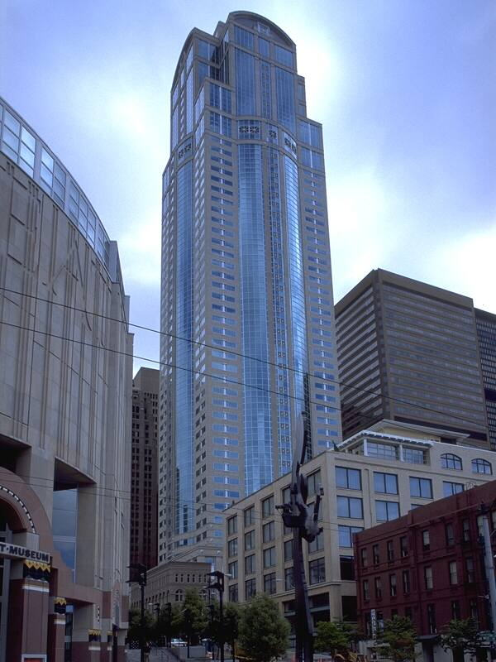
Washington Mutual seized by the United States Office of Thrift Supervision (OTS) on 25 September 2008. Later sold to JP Morgan Chase.

Slide 16
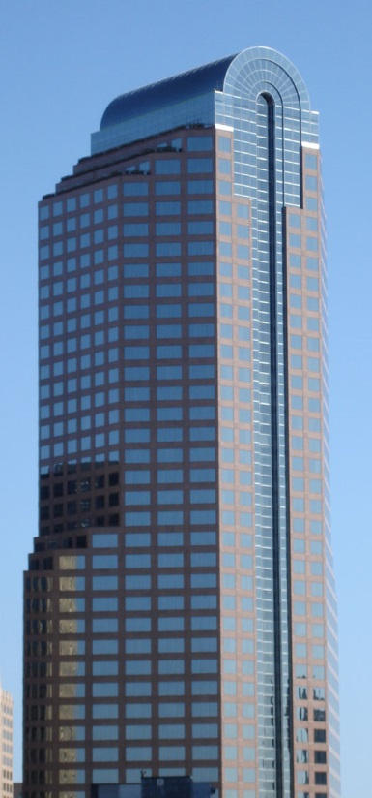
Wachovia purchased by Wells Fargo 31 December 2008.

