Slide 1
Citizen Affluence and Public Policy
Political Polarization and The Battle of the Budget

Slide 2
The Battle of the Budget

Slide 3
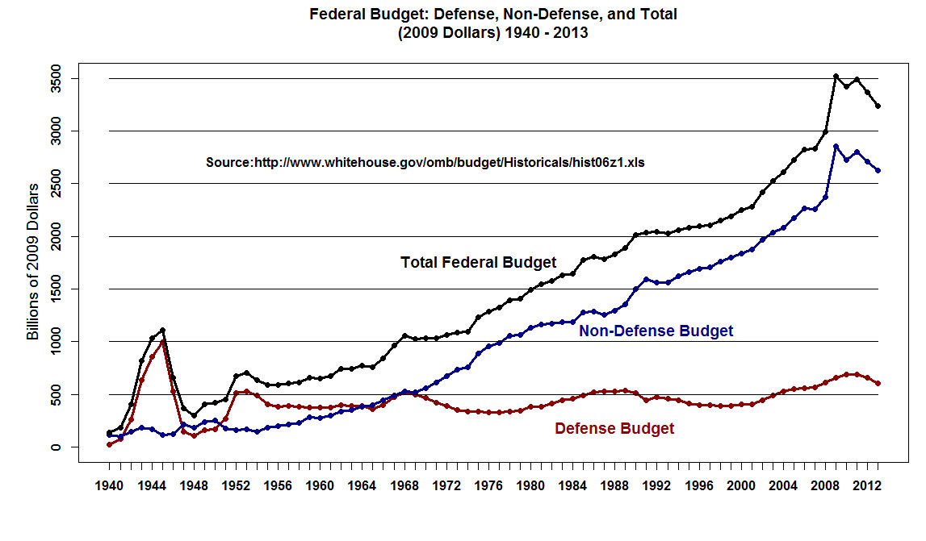

Slide 4
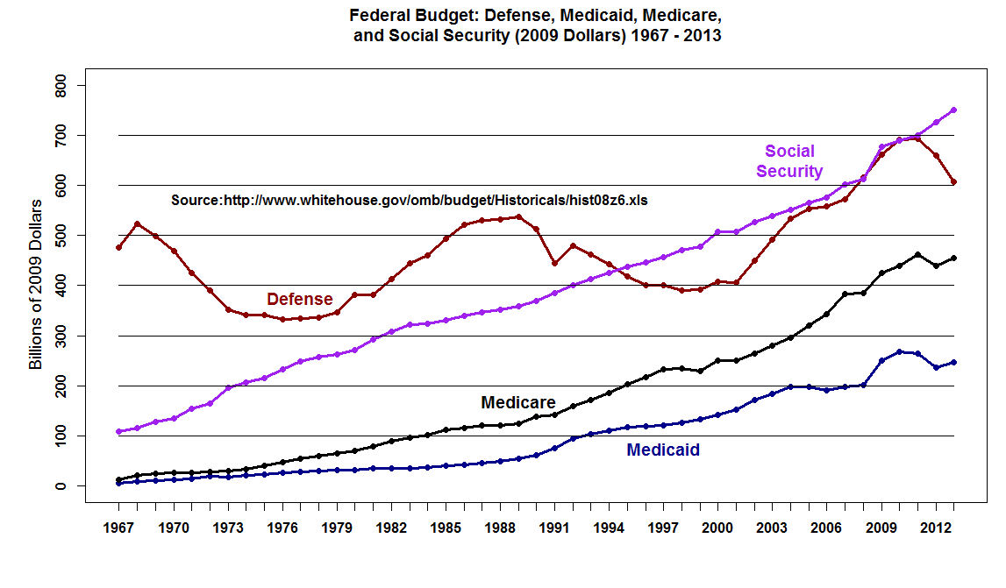

Slide 5
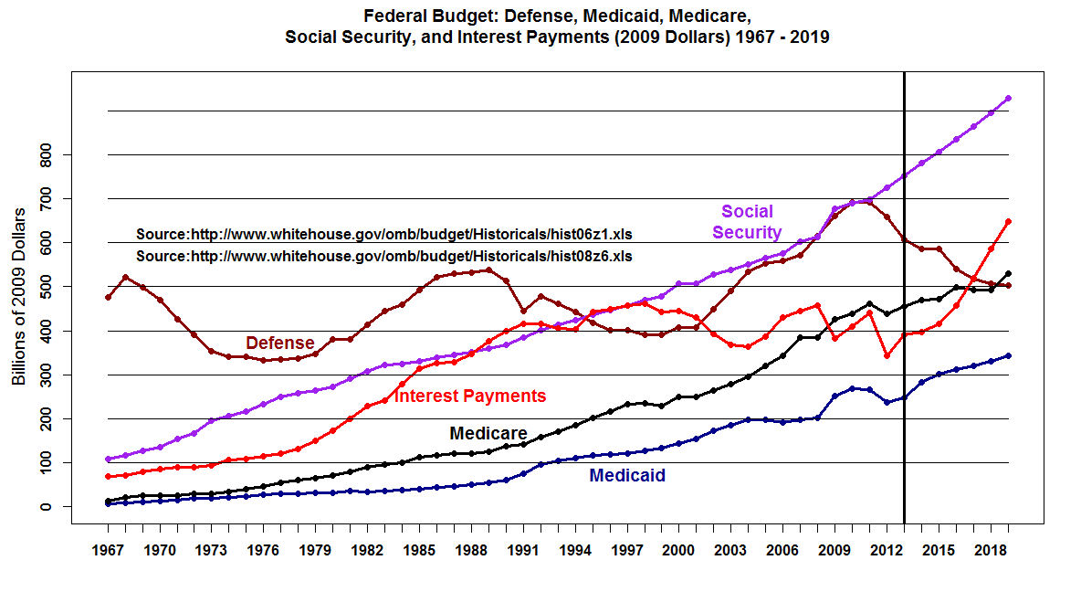

Slide 6
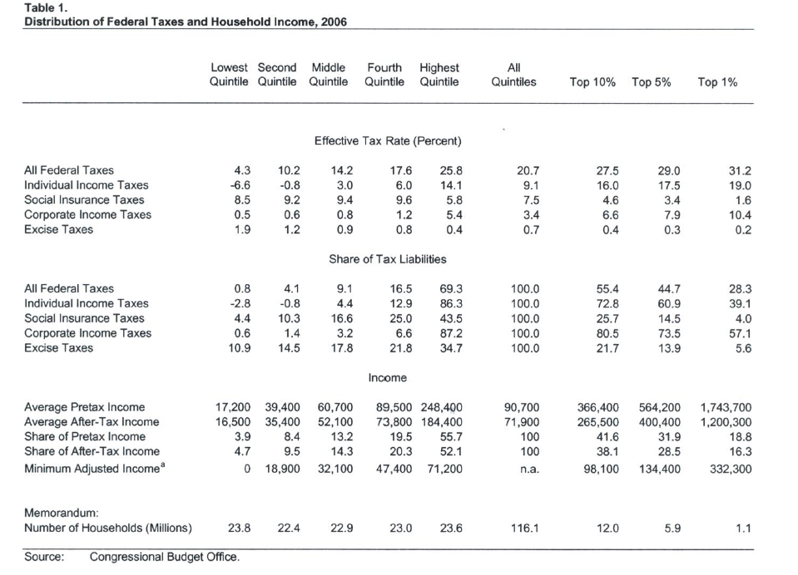

Slide 7
Vladimir Lenin: “What is to be Done?”

Slide 8
Reregulate Wall Street and break up the “Too Big to Fail Banks”
Soak the Rich! Income and Estate Taxes.
Universal Preschool

Slide 9
4. Impose Price Controls on Colleges and Universities
5. Revive the Labor Movement – Repeal Taft-Hartley and Raise the Minimum Wage
6. Single Payer Healthcare
7. Elect Democratic Presidents!

