Slide 1
The Public Policy Consequences of Political Polarization
What We Know So Far

Slide 2
ELITE POLARIZATION

Slide 3
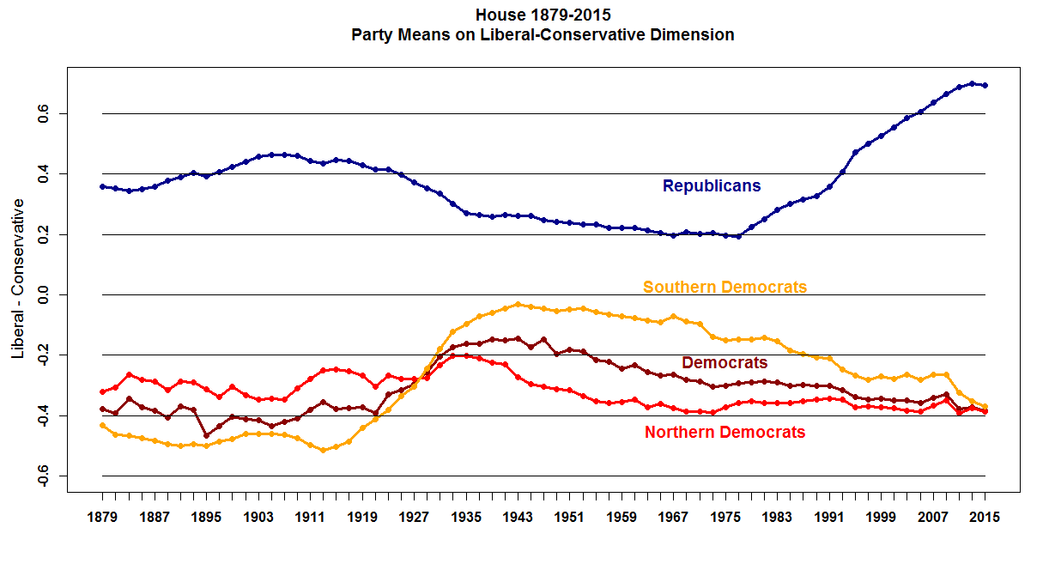

Slide 4
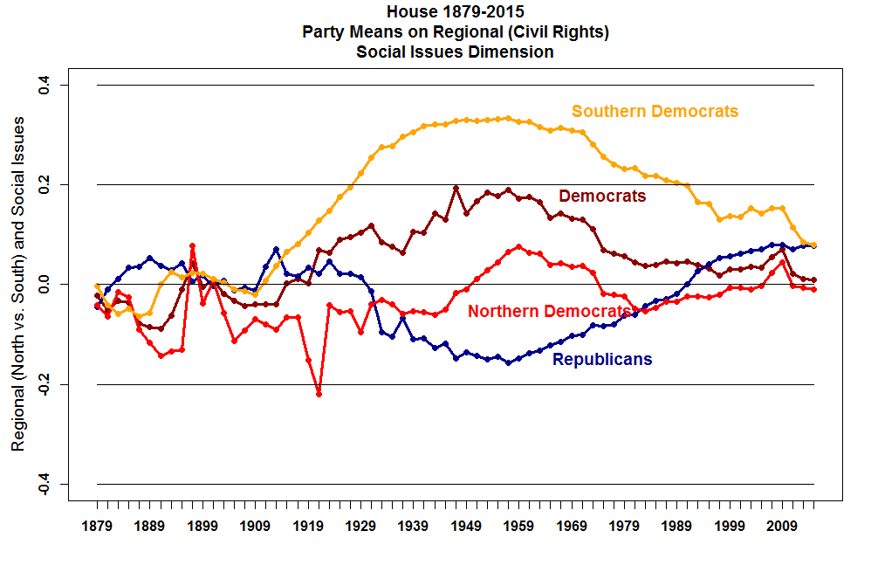

Slide 5
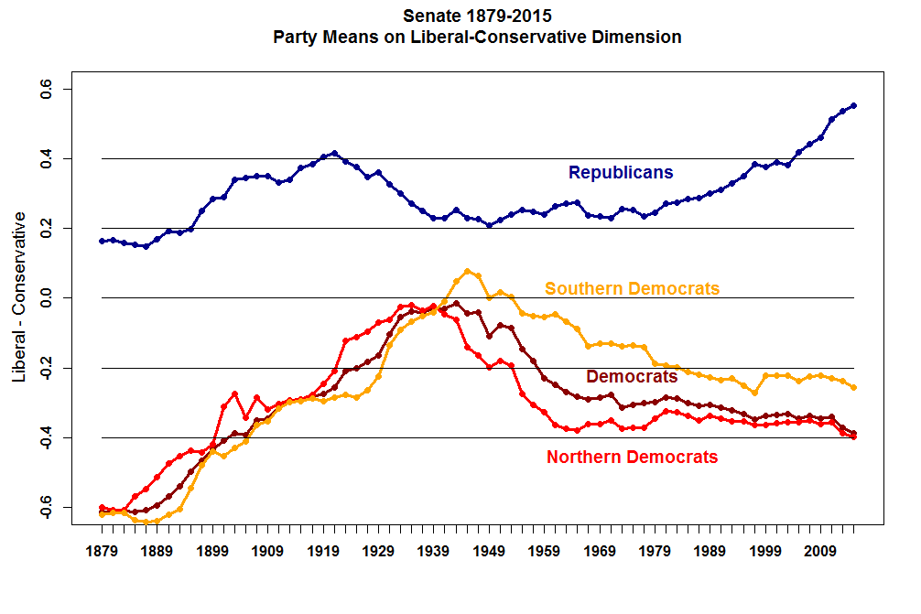

Slide 6
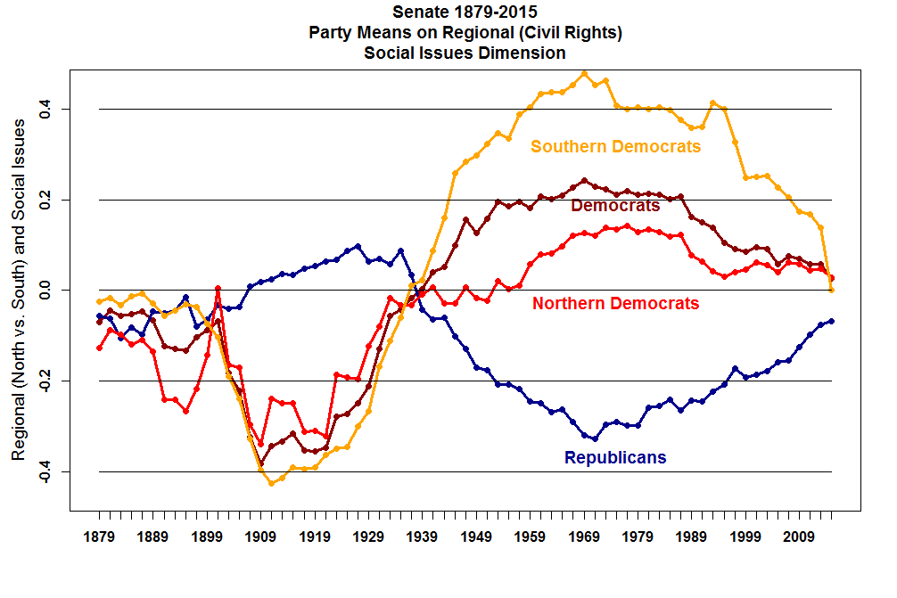

Slide 7
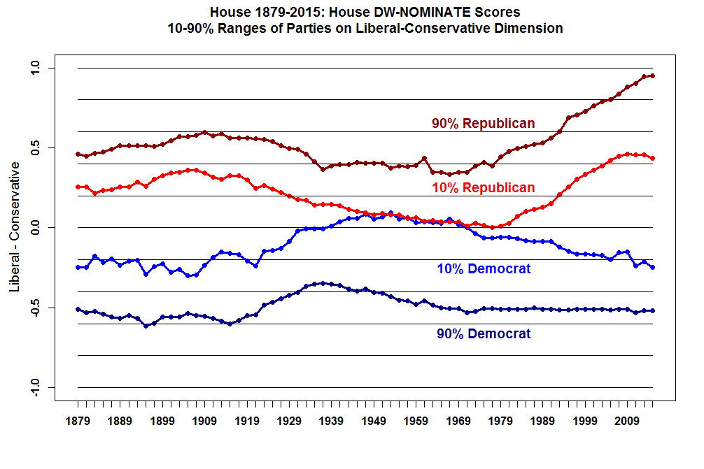

Slide 8
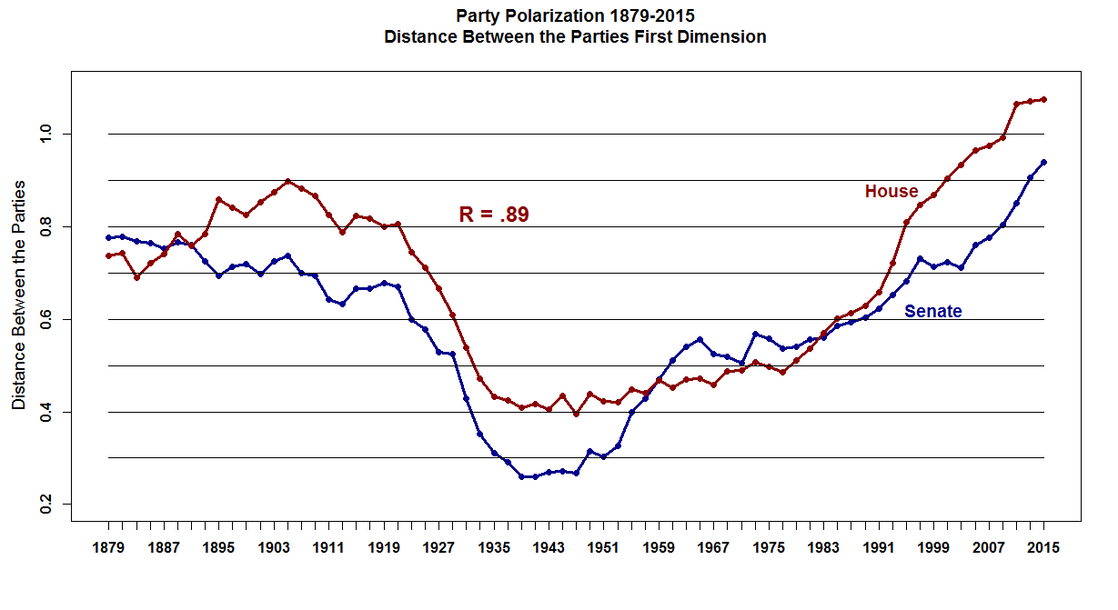

Slide 9
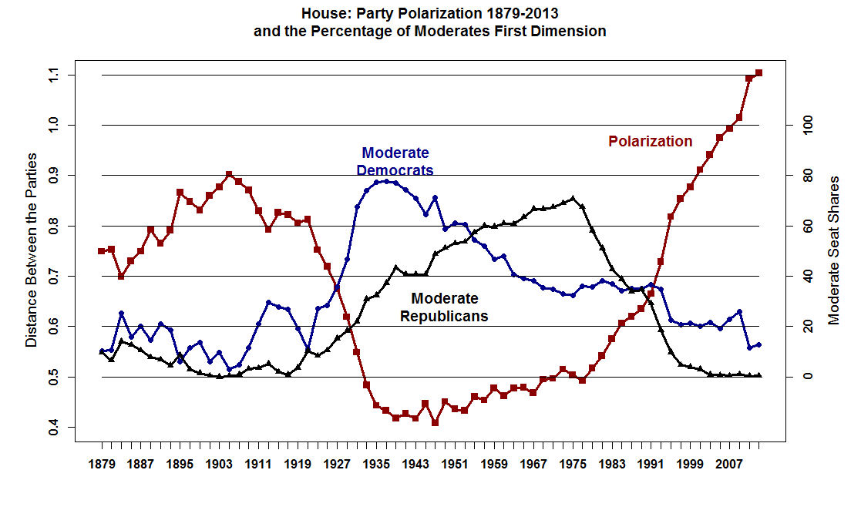

Slide 10
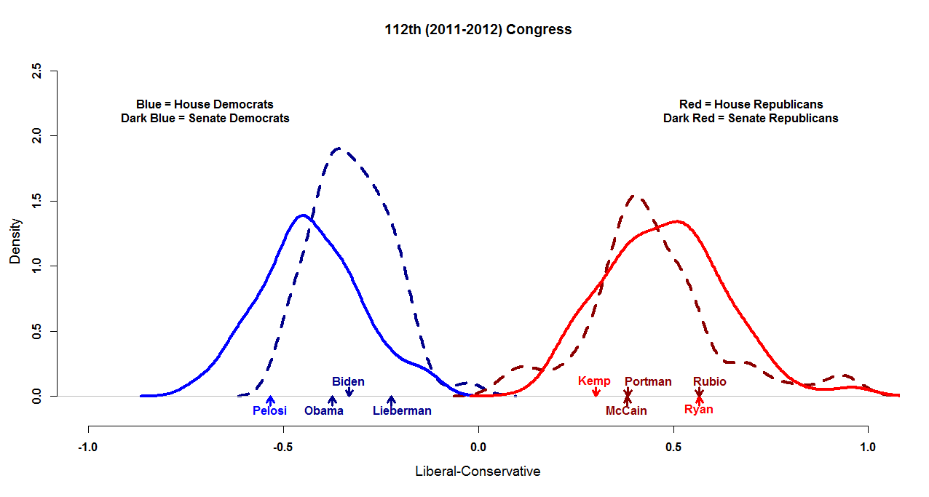

Slide 11
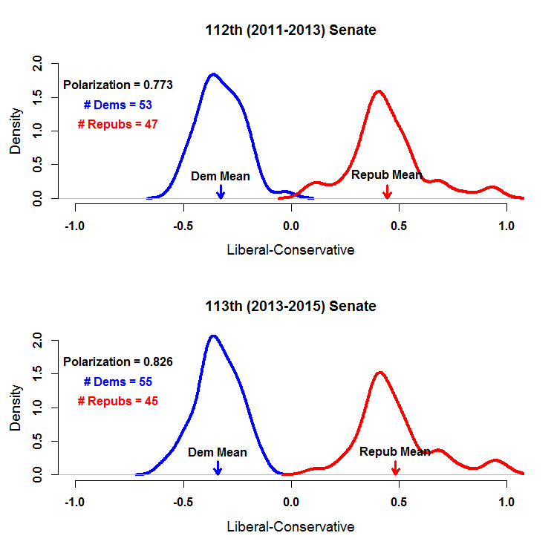

Slide 12
MASS POLARIZATION

Slide 14
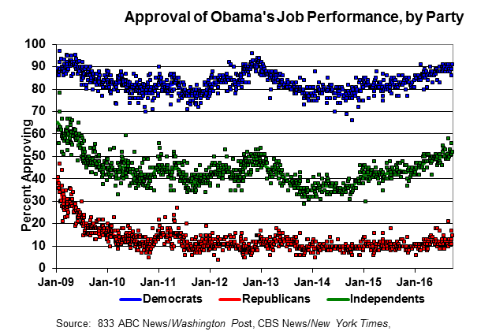
Gary Jacobson

Slide 15
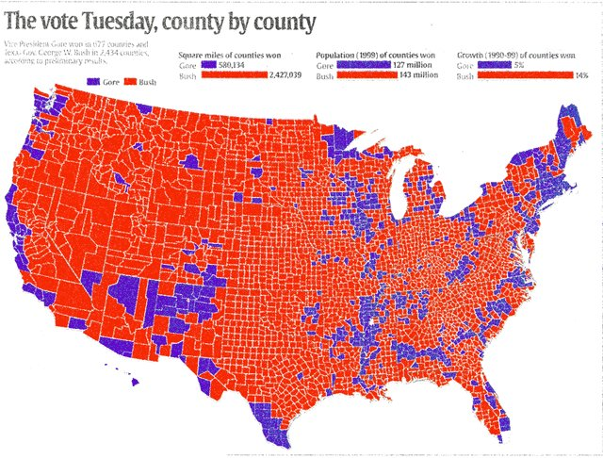
2000 Presidential Election Red for Bush, Blue for Gore

Slide 16
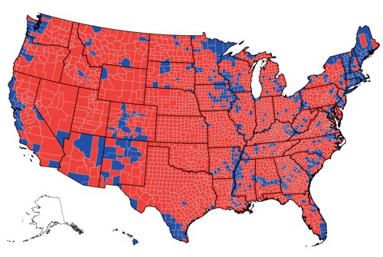
2004 Presidential Election Red for Bush, Blue for Kerry

Slide 17
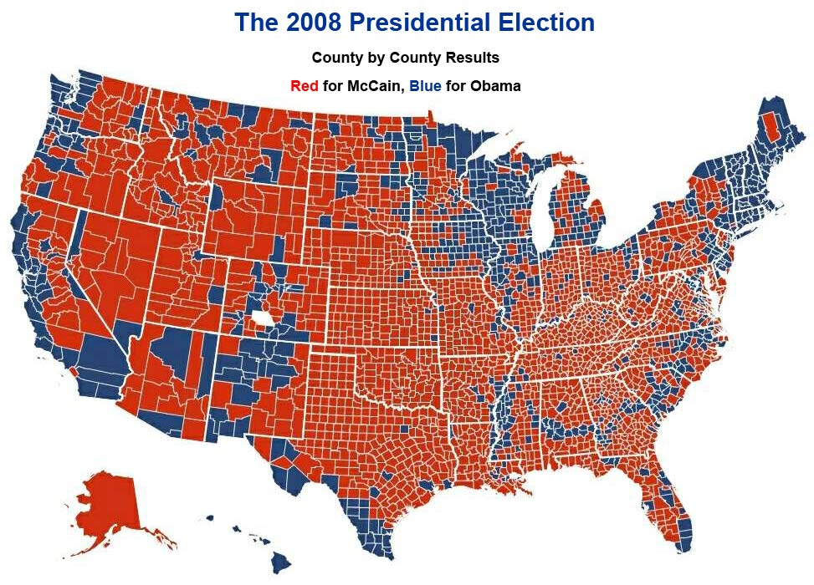

Slide 18
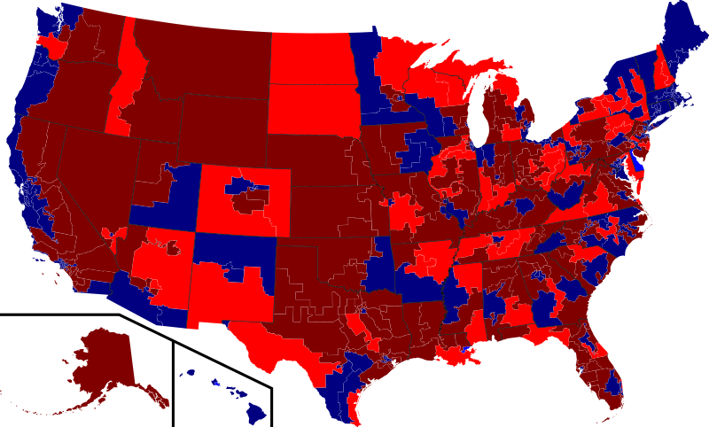
2010 HOUSE ELECTIONS BY CONGRESSIONAL DISTRICT

Slide 19
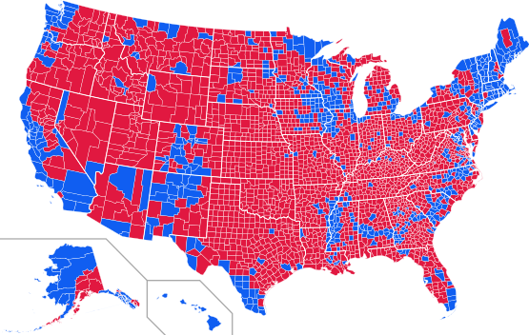
2012 Presidential Election
Blue for Obama, Red for Romney

Slide 20
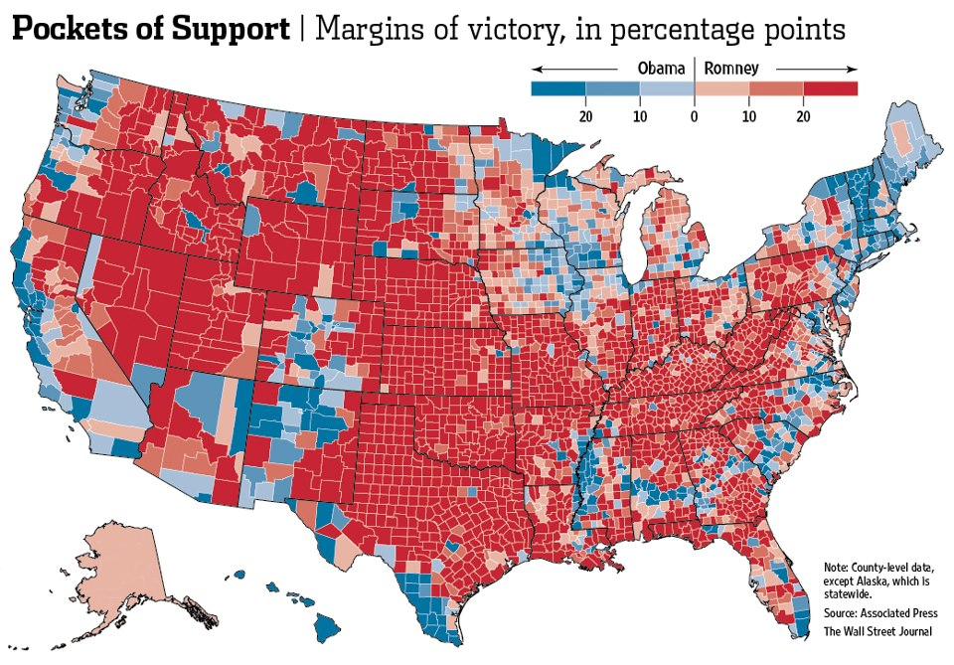

Slide 21
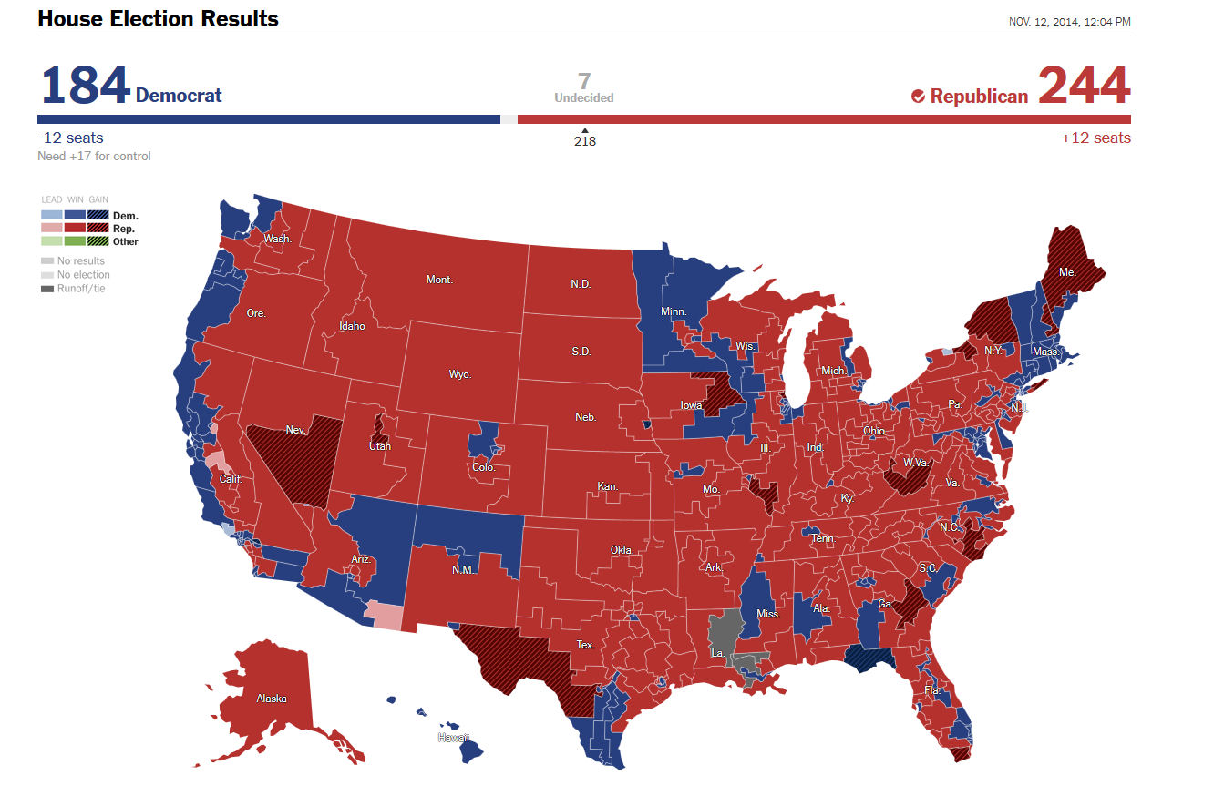

Slide 22
ELITE POLARIZATION And Inequality

Slide 23
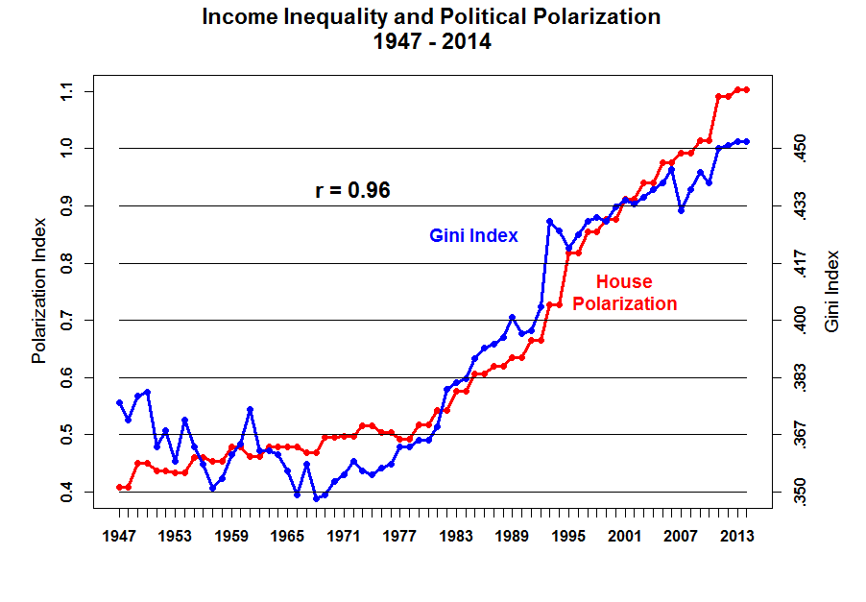

Slide 24
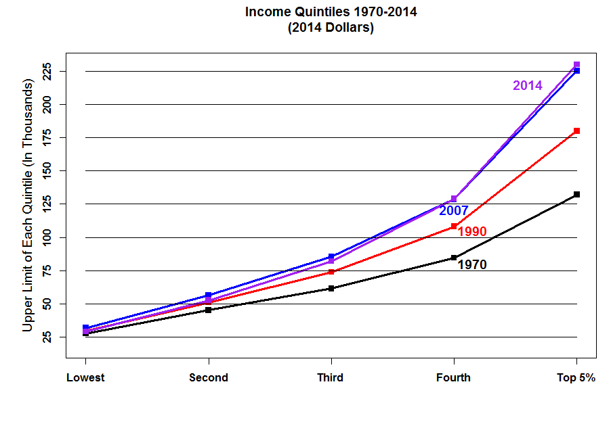

Slide 25
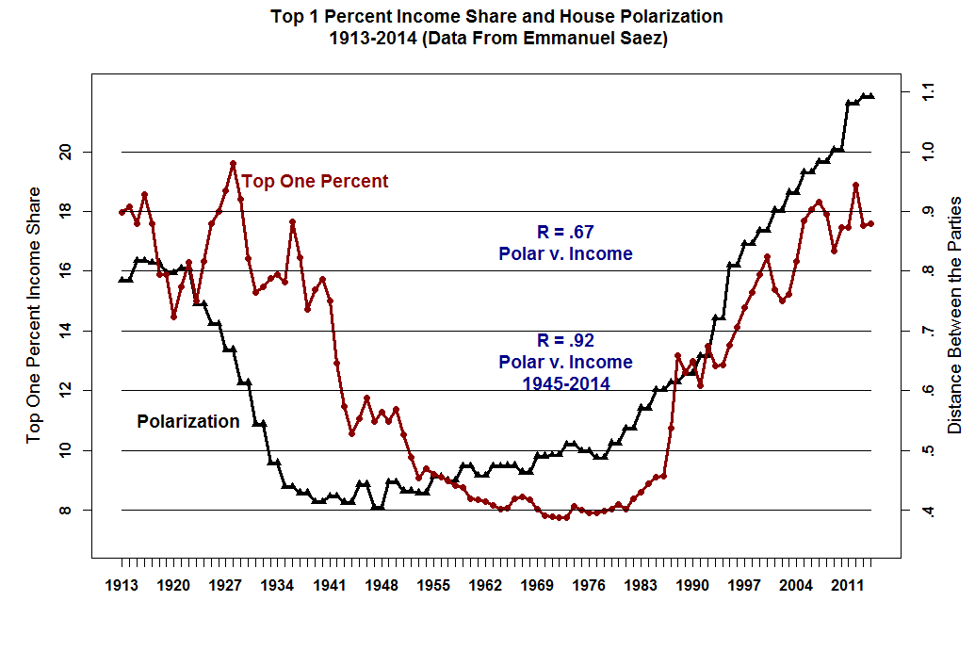

Slide 26
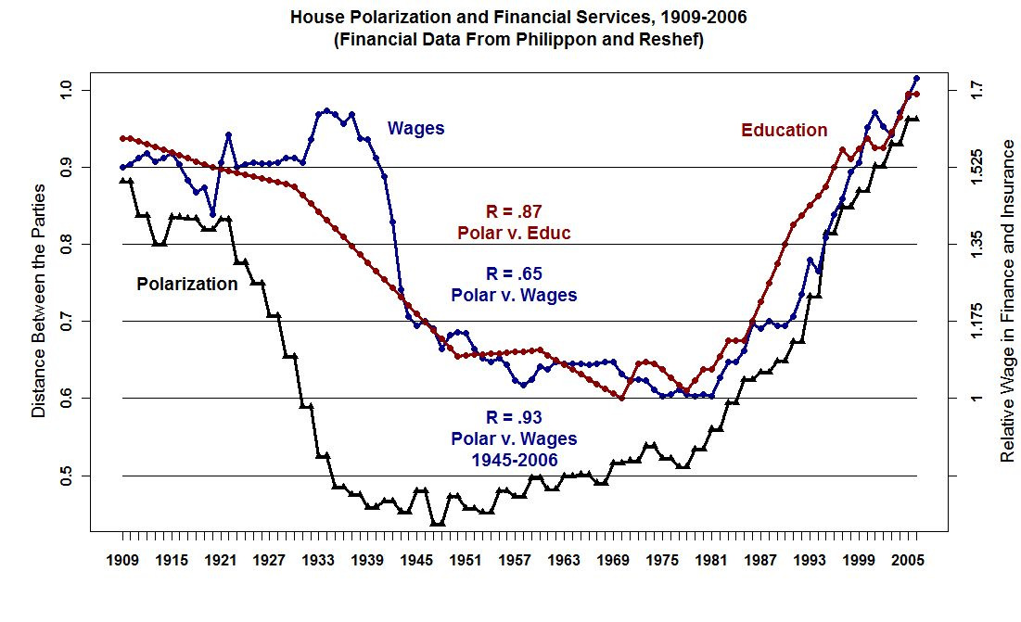

Slide 27
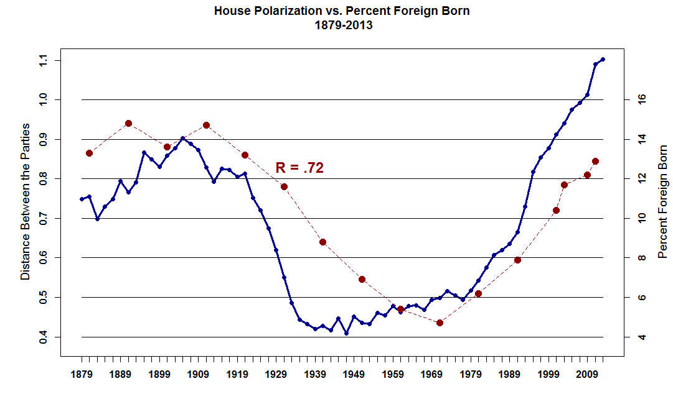

Slide 28
What we know so far 1. Elite Polarization has been increasing. a. Movement away from the Center b. Rigid Personalities c. Increase in non-rationality (reality distortion)

Slide 29
2. Mass Public a. Partisans have polarized b. Sorting has increased
Information tends to be correlated with strength of Partisanship
Extreme partisans can become delusional
Information is very low
Unclear whether Independents have coherent beliefs

Slide 30
Inequality
1. Declined From 1913 into the 1970s
a. Higher Income and Estate Taxes
b. The Depression followed by WWII
c. Tight Regulation of Banking and Finance
d. The “Stickiness of American Political Institutions

Slide 31
Increased from late 1970s until now. Likely causes:
a. Lower Income and Estate Taxes;
b. Deregulation of Banking & Finance;
c. Increasing Returns to Education (globalization, high technology);
d. Increasing Immigration that is primarily Low skilled;
e. Decline of Industrial Unions.

