Slide 1
The Second Political Party System: 1856 - 1896
The Economy After the Civil War
Part 2: The Rise of Monopolies and Trusts

Slide 2
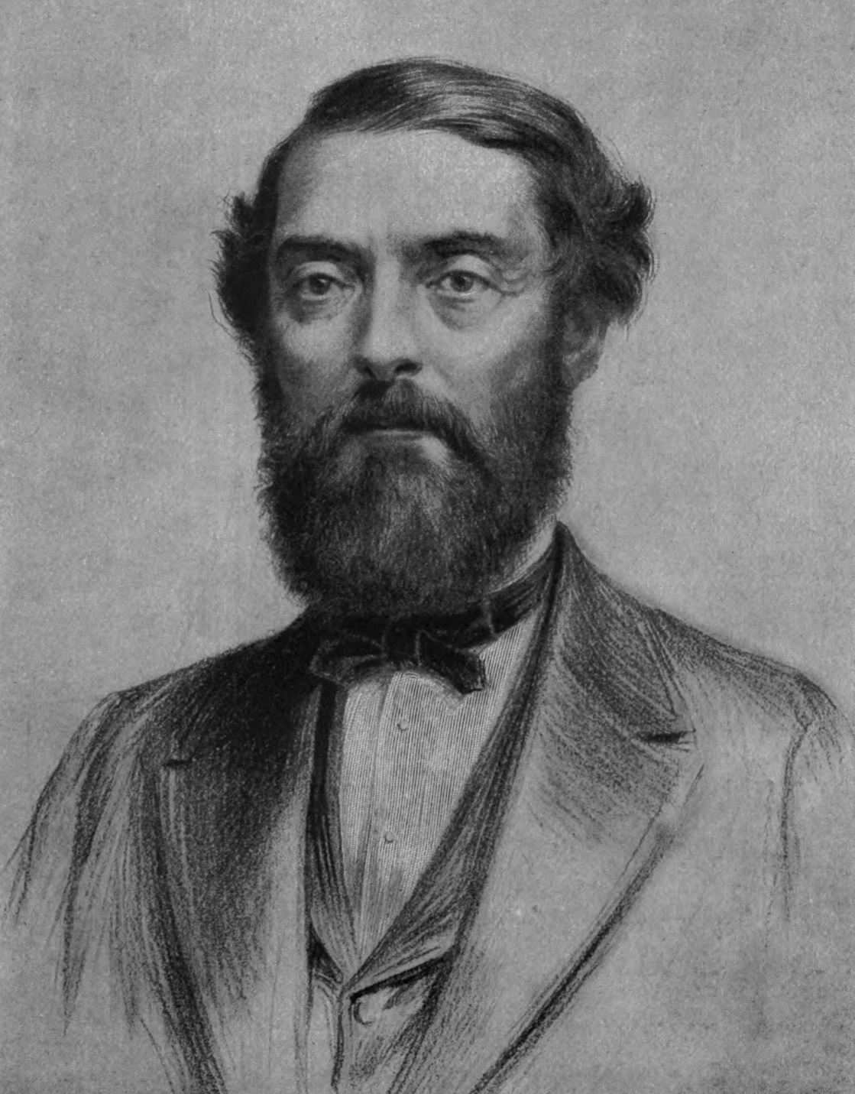
“Colonel” Edwin Drake
29 March 1819 – 9 November 1880

Slide 3
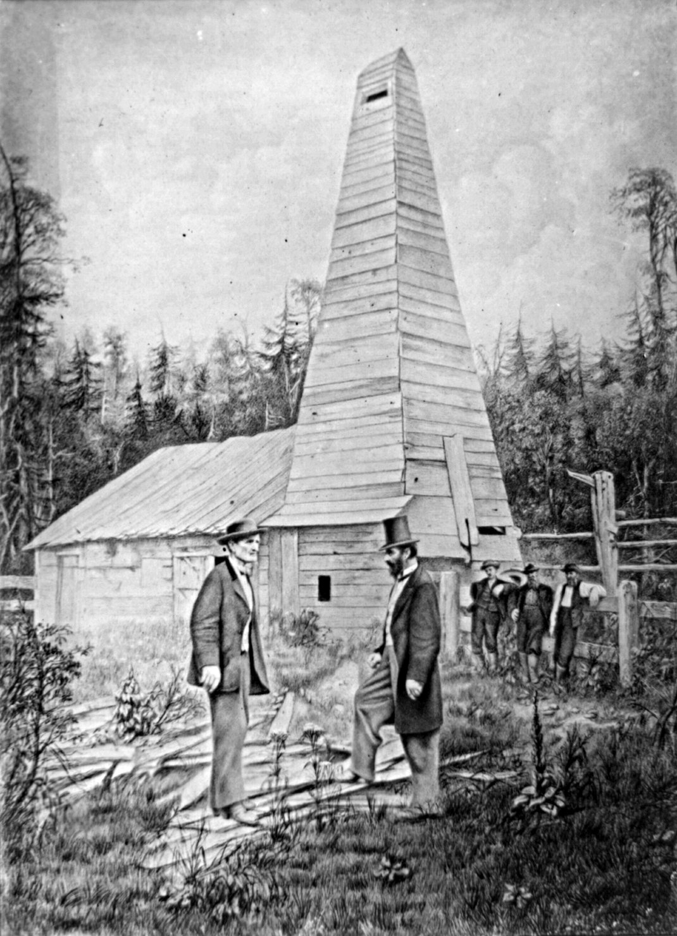
The First Oil Well, Titusville, PA, Oil Struck 27 August 1859

Slide 4
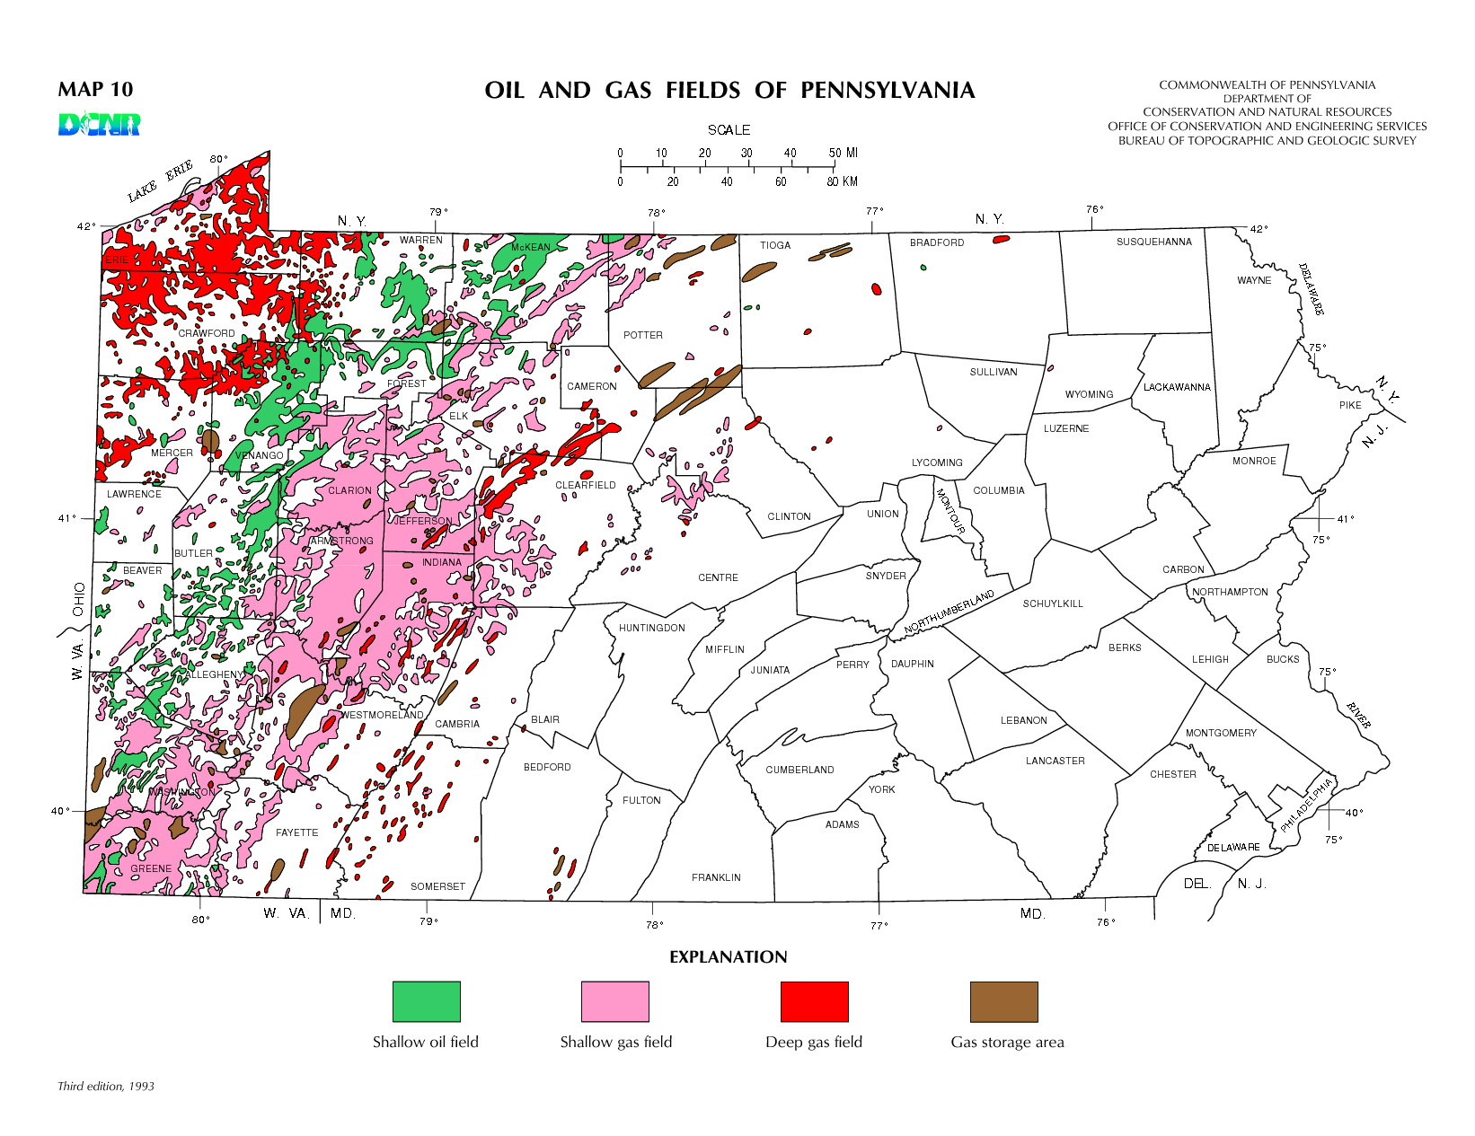

Slide 5
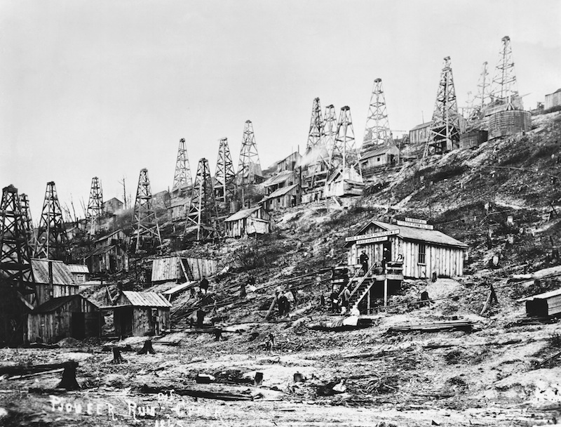
The “Oil Rush” in the Pennsylvania Oil Regions

Slide 6
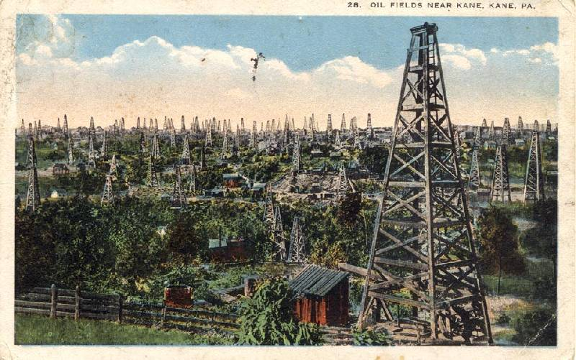

Slide 7
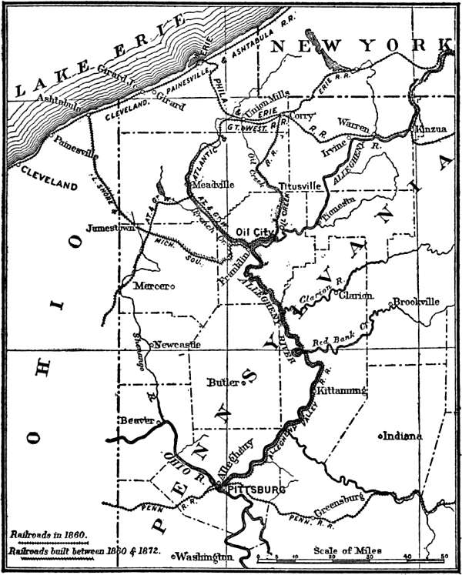

Slide 8
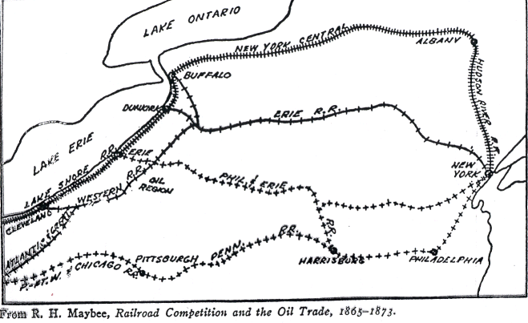

Slide 9
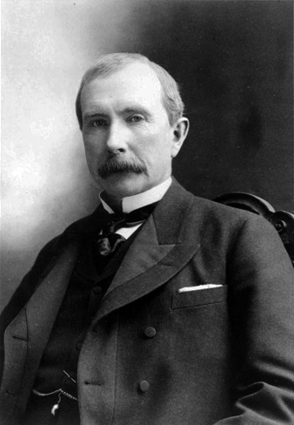
John D. Rockefeller
8 July 1839 – 23 May 1937

Slide 10
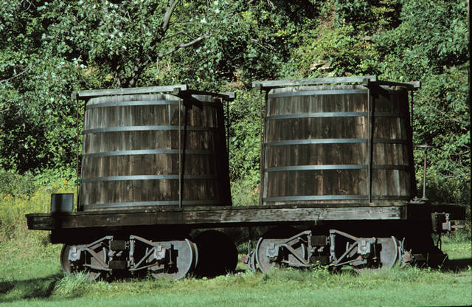
An Early Tanker Car to Transport Crude Oil

Slide 11
The South Improvement Scheme of 1871
Tom Scott of the Pennsylvania Railroad came up with the idea. The scheme was inspired by the Anthracite Railroad combination of 1868-71 in which five railroads and two coal companies bought up all the coal pits along the five railroads in order to control output and prices.

Slide 12
The South Improvement Company had been created by the Pennsylvania Legislature in 1870 and its charter allowed the Company to hold the stocks of other companies outside the state. This was an unusual power at the time and made it ideal for Scott’s scheme. Scott arranged for the purchase of the charter by a group of Philadelphia and Pittsburgh refiners with Scott in the background.

Slide 13
The Scheme was essentially a plan to unite the oil-carrying railroads in a pool; to unite the refiners in an association, the South Improvement Company; and to tie the two elements together by agreements which would stop "destructive" price-cutting and restore railroad freight charges to a profitable level.
John D. Rockefeller and his partner Henry Flagler were active participants in the scheme as they dominated oil refining in Cleveland, Ohio by 1871.

Slide 14
To enforce the cooperation of refiners, a set of rebates was agreed to for participating refiners. This alone would have undoubtedly forced all the refiners into the combine, but the scheme did not stop there. In what turned out to be a public relations disaster, the participants decided to add a drawback on every barrel shipped by a non-participant equal to the ordinary rebate! In effect, this would be a tax on non-participants the proceeds of which would be transferred to the participating oil refiners!

Slide 15
What the planners forgot, however, was to include the producers in the scheme as well. Despite efforts to reassure the drillers in the Oil Regions that the Scheme would benefit them as well by keeping prices up, the Oil Regions Men revolted and organized an effective boycott of all the refiners and railroads they suspected of being part of the Scheme. Consequently, the Scheme collapsed in 1872 before it was ever implemented!

Slide 16
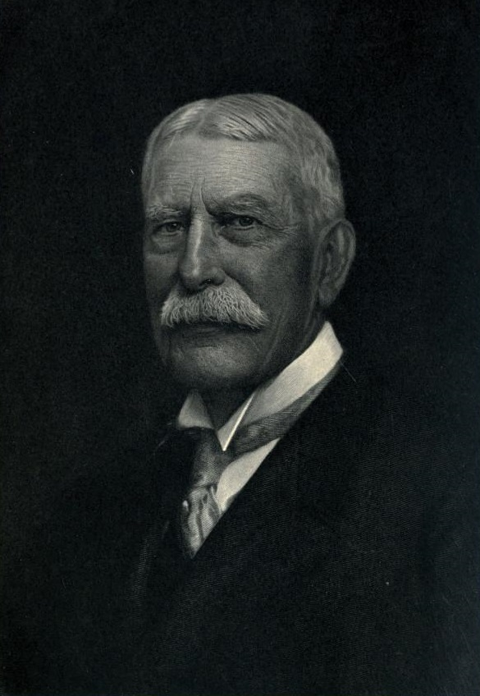
Henry Flagler
2 January 1830 – 20 May 1913

Slide 17
John D. Rockefeller, Henry Flagler, and the Standard Oil Company. By 1880 they controlled 80% of the industry. Rockefeller was the planner and Flagler negotiated the rebates from the Railroads and many of the consolidations.

Slide 18
The Standard Oil Trust: 1882-1892
On 2 January 1882 the Standard Oil Trust was formed. Attorney Samuel Dodd came up with the idea of a Trust. A Board of Trustees was set up and all the Standard properties were placed in its hands. Every stockholder received 20 Trust certificates for each share of Standard Oil stock and all the profits of the component companies were sent to the nine trustees who determined the dividends. The nine Trustees elected the directors and officers of all the component companies.

Slide 19
The Trust was capitalized quite conservatively at $70,000,000 – the true value was about $200,000,000 (no stock watering at the Standard!). The nine Trustees controlled 23,314 of the 35,000 shares with J.D. Rockefeller holding 9585 shares.

Slide 20
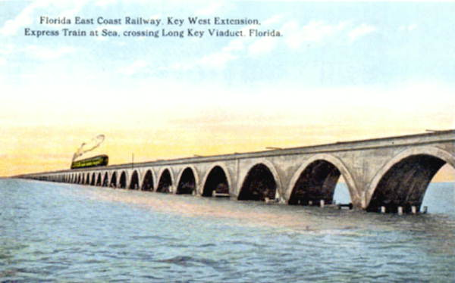
Flagler retires from Standard Oil in the late 1880s and Rockefeller retires in 1897 (but it is not announced). Rockefeller turns his attentions to investments and then philanthropy while Flagler built the Florida East Coast Railway down the coast of Florida all the way to Key West. He builds hotels along the coast including Palm Beach and Miami.

Slide 21
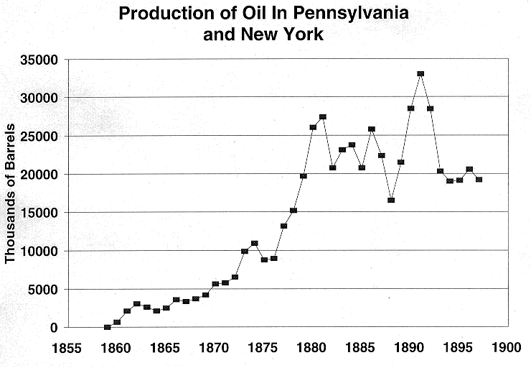

Slide 22
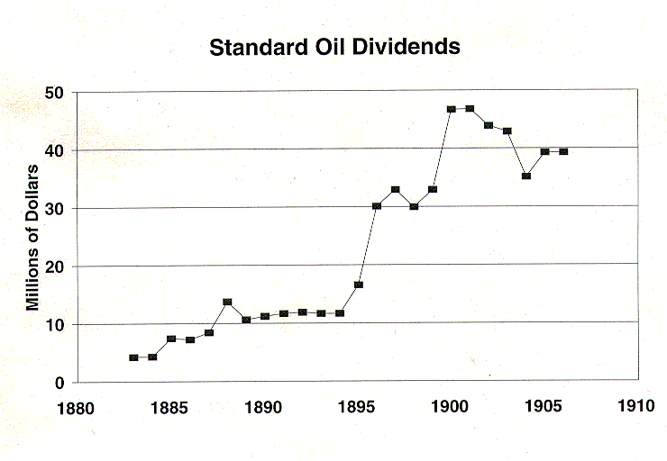

Slide 23
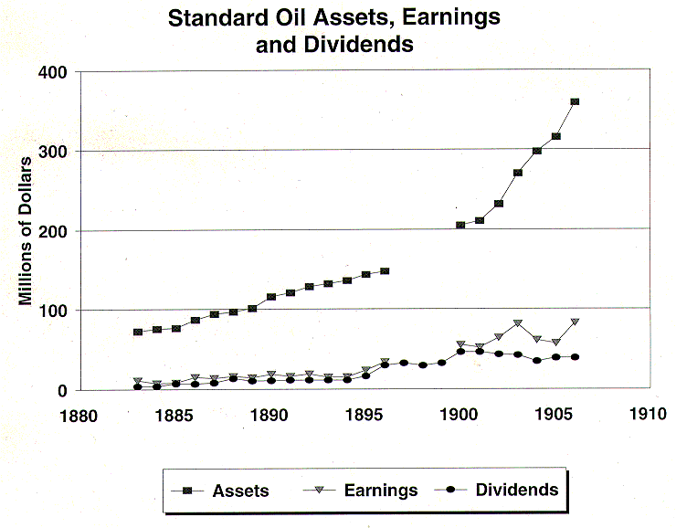

Slide 24
Pools, Trusts, and Holding Companies seemed to many business leaders to be the solution to the "curse" of cutthroat competition in the late 19th Century. The aim was to control price competition through cooperation and coordination of rival businesses. All these mechanisms were, in effect, forms of monopolization. In the case of Standard Oil John D. Rockefeller and Henry Flagler "solved" the problem by merging with their rivals and bringing their more capable managers into their organization.

Slide 25
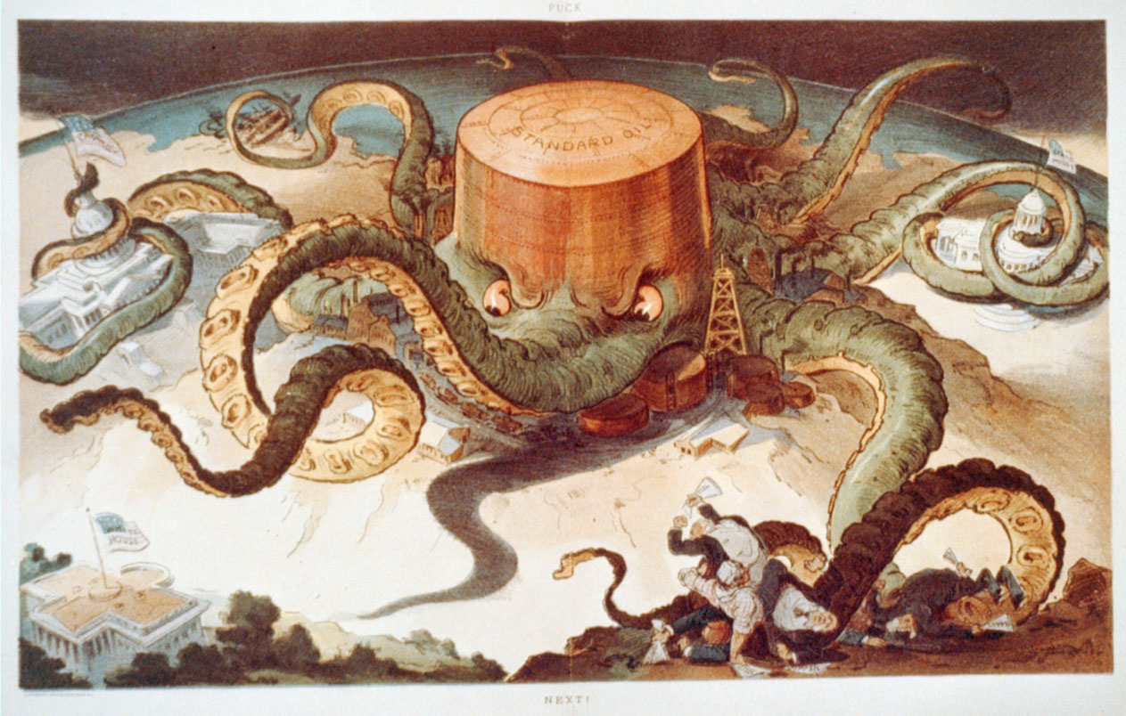

Slide 26
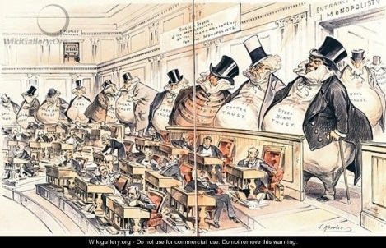

Slide 27
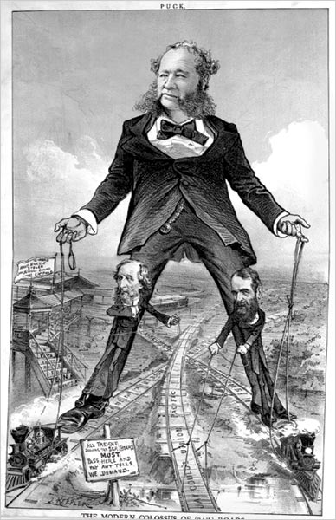

Slide 28
Congressional Action
By 1888 public discontent was so strong that both political parties put anti-trust planks into their Presidential platforms. Legislative action was a foregone conclusion. The Sherman Anti-Trust Act was passed by a
51 - 1 vote in the Senate on 8 April 1890 and by a unanimous vote of 242 - 0 by the House of Representatives on 20 June 1890. The bill was signed into law by President Benjamin Harrison on 2 July 1890.

Slide 29
SECTION 1 Every contract, combination in the form of trust or otherwise, or conspiracy, in restraint of trade or commerce among the several States, or with foreign nations, is declared to be illegal. Every person who shall make any contract or engage in any combination or conspiracy hereby declared to be illegal shall be deemed guilty of a felony, and, on conviction thereof, shall be punished by fine not exceeding ten million dollars if a corporation, or, if any other person, three hundred and fifty thousand dollars, or by imprisonment not exceeding three years, or by both said punishments, in the discretion of the court.

Slide 30
SECTION 2 Every person who shall monopolize, or attempt to monopolize, or combine or conspire with any other person or persons, to monopolize any part of the trade or commerce among the several States, or with foreign nations, shall be deemed guilty of a felony, and, on conviction thereof, shall be punished by fine not exceeding ten million dollars if a corporation, or, if any other person, three hundred and fifty thousand dollars or by imprisonment not exceeding three years, or by both said punishments, in the discretion of the court.

Slide 31
The Sherman Anti-Trust Act was a popular piece of legislation but it was poorly drafted and very vague. The act did not define "restraint of trade", "combination", or "monopolize". These terms may appear to be obvious to the layman but were not so to the Courts who were charged with enforcing the Act. As a result, the Courts have been free to interpret the Act. This problem was well stated by Chief Justice Stone in 1940:

Slide 32
“The prohibitions of the Sherman Act were not stated in terms of precision or of crystal clarity and the Act itself does not define them. In consequence of the vagueness of its language, perhaps not uncalculated, the courts have been left to give content to the statute, and in the performance of that function it is appropriate that courts should interpret its words in the light of its legislative history and of the particular evils at which the legislation was aimed.”

Slide 33
The problem with Justice Stone's argument is that the legislative history of the Sherman Act is not simple nor clear. There is no question that nearly everyone wanted to outlaw monopolies and create competition. However, there was serious disagreement about what part of the Constitution -- the Commerce Clause, the Judicial Clause, or the taxing power -- was the legal basis for outlawing illegal restraints of trade.

Slide 34
In addition, in the Senate, there were two completely different bills at one point. The result has been that Anti-Trust law changes according to the prevailing mood of legal opinion. Because legal opinion is in part a function of the politics of the day, Anti-Trust law has always been one of the most politicized portions of the legal code. What was illegal in the early 20th Century may not be illegal today. Other than a general agreement by everyone that monopoly is generally not a good idea, Anti-Trust law shifts constantly in time.

